Slide 1
SN2017egm
Full analysis outputs comparison

Slide 2
Bin 1

Slide 3
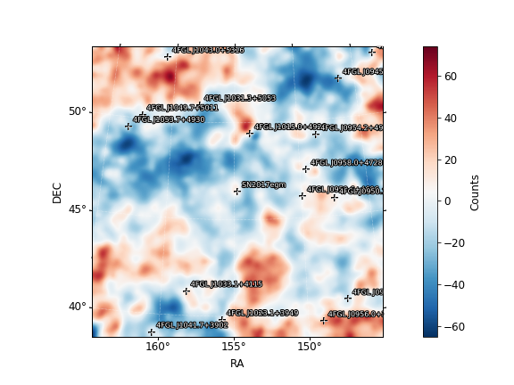
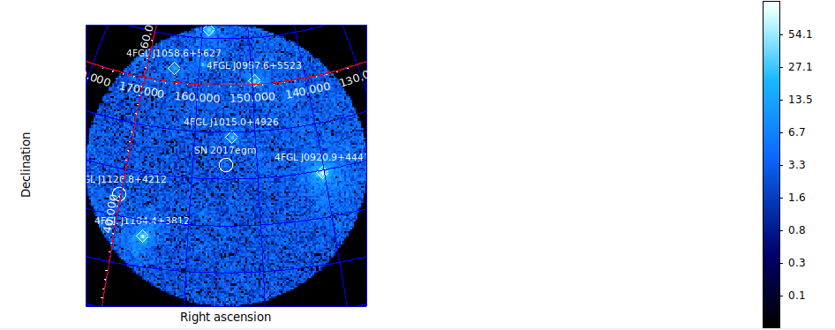
Fit results Bin 1
SN2017egm (6.75)
Prefactor 0.304 +/- 0.145
Index 2.27 +/- 0.383
galdiff
Prefactor 0.119 +/- 0.0118
Index 1 +/- 0.00152
isodiff
Normalization 1.4 +/- 0.037
SN2017egm (9.64)
Prefactor 0.0391 +/-0.017
Index -2
galdiff
Prefactor 1.219 +/-0.221
Index 0
isodiff
Normalization 0.65 +/- 0.181

Slide 4
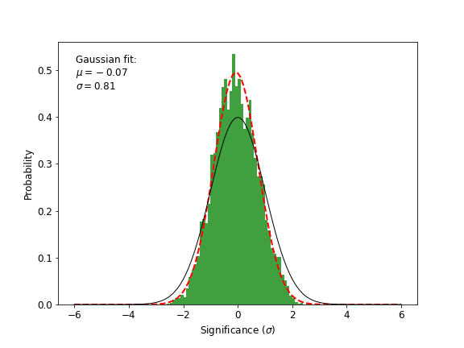
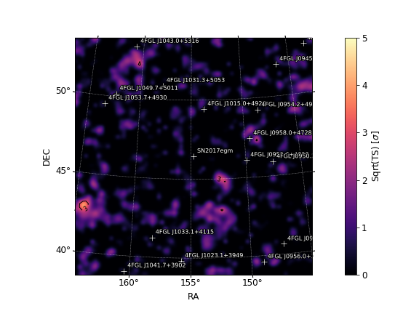
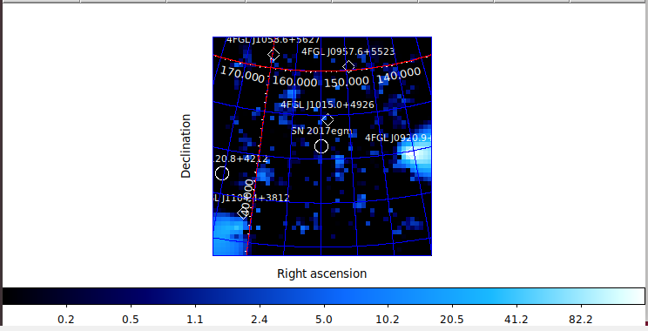
Bin 1

Slide 5
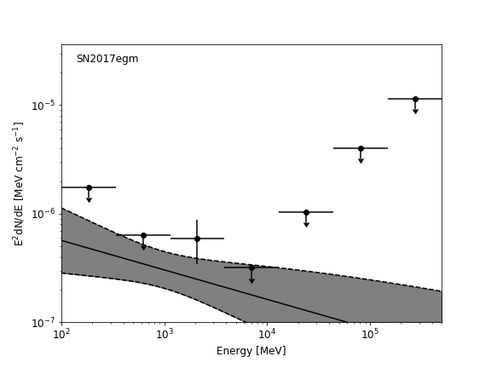
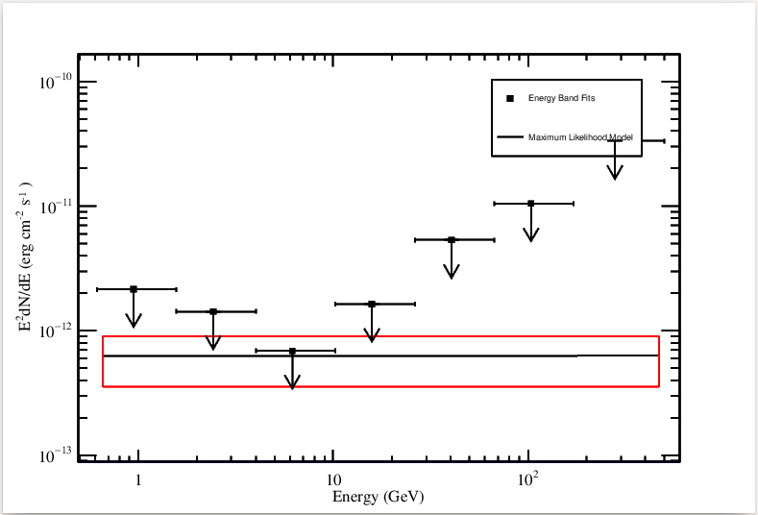
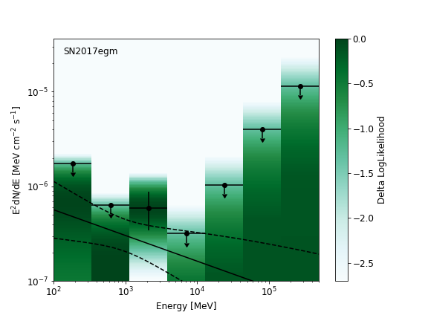
Bin 1

Slide 6
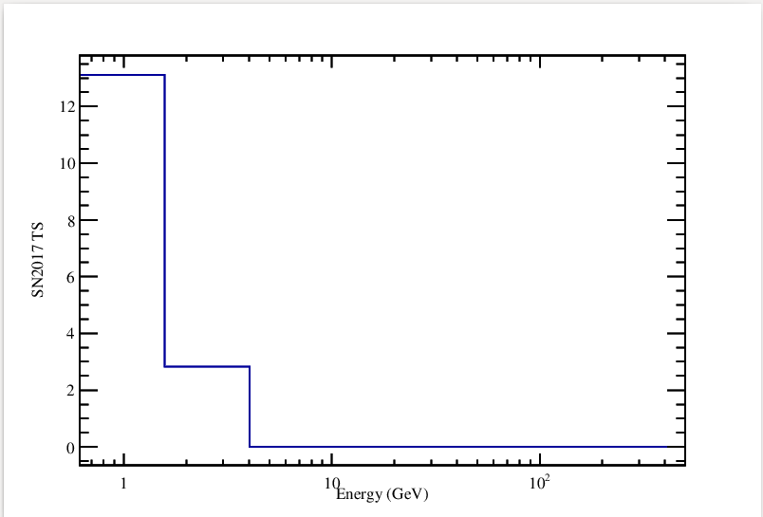
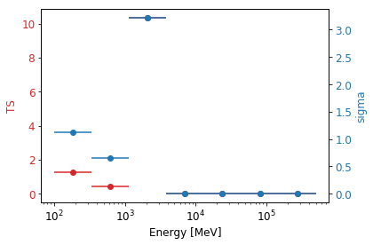
TS per energy – Bin 1

Slide 7
Bin 2

Slide 8
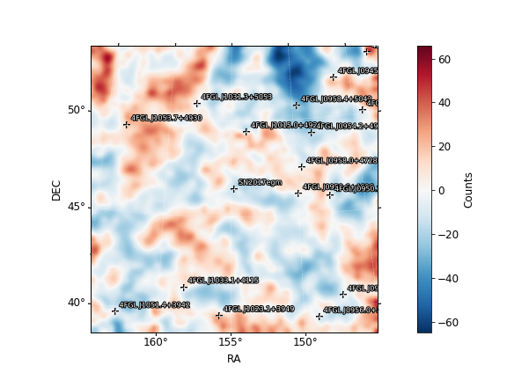
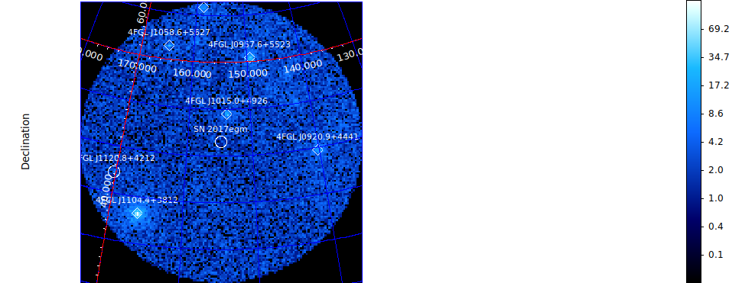
Fit results Bin 2
SN2017egm (8.54)
Prefactor 0.034 +/-0.0187
Index -2
galdiff
Prefactor 1.075 +/-0.25
Index 0
isodiff
Normalization 0.704 +/- 0.206
SN2017egm (8.36)
Prefactor 0.202 +/-0.145
Index 1.61 +/- 0.331
galdiff
Prefactor 0.109 +/- 0.0153
Index 1 +/- 0.00453
isodiff
Normalization 1.38 +/- 0.043

Slide 9
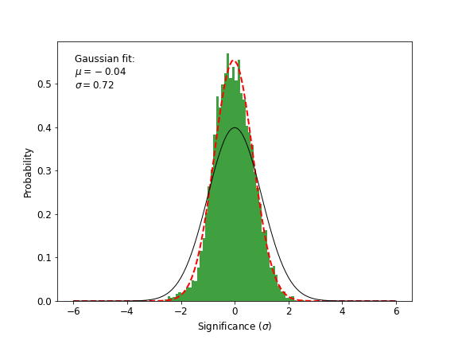
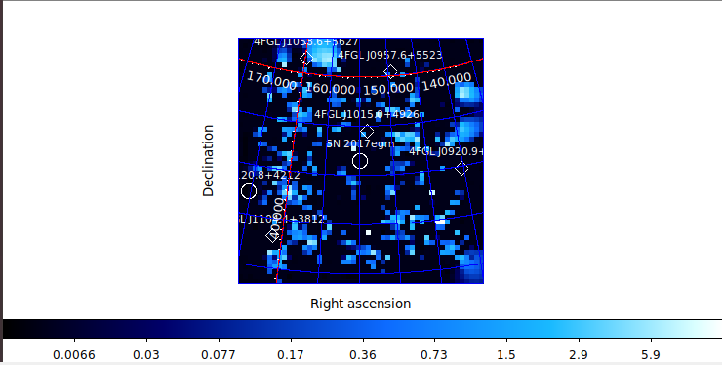
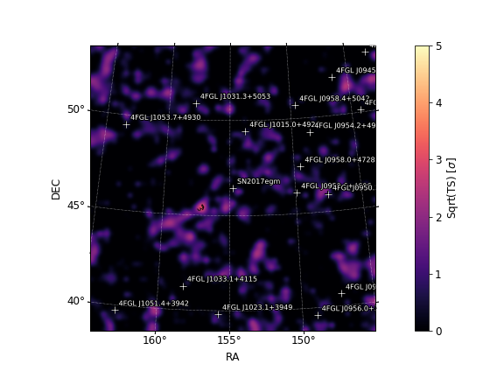
Bin 2

Slide 10
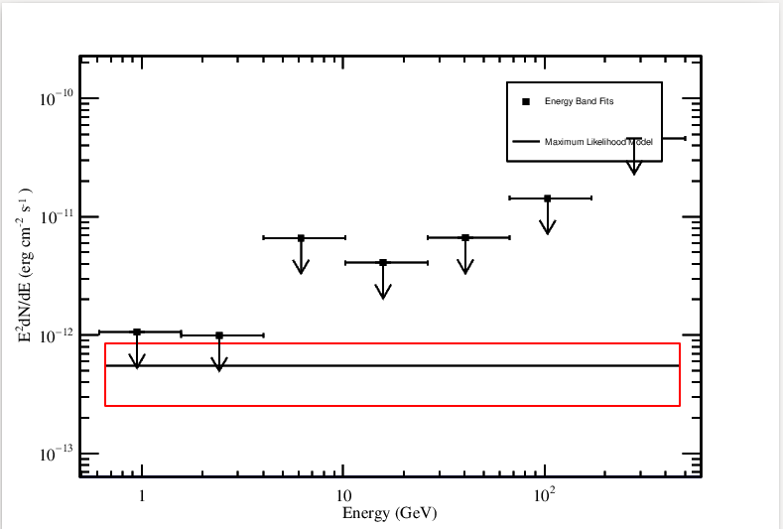
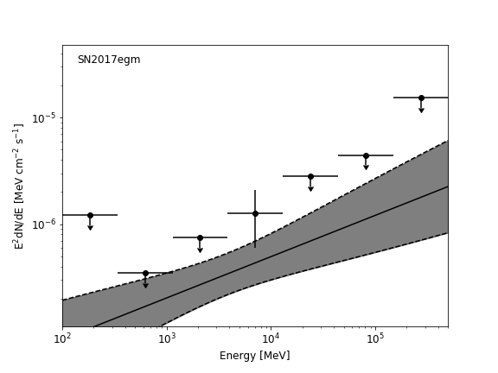
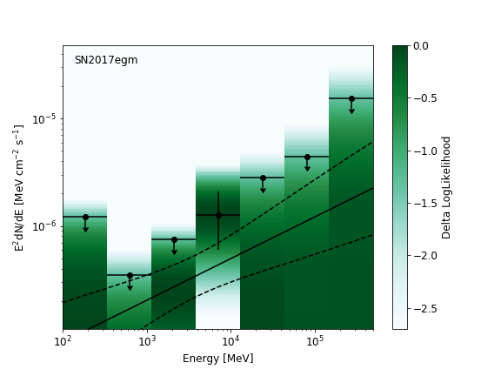
Bin 2

Slide 11
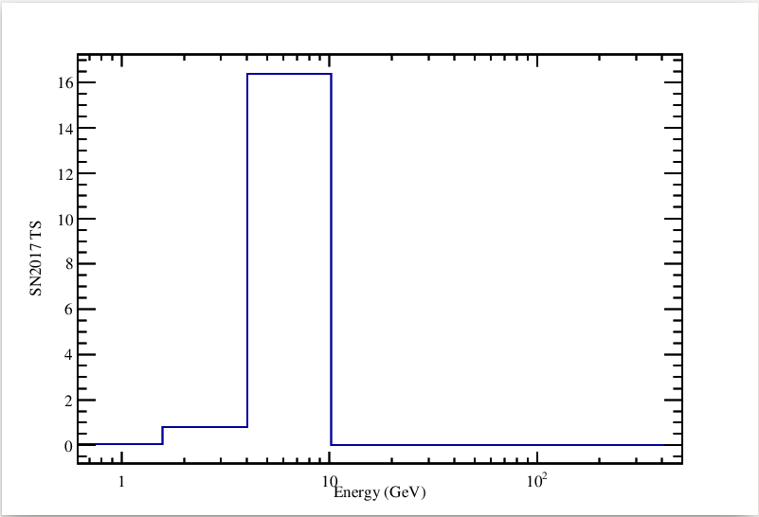
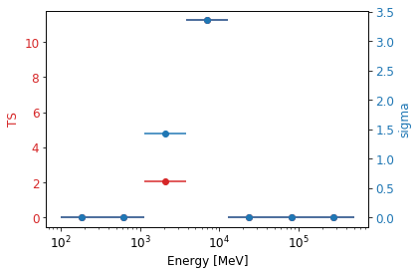
TS per energy – Bin 2

Slide 12
Bin 3

Slide 13
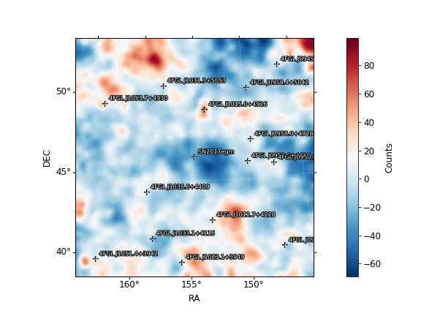
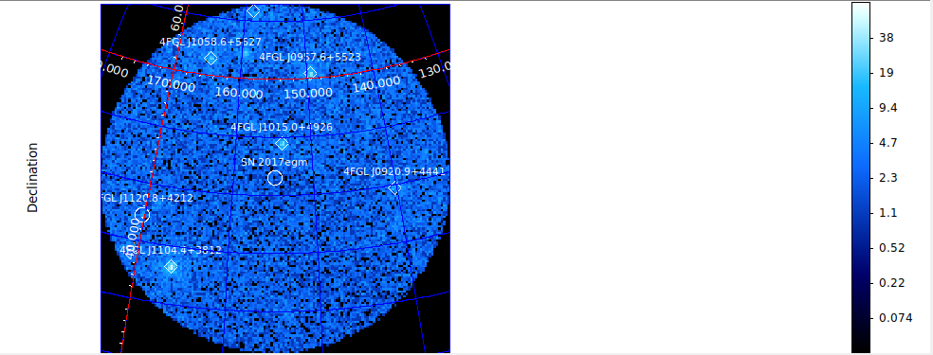
Fit results Bin 3
SN2017egm (0.045)
Prefactor 0.00178 +/- 0.0106
Index -2
galdiff
Prefactor 0.525 +/-0.249
Index 0
isodiff
Normalization 1.244 +/-0.2065
SN2017egm (0)
Prefactor 6.18e-05 +/- 0.00233
Index 2.17 +/- 1.7
galdiff
Prefactor 0.295 +/- 0.00571
Index 0.707 +/- 0.0107
isodiff
Normalization 1.31 +/- 0.0101

Slide 14
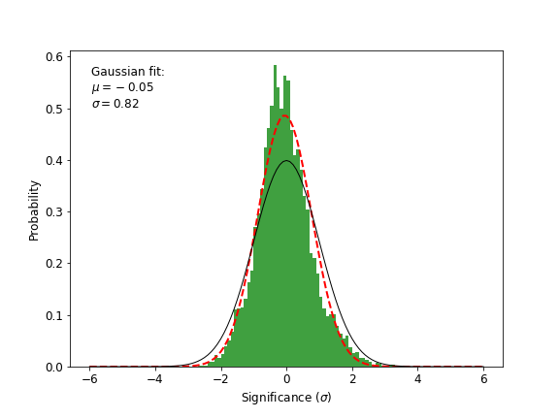
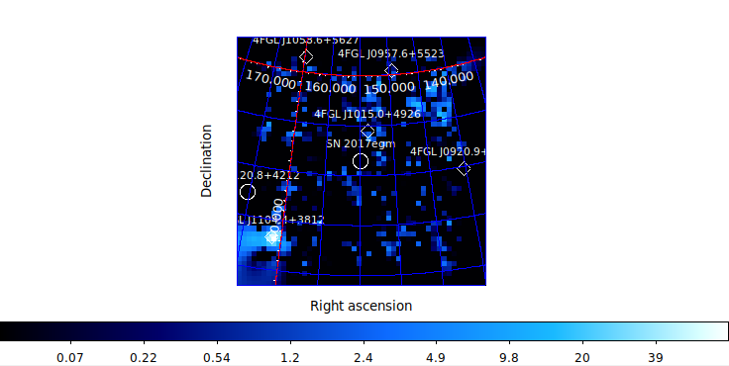
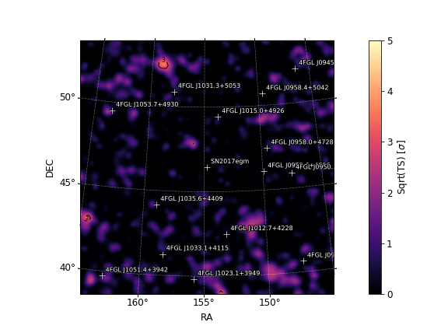
Bin 3

Slide 15
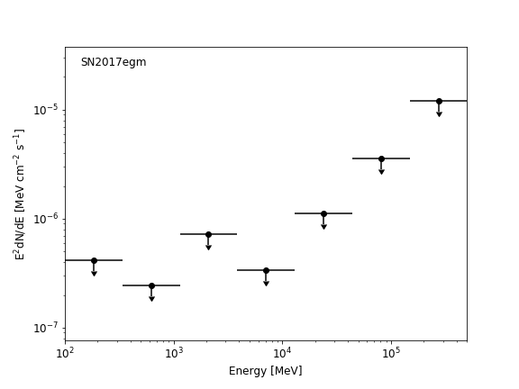
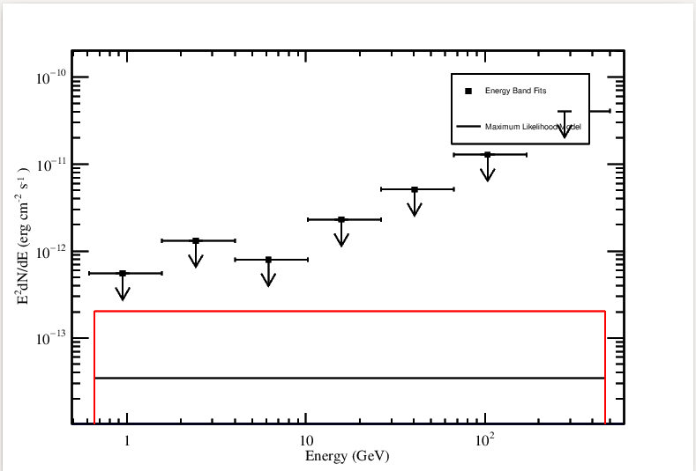
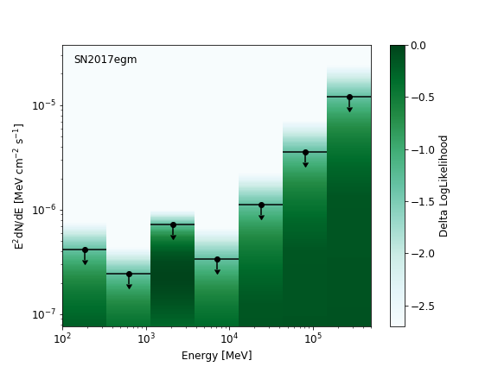
Bin 3

Slide 16
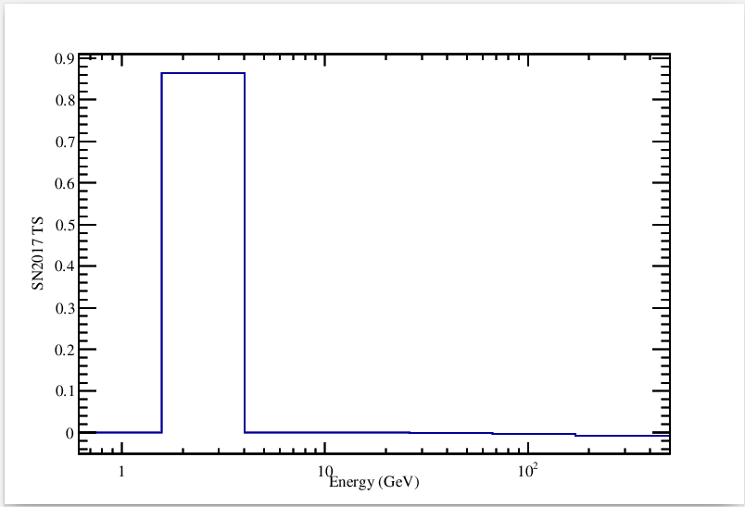
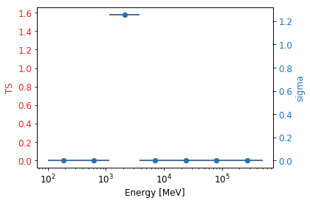
TS per energy – Bin 3

Slide 17
Bin 4

Slide 18
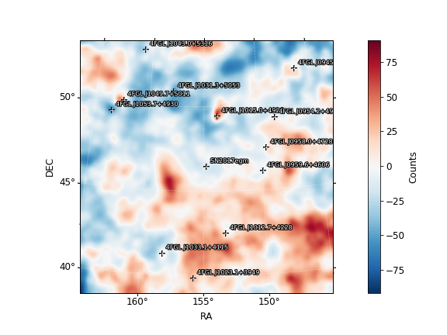
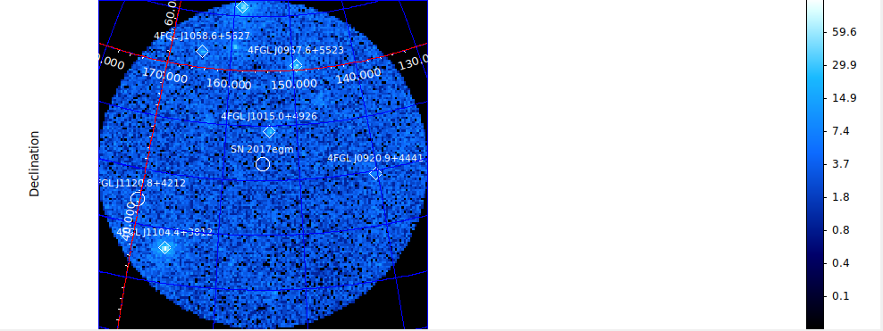
Fit results Bin 4
SN2017egm (-0.0063)
Prefactor 0.0001 +/-9.81e-6
Index -2
galdiff
Prefactor 0.394 +/-0.232
Index 0
isodiff
Normalization 1.327 +/-0.192
SN2017egm (0)
Prefactor 1.02e-05+/-0.000296
Index 2.08+/-44.5
galdiff
Prefactor 0.109+/-0.0565
Index 0.994+/-0.244
isodiff
Normalization 1.41 +/- 0.031

Slide 19
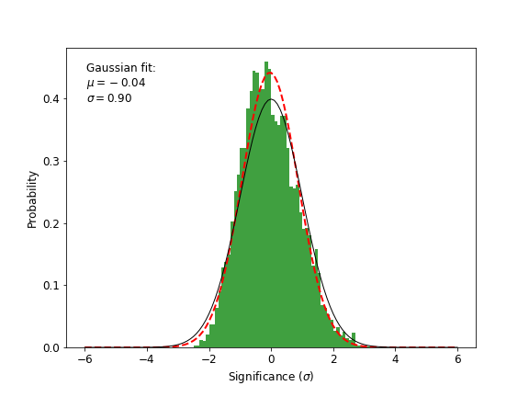
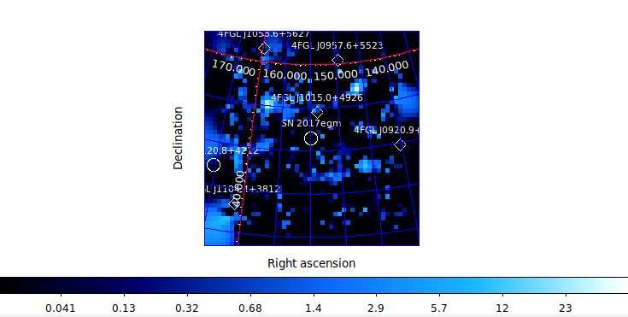
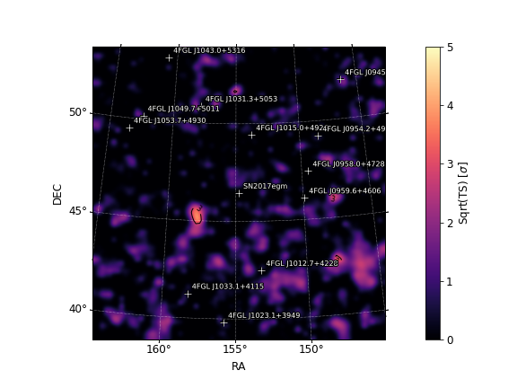
Bin 4

Slide 20
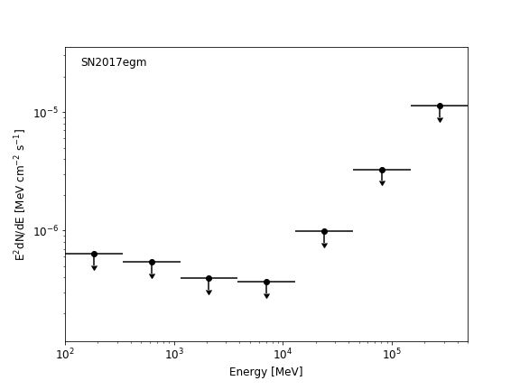
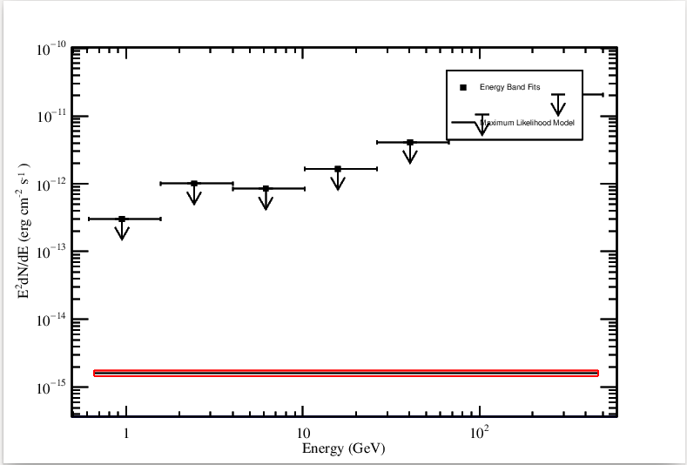
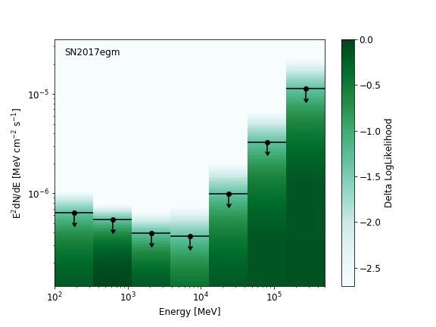
Bin 4

Slide 21
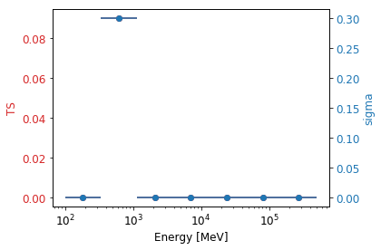
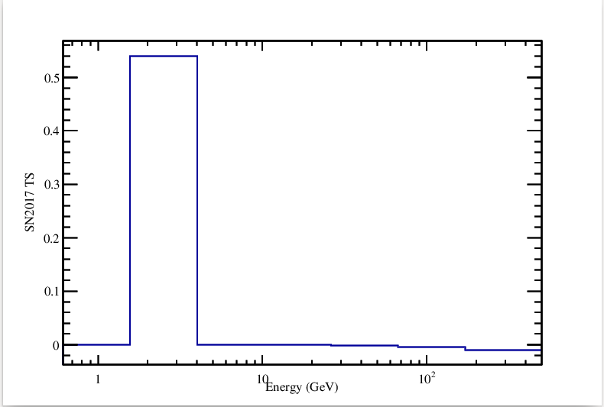
TS per energy – Bin 4

Slide 22
Bin 5

Slide 23
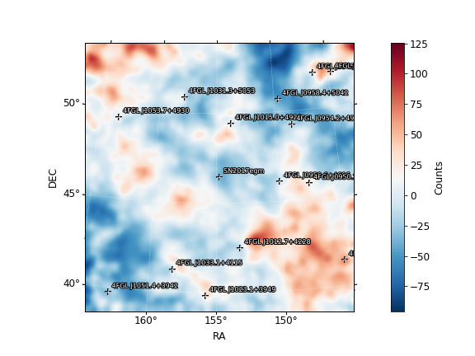
Fit results Bin 5
SN2017egm (0)
Prefactor 1e-05 +/- 7.74e-05
Index 2.24 +/- 520
galdiff
Prefactor 0.117 +/- 0.0043
Index 0.999 +/- 0.0143
isodiff
Normalization 1.46 +/- 0.0144

Slide 24
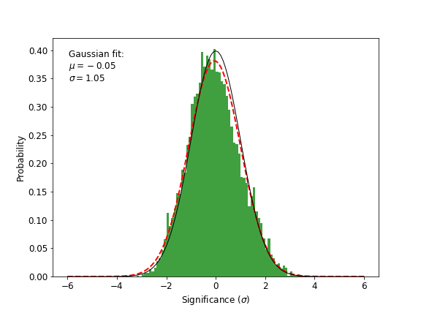
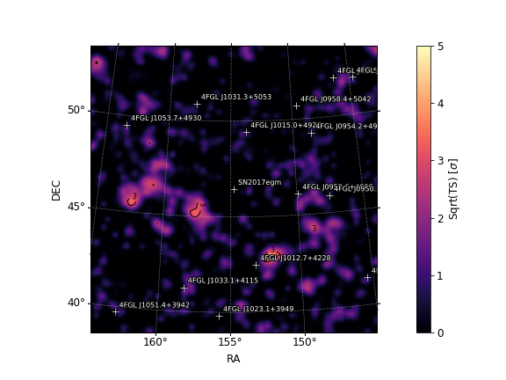
Bin 5

Slide 25
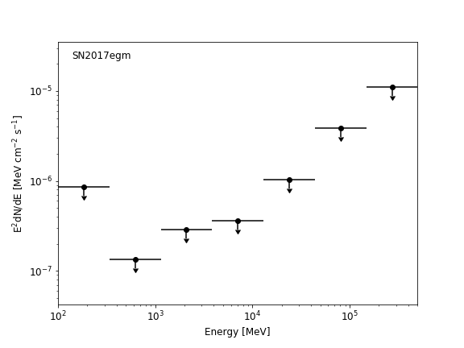
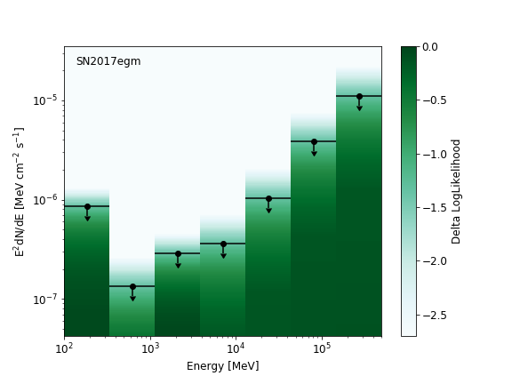
Bin 5

Slide 26
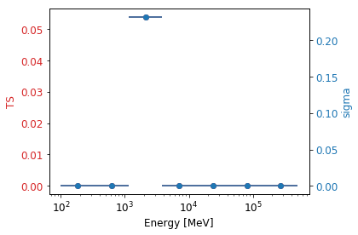
TS per energy – Bin 5

Slide 27
All 2.5yrs

Slide 28
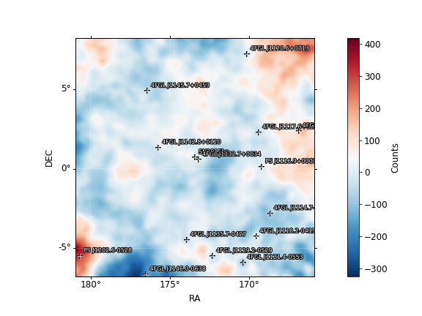
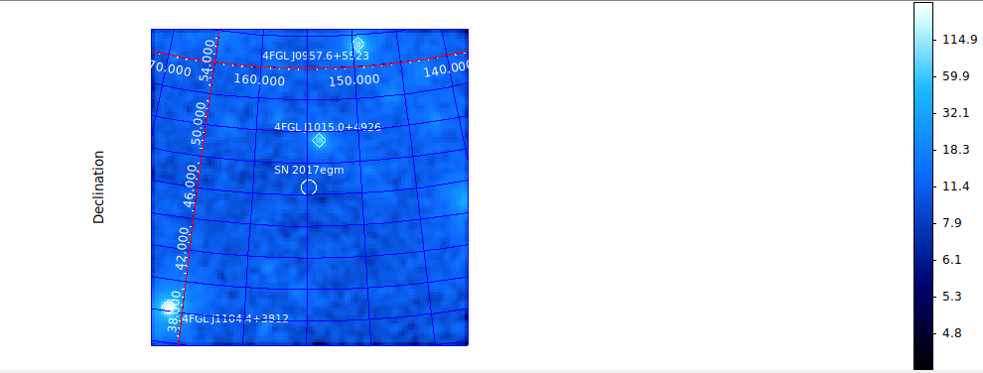
Fit Results 2.5yrs
SN2017egm (6.93)
Prefactor 0.0906 +/- 0.0507
Index 1.96 +/- 0.321
galdiff
Prefactor 0.1 +/- 0.00425
Index 0.952 +/- 0.0266
Isodiff
Normalization 1.42 +/- 0.013
SN2017egm (8.83)
Prefactor 0.0356 +/-0.046
Index -2.29 +/-0.423
galdiff
Prefactor 0.849 +/-0.116
Index 0
Isodiff
Normalization 0.954 +/-0.0956

Slide 29
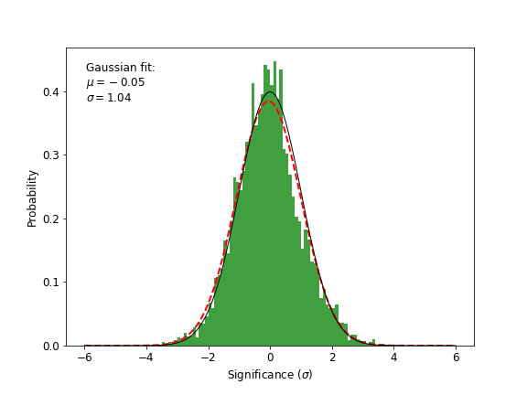
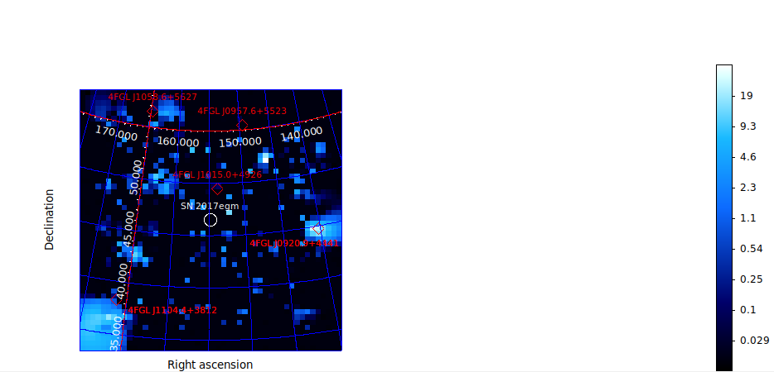

2.5yrs

Slide 30



2.5yrs

Slide 31


TS per energy – 2.5yrs

Slide 32
Bin 1 day 90-270

Slide 33


Fit results Bin 1
SN2017egm (5.01)
Prefactor 0.0223 +/-0.0126
Index -2
galdiff
Prefactor 0.000142 +/- 0.0549
Index 0
isodiff
Normalization 1.887 +/-0.1979
SN2017egm (9.93)
Prefactor 0.285 +/- 0.157
Index 1.91 +/- 0.359
galdiff
Prefactor 0.113 +/- 0.0113
Index 1 +/- 0.00599
isodiff
Normalization 1.37 +/- 0.0371

Slide 34



Bin 1 day 90-270

Slide 35



Bin 1 day 90-270

Slide 36

TS per energy – Bin 1 day 90-270

Slide 37
Bin 2 day 270-450

Slide 38


Fit results Bin 2 day 270-450
SN2017egm (0.57)
Prefactor 0.0643 +/- 0.106
Index 1.79 +/- 0.672
galdiff
Prefactor 0.117 +/- 0.0138
Index 1 +/- 0.00235
isodiff
Normalization 1.41 +/- 0.0427
SN2017egm (1.14)
Prefactor 0.00946 +/-0.011
Index -2
galdiff
Prefactor 1.14e-7 +/-0.00013
Index 0
isodiff
Normalization 1.938 +/-0.0182

Slide 39



Bin 2 day 270-450

Slide 40



Bin 2 day 270-450

Slide 41


TS per energy – Bin 2 day 270-450

Slide 42
Bin 3 day 450-630

Slide 43


Fit results Bin 3 day 450-630
SN2017egm (0.64)
Prefactor 0.0893 +/- 0.124
Index 2.09 +/- 0.646
galdiff
Prefactor 0.38 +/- 0.171
Index 0.666 +/- 0.151
isodiff
Normalization 1.17 +/- 0.137
SN2017egm (0.74)
Prefactor 8.93e-12 +/-1.204e-11
Index -2
galdiff
Prefactor 9.17e-6 +/-0.000817
Index 0
isodiff
Normalization 1.909 +/-0.0169

Slide 44



Bin 3 day 450-630

Slide 45



Bin 3 day 450-630

Slide 46


TS per energy – Bin 3 day 450-630

Slide 47
Bin 4 day 630-810

Slide 48


Fit results Bin 4 day 630-810
SN2017egm (-0.033)
Prefactor 0.0001 +/-5.474e-7
Index -2
galdiff
Prefactor 8.23e-8 +/-7.834e-5
Index 0
isodiff
Normalization2.466 +/-0.0189
SN2017egm (0)
Prefactor 1e-05 +/- 9.27e-06
Index 2.03 +/- 20.6
galdiff
Prefactor 0.123 +/- 0.0022
Index 0.98 +/- 0.00865
isodiff
Normalization 1.46 +/- 0.00746

Slide 49



Bin 4 day 630-810

Slide 50



Bin 4 day 630-810

Slide 51


TS per energy – Bin 4 day 630-810

Slide 52
Bin 5 day 810-990

Slide 53

Fit results Bin 5 day 810-990
SN2017egm (0)
Prefactor 1.1e-05 0.00834
Index 2.11 691
galdiff
Prefactor 0.105 0.00301
Index 1 0.00291
isodiff
Normalization 1.47 0.0107

Slide 54


Bin 5 day 810-990

Slide 55


Bin 5 day 810-990

Slide 56

TS per energy – Bin 5 day 810-990

Slide 57
2.5 years

Slide 58


Fit results 2.5yrs
SN2017egm (1.99)
Prefactor 5.928e-12 +/-4.918e-12
Index -2
galdiff
Prefactor 4.42e-7 +/-0.000107
Index 0
isodiff
Normalization 1.914 +/-0.00808
SN2017egm (5.9)
Prefactor 0.0723 +/- 0.0443
Index 1.86 +/- 0.297
galdiff
Prefactor 0.119 +/- 0.0132
Index 0.997 +/- 0.039
isodiff
Normalization 1.42 +/- 0.0194

Slide 59



2.5yrs

Slide 60



2.5yrs

Slide 61


TS per energy – 2.5yrs

