Slide 1
SN2017egm
Full analysis outputs comparison

Slide 2
Bin 1 day 90-270

Slide 3
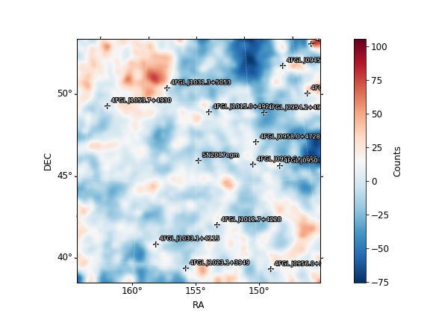
Fit results Bin 1
Pazit’s results
Deivid’s results
SN2017egm (9.62)
  Prefactor 0.271
  Index 1.88
galdiff
  Prefactor 0.11
  Index 1
isodiff
  Normalization 1.39
SN2017egm (9.93)
  Prefactor 0.285 +/- 0.157
  Index 1.91 +/- 0.359
galdiff
  Prefactor 0.113 +/- 0.0113
  Index 1 +/- 0.00599
isodiff
  Normalization 1.37 +/- 0.0371

Slide 4
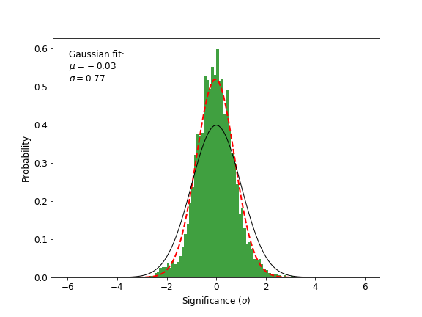
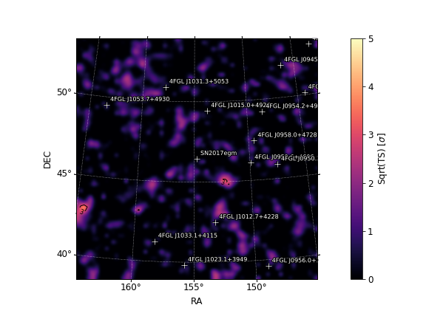
Bin 1 day 90-270
Deivid’s results
Pazit’s results

Slide 5
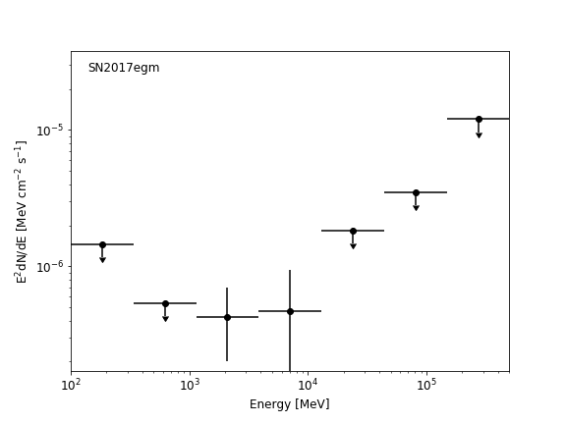
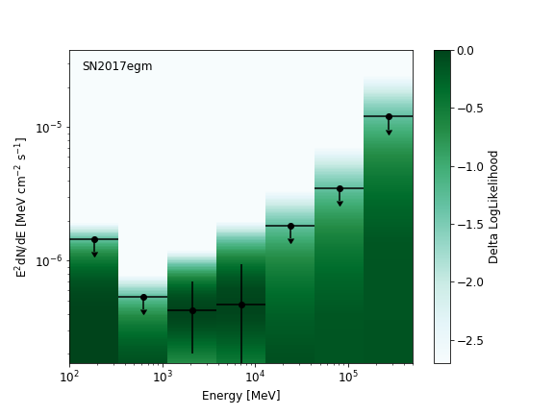
Bin 1 day 90-270
Deivid’s results
Pazit’s results

Slide 6
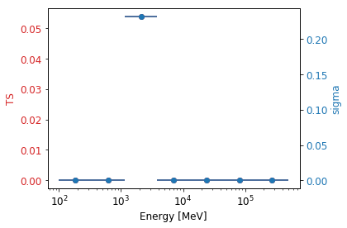
TS per energy – Bin 1 day 90-270
Deivid’s results
Pazit’s results

Slide 7
Bin 1 day 90-270
Deivid’s results
Pazit’s results
sourcename offset norm eflux index ts npred free
--------------------------------------------------------------------------------
SN2017egm 0.000 0.285 3e-06 1.91 9.93 30.1 *
4FGL J1015.0+4926 3.055 0.545 6.21e-05 1.84 879.23 524.5 *
4FGL J0959.6+4606 3.374 2.525 1.62e-06 2.75 2.76 69.1 *
4FGL J0958.0+4728 3.732 0.777 2.42e-06 10.57 13.76 99.5 *
4FGL J1012.7+4228 4.128 2.255 3.67e-06 1.94 8.76 38.6 *
4FGL J1031.3+5053 4.871 0.856 1.2e-05 1.69 52.64 53.6 *
4FGL J0954.2+4913 5.008 0.236 1.83e-06 1.59 5.33 5.3
4FGL J0950.2+4553 5.022 0.772 3.32e-06 1.99 17.66 41.7
4FGL J1033.1+4115 5.772 0.194 5.52e-06 2.60 33.31 182.4 *
4FGL J1053.7+4930 6.542 0.595 3.83e-06 1.94 18.82 38.7
4FGL J1023.1+3949 6.672 0.590 6.2e-06 2.82 45.52 167.5 *
4FGL J0945.2+5200 7.821 8.035 7.11e-06 2.54 47.74 209.3 *
4FGL J0937.1+5008 7.876 0.359 1.94e-06 2.42 4.04 46.1
4FGL J0956.0+3936 8.036 1.702 1.7e-06 2.43 4.86 37.7
4FGL J1109.8+4406 9.221 3.459 9.91e-06 2.98 6.47 115.6
4FGL J0957.6+5523 9.540 2.850 9.33e-05 2.12 20.59 198.3
4FGL J0922.6+4454 9.967 9.453 1.68e-05 2.91 6.11 131.0
4FGL J0932.6+5306 10.000 3.300 1.5e-05 2.37 183.84 222.8 *
4FGL J0920.9+4441 10.315 2.853 7.49e-05 2.61 9.86 163.4
4FGL J1101.5+3904 10.713 1.543 6.82e-06 2.98 4.13 75.1
4FGL J1018.4+3540 10.774 20.912 5.45e-05 2.54 10.56 178.3
4FGL J1104.4+3812 11.740 1.800 0.000107 8.28 34.87 142.9 *
isodiff --- 1.368 0.0705 2.24 2816.57 10104.4 *
galdiff --- 0.113 0.0587 1.00 124.37 2833.0 *
sourcename offset norm eflux index ts npred free
--------------------------------------------------------------------------------
SN2017egm 0.000 0.271 3.05e-06 1.88 9.60 28.0 *
4FGL J1015.0+4926 3.055 0.545 6.6e-05 1.83 904.40 527.4 *
4FGL J0959.6+4606 3.374 2.447 1.56e-06 2.71 2.99 65.0 *
4FGL J0958.0+4728 3.732 0.557 2.41e-06 11.52 14.34 99.9*
4FGL J1012.7+4228 4.128 2.245 3.55e-06 1.97 8.88 41.9 *
4FGL J1031.3+5053 4.871 0.840 1.22e-05 1.68 52.15 51.4 *
4FGL J0954.2+4913 5.008 0.238 1.85e-06 1.59 5.39 5.4
4FGL J0950.2+4553 5.022 0.780 3.36e-06 1.99 17.80 42.1
4FGL J1033.1+4115 5.772 0.199 5.76e-06 2.64 37.03 196.5 *
4FGL J1053.7+4930 6.542 0.522 3.36e-06 1.94 14.93 33.9
4FGL J1023.1+3949 6.672 0.559 5.92e-06 2.77 43.58 157.4 *
4FGL J0945.2+5200 7.821 7.981 7.05e-06 2.54 49.51 208.2 *
4FGL J0937.1+5008 7.876 0.380 2.06e-06 2.42 4.46 48.9
4FGL J1109.8+4406 9.221 3.615 1.04e-05 2.98 7.06 120.6
4FGL J0957.6+5523 9.540 2.841 9.31e-05 2.12 20.53 197.8
4FGL J0922.6+4454 9.967 9.187 1.63e-05 2.91 5.80 127.2
4FGL J0932.6+5306 10.000 3.243 1.48e-05 2.36 184.50 216.3 *
4FGL J0920.9+4441 10.315 2.759 7.25e-05 2.61 9.23 157.9
4FGL J1101.5+3904 10.713 1.587 7.01e-06 2.98 4.34 77.0
4FGL J1018.4+3540 10.774 20.341 5.31e-05 2.54 9.86 173.2
4FGL J1104.4+3812 11.740 1.270 9.16e-05 8.31 33.65 141.8 *
isodiff --- 1.387 0.0715 2.24 4021.31 10240.8 *
galdiff --- 0.110 0.0571 1.00 136.04 2753.5 *

Slide 8
Bin 2 day 270-450

Slide 9
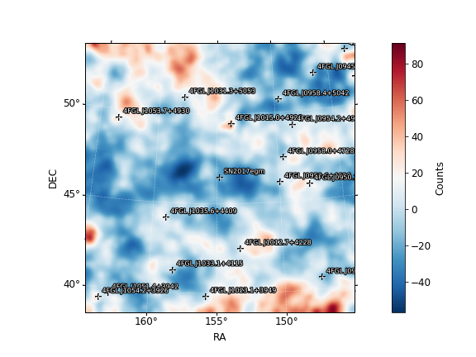
Fit results Bin 2 day 270-450
Deivid’s results
Pazit’s results
SN2017egm (0.57)
  Prefactor 0.0643 +/- 0.106
  Index 1.79 +/- 0.672
galdiff
  Prefactor 0.117 +/- 0.0138
  Index 1 +/- 0.00235
isodiff
  Normalization 1.41 +/- 0.0427
SN2017egm (0.61)
  Prefactor 0.0654 +/- 0.102
  Index 1.78 +/- 0.63
galdiff
  Prefactor 0.129 +/- 0.0179
  Index 0.999 +/- 0.0209
isodiff
  Normalization 1.39 +/- 0.0491

Slide 10
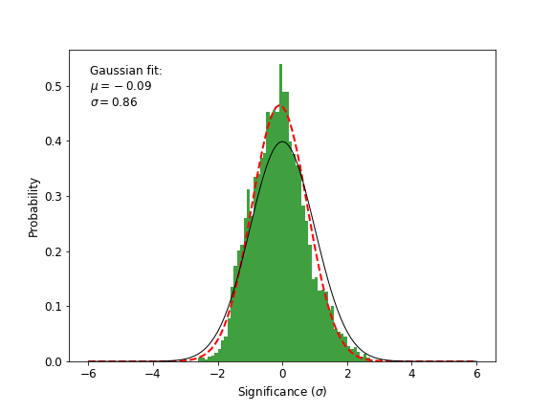
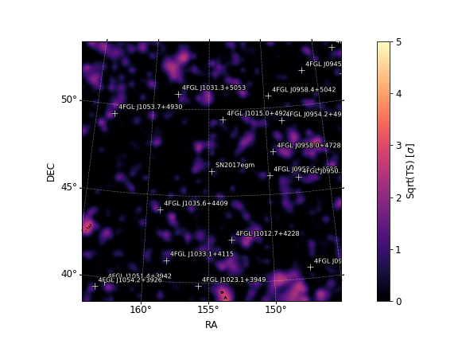
Bin 2 day 270-450
Deivid’s results
Pazit’s results

Slide 11
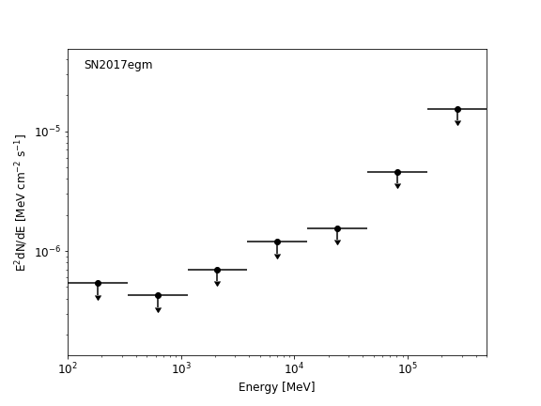
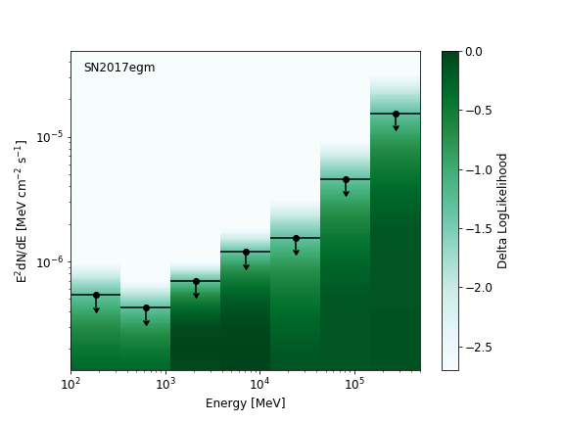
Bin 2 day 270-450
Deivid’s results
Pazit’s results

Slide 12
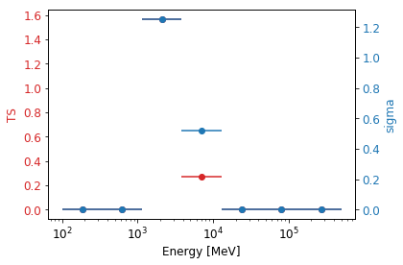
TS per energy – Bin 2 day 270-450
Deivid’s results
Pazit’s results

Slide 13
Deivid’s results
Pazit’s results
sourcename offset norm eflux index ts npred free
--------------------------------------------------------------------------------
SN2017egm 0.000 0.064 9.48e-07 1.79 0.57 4.8 *
4FGL J1015.0+4926 3.055 0.666 6.94e-05 1.75 935.00 395.1 *
4FGL J0959.6+4606 3.374 0.000 3.71e-11 3.01 -0.00 0.0 *
4FGL J1035.6+4409 3.710 2.213 2.55e-06 3.10 5.22 100.6 *
4FGL J0958.0+4728 3.732 0.587 4.92e-06 2.73 18.10 133.1 *
4FGL J1012.7+4228 4.128 1.462 3.01e-06 1.76 4.46 13.2
4FGL J1031.3+5053 4.871 0.823 7.21e-06 1.95 34.89 64.0 *
4FGL J0954.2+4913 5.008 0.460 3.57e-06 1.59 5.85 7.9
4FGL J0950.2+4553 5.022 1.172 5.04e-06 1.99 19.13 46.8
4FGL J0958.4+5042 5.449 2.216 4.41e-06 2.61 22.83 123.2
4FGL J1033.1+4115 5.772 0.191 7.4e-06 3.02 41.20 243.6 *
4FGL J1053.7+4930 6.542 0.583 3.75e-06 1.94 8.83 30.8
4FGL J1023.1+3949 6.672 0.254 2.69e-06 2.59 7.68 47.2
4FGL J0945.2+5200 7.821 2.882 2.59e-06 2.81 6.39 68.5
4FGL J0949.0+4038 7.960 1.341 5.76e-06 2.55 18.29 112.9
4FGL J1051.4+3942 8.955 0.772 2.66e-06 1.71 5.91 7.9
4FGL J0929.3+5014 9.081 0.957 1.84e-05 2.10 8.37 73.8
4FGL J1109.8+4406 9.221 4.935 1.41e-05 2.98 10.50 134.7
4FGL J0930.5+5132 9.435 4.289 4.89e-06 1.93 5.00 17.8
4FGL J1054.2+3926 9.507 0.876 1.73e-06 2.25 5.08 19.2
4FGL J0957.6+5523 9.540 1.921 6.29e-05 2.12 7.57 103.2
4FGL J0932.6+5306 10.000 1.002 4.56e-06 2.40 10.55 50.9
4FGL J0920.9+4441 10.315 3.985 0.000105 2.61 12.17 162.6
4FGL J0934.3+3926 10.766 4.735 1.52e-05 2.54 4.54 66.8
4FGL J1104.4+3812 11.740 2.263 0.000466 1.76 25.88 146.5 *
isodiff --- 1.413 0.0728 2.24 2313.10 8039.5 *
galdiff --- 0.117 0.0612 1.00 95.67 2246.0 *
sourcename offset norm eflux index ts npred free
--------------------------------------------------------------------------------
SN2017egm 0.000 0.065 1e-06 1.78 0.61 4.8 *
4FGL J1015.0+4926 3.055 0.669 6.39e-05 1.75 917.95 375.3 *
4FGL J0959.6+4606 3.374 0.000 4.84e-10 4.47 -0.00 0.0 *
4FGL J1035.6+4409 3.710 2.001 2.9e-06 3.25 6.69 121.4 *
4FGL J0958.0+4728 3.732 0.580 4.67e-06 2.76 18.17 120.0 *
4FGL J1012.7+4228 4.128 1.505 3.1e-06 1.76 4.61 13.4
4FGL J1031.3+5053 4.871 0.830 7.92e-06 1.88 34.77 56.3 *
4FGL J0954.2+4913 5.008 0.462 3.59e-06 1.59 5.88 7.8
4FGL J0950.2+4553 5.022 1.164 5.01e-06 1.99 19.01 45.8
4FGL J0958.4+5042 5.449 2.302 4.58e-06 2.61 23.96 126.2
4FGL J1033.1+4115 5.772 0.241 6.79e-06 2.56 40.19 164.8 *
4FGL J1053.7+4930 6.542 0.603 3.88e-06 1.94 9.14 31.5
4FGL J1023.1+3949 6.672 0.269 2.86e-06 2.59 8.36 49.4
4FGL J0945.2+5200 7.821 2.933 2.63e-06 2.81 6.53 68.7
4FGL J0949.0+4038 7.960 1.329 5.71e-06 2.55 17.82 110.5
4FGL J1051.4+3942 8.955 0.765 2.63e-06 1.71 5.89 7.7
4FGL J0929.3+5014 9.081 0.905 1.75e-05 2.10 7.46 68.8
4FGL J1109.8+4406 9.221 4.876 1.4e-05 2.98 10.14 131.5
4FGL J0930.5+5132 9.435 4.380 5e-06 1.93 5.15 18.0
4FGL J1054.2+3926 9.507 0.896 1.77e-06 2.25 5.24 19.4
4FGL J0957.6+5523 9.540 1.961 6.42e-05 2.12 7.81 103.9
4FGL J0932.6+5306 10.000 0.997 4.54e-06 2.40 10.33 49.9
4FGL J0920.9+4441 10.315 4.076 0.000107 2.61 12.57 164.0
4FGL J1104.4+3812 11.740 2.197 0.00614 1.41 25.19 148.8 *
isodiff --- 1.393 0.0718 2.24 2217.78 7826.8 *
galdiff --- 0.129 0.0672 1.00 101.58 2435.1 *

Slide 14
Bin 3 day 450-630

Slide 15
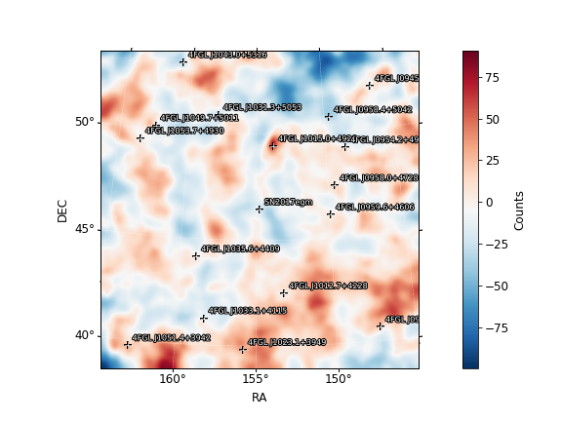
Fit results Bin 3 day 450-630
Deivid’s results
Pazit’s results
SN2017egm (0.80)
  Prefactor 0.102
  Index 2.15
galdiff
  Prefactor 0.368
  Index 0.675
isodiff
  Normalization 1.18
SN2017egm (0.64)
  Prefactor 0.0893 +/- 0.124
  Index 2.09 +/- 0.646
galdiff
  Prefactor 0.38 +/- 0.171
  Index 0.666 +/- 0.151
isodiff
  Normalization 1.17 +/- 0.137

Slide 16
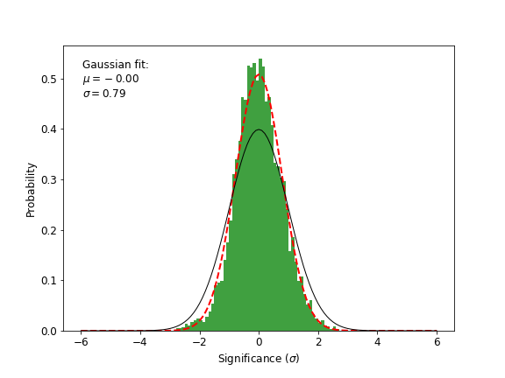
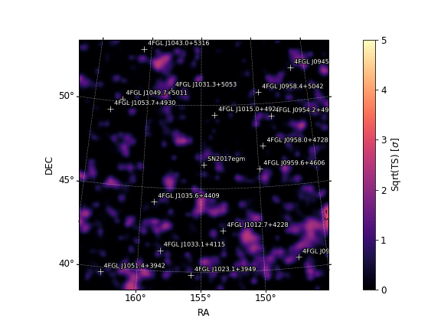
Bin 3 day 450-630
Deivid’s results
Pazit’s results

Slide 17
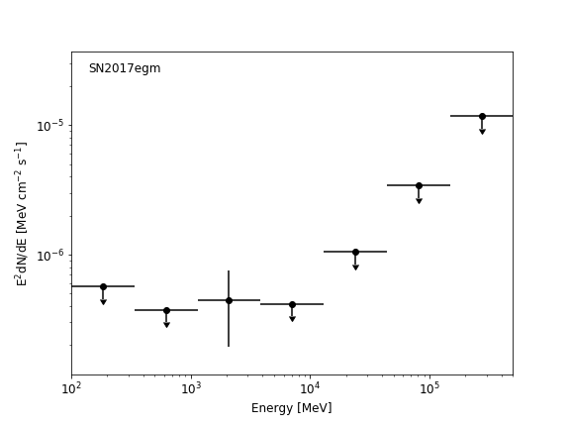
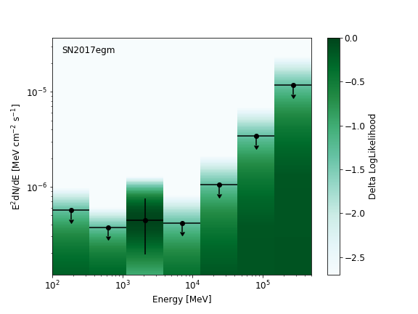
Bin 3 day 450-630
Deivid’s results
Pazit’s results

Slide 18
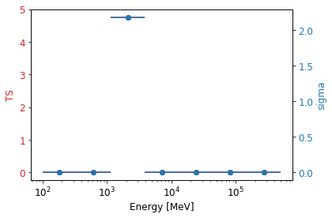
TS per energy – Bin 3 day 450-630
Deivid’s results
Pazit’s results

Slide 19
Deivid’s results
Pazit’s results
sourcename offset norm eflux index ts npred free
--------------------------------------------------------------------------------
SN2017egm 0.000 0.089 6.55e-07 2.09 0.64 11.4 *
4FGL J1015.0+4926 3.055 0.531 3.7e-05 1.96 764.78 480.2 *
4FGL J0959.6+4606 3.374 2.337 1.96e-06 3.36 3.57 116.6 *
4FGL J1035.6+4409 3.710 4.580 2.84e-06 2.46 10.69 92.7 *
4FGL J0958.0+4728 3.732 0.842 2.83e-06 7.17 17.09 96.3 *
4FGL J1012.7+4228 4.128 2.124 6e-06 1.62 18.44 19.1 *
4FGL J1031.3+5053 4.871 1.163 1.16e-05 1.85 57.62 101.9 *
4FGL J0954.2+4913 5.008 0.659 5.12e-06 1.59 13.57 15.4
4FGL J0958.4+5042 5.449 1.511 3.01e-06 2.61 8.24 114.3
4FGL J1033.1+4115 5.772 0.079 2.2e-06 2.41 5.91 59.3
4FGL J1049.7+5011 6.308 5.502 6.9e-06 2.37 58.61 199.1 *
4FGL J1053.7+4930 6.542 0.710 4.57e-06 1.94 14.26 50.2
4FGL J1023.1+3949 6.672 0.287 3.05e-06 2.59 10.44 68.5
4FGL J0945.2+5200 7.821 12.051 1.23e-05 2.30 142.82 280.5 *
4FGL J1043.0+5316 7.827 3.564 2.91e-06 2.84 7.66 99.0
4FGL J0949.0+4038 7.960 0.608 2.61e-06 2.55 8.33 68.7
4FGL J1051.4+3942 8.955 1.187 4.08e-06 1.71 10.74 15.3
4FGL J0957.6+5523 9.540 2.871 9.4e-05 2.12 21.49 211.6
4FGL J0922.6+4454 9.967 8.431 1.5e-05 2.91 4.48 113.4
4FGL J1101.5+3904 10.713 2.024 8.95e-06 2.98 7.32 100.0
4FGL J1104.4+3812 11.740 2.093 0.000431 1.76 22.98 163.9
isodiff --- 1.171 0.0603 2.24 1007.91 8846.9 *
galdiff --- 0.380 0.136 0.67 202.06 5265.2 *
sourcename offset norm eflux index ts npred free
--------------------------------------------------------------------------------
SN2017egm 0.000 0.102 6.96e-07 2.15 0.80 14.1 *
4FGL J1015.0+4926 3.055 0.530 3.91e-05 1.93 806.30 477.8 *
4FGL J0959.6+4606 3.374 2.376 2.09e-06 3.44 4.97 129.9 *
4FGL J1035.6+4409 3.710 4.708 2.92e-06 2.46 11.47 96.2 *
4FGL J0958.0+4728 3.732 0.740 3.02e-06 5.85 18.98 105.5 *
4FGL J1012.7+4228 4.128 2.075 6.04e-06 1.61 18.31 18.4 *
4FGL J1031.3+5053 4.871 1.153 1.15e-05 1.86 57.82 102.0 *
4FGL J0954.2+4913 5.008 0.649 5.04e-06 1.59 13.45 15.2
4FGL J0958.4+5042 5.449 1.551 3.09e-06 2.61 8.77 118.2
4FGL J1033.1+4115 5.772 0.074 2.07e-06 2.41 5.44 56.3
4FGL J1049.7+5011 6.308 5.491 6.9e-06 2.37 59.84 202.4 *
4FGL J1053.7+4930 6.542 0.704 4.53e-06 1.94 14.17 50.0
4FGL J1023.1+3949 6.672 0.275 2.91e-06 2.59 9.80 66.0
4FGL J0945.2+5200 7.821 12.080 1.23e-05 2.31 144.30 284.3 *
4FGL J1043.0+5316 7.827 3.477 2.84e-06 2.84 7.36 97.3
4FGL J0949.0+4038 7.960 0.589 2.53e-06 2.55 7.96 67.1
4FGL J1051.4+3942 8.955 1.177 4.05e-06 1.71 10.69 15.3
4FGL J0957.6+5523 9.540 2.935 9.61e-05 2.12 22.62 217.9
4FGL J0922.6+4454 9.967 8.531 1.51e-05 2.91 4.65 115.6
4FGL J1101.5+3904 10.713 2.019 8.92e-06 2.98 7.36 100.4
4FGL J1104.4+3812 11.740 2.049 0.000422 1.76 22.24 161.5
isodiff --- 1.180 0.0608 2.24 1472.65 8977.2 *
galdiff --- 0.368 0.133 0.67 275.57 5213.6 *

Slide 20
Bin 4 day 630-810

Slide 21
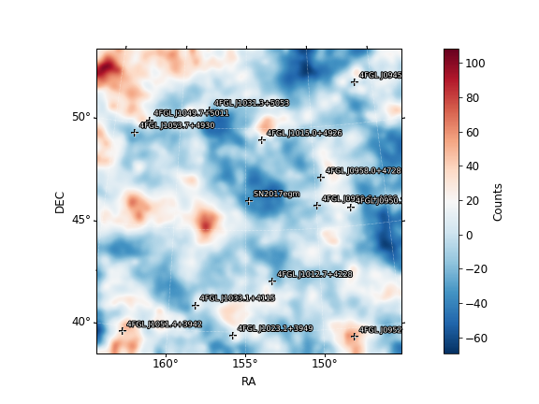
Fit results Bin 4 day 630-810
Deivid’s results
Pazit’s results
SN2017egm (0)
  Prefactor 1e-05 +/- 9.27e-06
  Index 2.03 +/- 20.6
galdiff
  Prefactor 0.123 +/- 0.0022
  Index 0.98 +/- 0.00865
isodiff
  Normalization 1.46 +/- 0.00746
SN2017egm (0)
  Prefactor 1.09e-05 +/- 0.000108
  Index 1.96 +/- 6.84
galdiff
  Prefactor 0.123 +/- 0.00119
  Index 0.985 +/- 0.00473
isodiff
  Normalization 1.45 +/- 0.00414

Slide 22
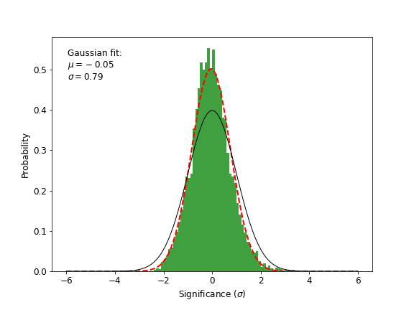
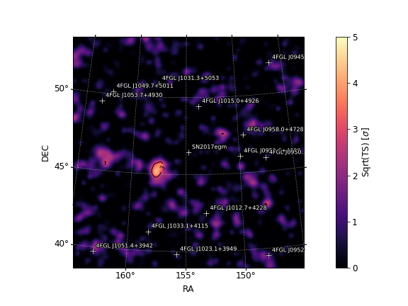
Bin 4 day 630-810
Deivid’s results
Pazit’s results

Slide 23
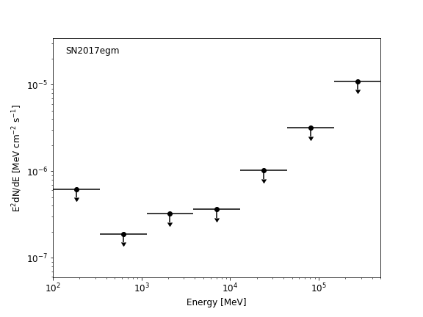
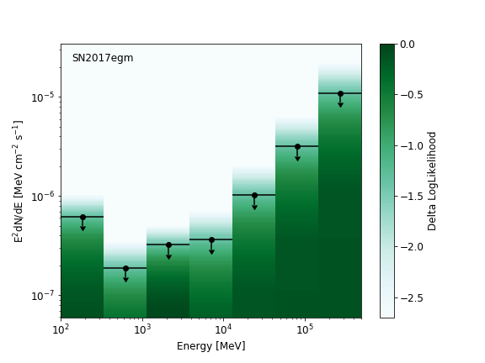
Bin 4 day 630-810
Deivid’s results
Pazit’s results

Slide 24
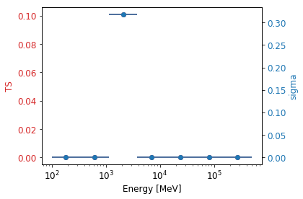
TS per energy – Bin 4 day 630-810
Deivid’s results
Pazit’s results

Slide 25
Deivid’s results
Pazit’s results
sourcename offset norm eflux index ts npred free
--------------------------------------------------------------------------------
SN2017egm 0.000 0.000 8.05e-11 2.03 -0.00 0.0 *
4FGL J1015.0+4926 3.055 0.547 5.01e-05 1.85 892.16 514.7 *
4FGL J0959.6+4606 3.374 0.000 3.36e-10 4.45 -0.00 0.0 *
4FGL J0958.0+4728 3.732 0.224 2.93e-06 2.23 10.80 77.0 *
4FGL J1012.7+4228 4.128 2.096 5.38e-06 1.66 19.11 22.0 *
4FGL J1031.3+5053 4.871 1.365 2.13e-05 1.65 113.03 91.7 *
4FGL J0950.2+4553 5.022 0.492 2.12e-06 1.99 4.88 28.4
4FGL J1033.1+4115 5.772 0.218 7.49e-06 2.14 55.98 141.6 *
4FGL J1049.7+5011 6.308 3.287 4.1e-06 2.27 21.31 108.3
4FGL J1053.7+4930 6.542 0.617 3.97e-06 1.94 17.35 46.3
4FGL J1023.1+3949 6.672 0.539 7.18e-06 2.73 46.64 241.3 *
4FGL J0945.2+5200 7.821 12.543 1.14e-05 2.46 129.16 336.1 *
4FGL J0952.1+3932 8.483 6.842 3.16e-06 1.71 4.93 12.7
4FGL J1051.4+3942 8.955 0.817 2.81e-06 1.71 6.80 11.5
4FGL J1109.8+4406 9.221 0.937 5.26e-06 4.37 13.33 212.6 *
4FGL J0957.6+5523 9.540 2.274 7.45e-05 2.12 14.59 175.6
4FGL J0922.6+4454 9.967 8.987 1.59e-05 2.91 5.24 127.9
4FGL J0920.9+4441 10.315 3.871 0.000102 2.61 17.22 228.2
4FGL J1101.5+3904 10.713 1.855 8.2e-06 2.98 5.90 99.9
4FGL J1018.4+3540 10.774 16.849 4.4e-05 2.54 7.06 151.5
4FGL J1104.4+3812 11.740 1.793 0.000369 1.76 17.64 154.6 *
isodiff --- 1.457 0.075 2.24 3171.53 11824.9 *
galdiff --- 0.123 0.0628 0.98 112.11 3268.6 *
sourcename offset norm eflux index ts npred free
--------------------------------------------------------------------------------
SN2017egm 0.000 0.000 1.02e-10 1.96 -0.00 0.0 *
4FGL J1015.0+4926 3.055 0.550 4.77e-05 1.87 867.43 524.7 *
4FGL J0959.6+4606 3.374 0.000 2.07e-11 4.13 -0.00 0.0 *
4FGL J0958.0+4728 3.732 0.209 2.61e-06 2.22 10.32 64.3 *
4FGL J1012.7+4228 4.128 2.149 5.35e-06 1.67 19.27 23.0 *
4FGL J1031.3+5053 4.871 1.365 2.14e-05 1.65 113.10 91.2 *
4FGL J0950.2+4553 5.022 0.504 2.17e-06 1.99 5.04 29.1
4FGL J1033.1+4115 5.772 0.221 7.49e-06 2.15 56.28 143.8 *
4FGL J1049.7+5011 6.308 3.329 4.15e-06 2.27 21.90 109.6
4FGL J1053.7+4930 6.542 0.613 3.94e-06 1.94 17.27 46.1
4FGL J1023.1+3949 6.672 0.538 7.3e-06 2.73 47.57 248.3 *
4FGL J0945.2+5200 7.821 12.720 1.16e-05 2.45 134.08 337.9 *
4FGL J0952.1+3932 8.483 6.891 3.18e-06 1.71 4.96 12.8
4FGL J1051.4+3942 8.955 0.803 2.76e-06 1.71 6.71 11.3
4FGL J1109.8+4406 9.221 1.512 7.11e-06 4.10 14.95 225.7 *
4FGL J0957.6+5523 9.540 2.157 7.07e-05 2.12 13.15 166.5
4FGL J0922.6+4454 9.967 9.006 1.6e-05 2.91 5.27 128.0
4FGL J0920.9+4441 10.315 3.709 9.74e-05 2.61 15.98 218.4
4FGL J1018.4+3540 10.774 17.402 4.54e-05 2.54 7.50 156.3
4FGL J1104.4+3812 11.740 1.414 9.97e-05 3.01 48.15 255.4 *
isodiff --- 1.453 0.0748 2.24 3204.28 11783.9 *
galdiff --- 0.123 0.0629 0.99 116.24 3282.1 *
Fixed all: 4FGL J1104.4+3812, 4FGL J1033.1+4115.
Norm only for 4FGL J0945.2+5200

Slide 26
2.5 years

Slide 27
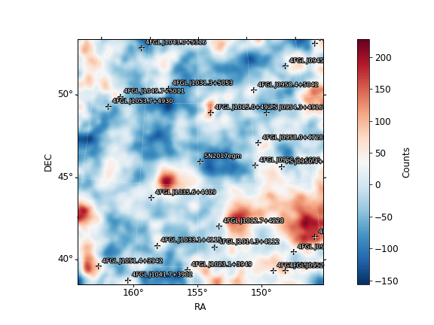
Fit results 2.5yrs
SN2017egm (5.10)
  Prefactor 0.0801
  Index 1.86
galdiff
  Prefactor 0.193
  Index 0.792
isodiff
  Normalization 1.35
SN2017egm (5.9)
  Prefactor 0.0723 +/- 0.0443
  Index 1.86 +/- 0.297
galdiff
  Prefactor 0.119 +/- 0.0132
  Index 0.997 +/- 0.039
isodiff
  Normalization 1.42 +/- 0.0194
Deivid’s results
Pazit’s results

Slide 28
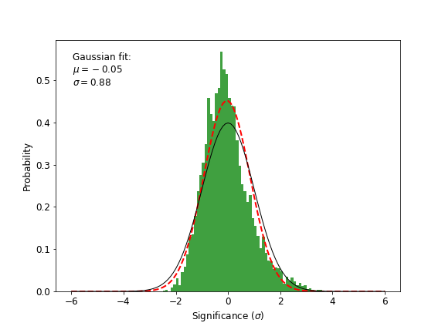
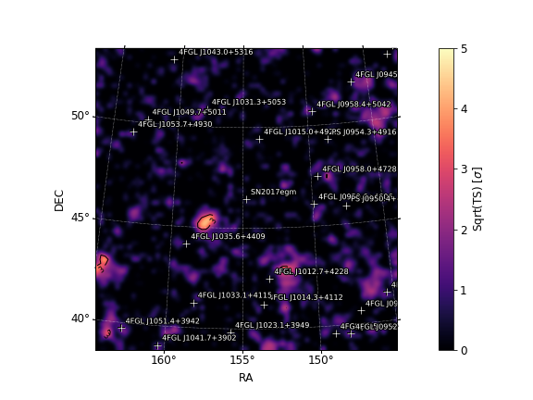
2.5yrs
Deivid’s results
Pazit’s results

Slide 29
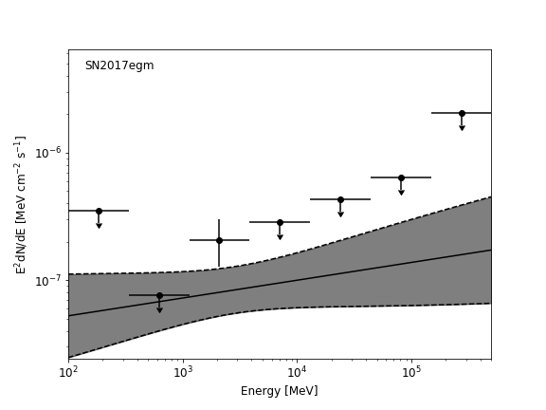
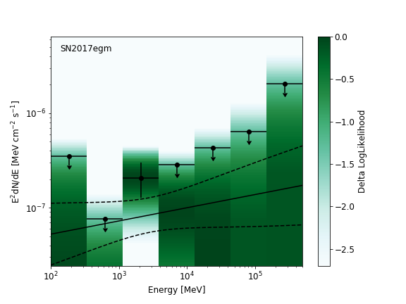
2.5yrs
Deivid’s results
Pazit’s results

Slide 30
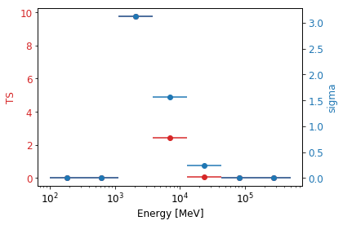
TS per energy – 2.5yrs
Deivid’s results
Pazit’s results

Slide 31
Deivid’s results
Pazit’s results
sourcename offset norm eflux index ts npred free
--------------------------------------------------------------------------------
SN2017egm 0.000 0.080 9.59e-07 1.86 5.10 31.6 *
4FGL J1015.0+4926 3.055 0.572 5.46e-05 1.85 3539.22 1989.8 *
4FGL J0959.6+4606 3.374 0.605 3.95e-07 2.86 0.69 69.3 *
4FGL J1035.6+4409 3.710 2.292 1.84e-06 2.81 15.98 310.7 *
4FGL J0958.0+4728 3.732 0.448 4.09e-06 2.91 71.36 675.6 *
4FGL J1012.7+4228 4.128 2.026 4.72e-06 1.70 50.60 81.5 *
4FGL J1031.3+5053 4.871 1.073 1.33e-05 1.74 252.83 290.9 *
4FGL J0954.2+4913 5.008 0.359 2.79e-06 1.59 23.99 31.6
4FGL J0950.2+4553 5.022 0.897 3.48e-06 2.12 62.15 231.9 *
4FGL J1014.3+4112 5.314 1.559 1.18e-06 2.40 5.94 123.1
4FGL J1033.1+4115 5.772 0.173 5.18e-06 2.26 120.24 438.1 *
4FGL J1049.7+5011 6.308 2.735 3.63e-06 2.48 72.69 451.8 *
4FGL J1053.7+4930 6.542 0.526 3.76e-06 1.87 55.66 123.5 *
4FGL J1023.1+3949 6.672 0.425 4.34e-06 2.88 91.33 443.5 *
4FGL J0945.2+5200 7.821 10.666 9.54e-06 2.50 356.06 1039.1 *
4FGL J1043.0+5316 7.827 1.916 1.56e-06 2.84 10.24 198.9
4FGL J0949.0+4038 7.960 0.459 1.97e-06 2.55 15.03 200.8
4FGL J0956.0+3936 8.036 1.081 1.08e-06 2.43 6.40 88.6
4FGL J0952.1+3932 8.483 3.111 1.44e-06 1.71 6.24 20.6
4FGL J1051.4+3942 8.955 0.700 2.41e-06 1.71 19.97 34.9
4FGL J1109.8+4406 9.221 2.915 8.68e-06 2.65 8.23 284.8 *
4FGL J0957.6+5523 9.540 0.041 0.00593 1.75 30.36 547.7 *
4FGL J1033.7+3708 9.701 9.287 1.14e-05 2.39 4.81 206.2
4FGL J0922.6+4454 9.967 8.408 1.49e-05 2.91 16.71 430.4
4FGL J0932.6+5306 10.000 1.089 5.27e-06 2.61 113.80 368.7 *
4FGL J0920.9+4441 10.315 0.245 1.67e-05 7.14 4.67 249.4 *
4FGL J1101.5+3904 10.713 1.821 8.05e-06 2.98 21.42 347.1
4FGL J0934.3+3926 10.766 2.387 7.68e-06 2.54 6.57 174.8
4FGL J1018.4+3540 10.774 16.696 4.36e-05 2.54 24.59 536.0
4FGL J1104.4+3812 11.740 1.891 0.000851 1.64 78.99 605.6 *
4FGL J1138.4+4857 13.537 20.133 2.81e-05 2.73 4.18 223.6
isodiff --- 1.354 0.0698 2.24 10246.53 38897.7 *
galdiff --- 0.193 0.079 0.79 483.50 12750.8 *
sourcename offset norm eflux index ts npred free
--------------------------------------------------------------------------------
SN2017egm 0.000 0.072 8.58e-07 1.86 5.90 43.1 *
4FGL J1015.0+4926 3.055 0.546 5.04e-05 1.86 4803.25 2833.6 *
4FGL J0959.6+4606 3.374 1.715 1.11e-06 2.58 8.76 238.8 *
4FGL J1035.6+4409 3.710 2.407 1.88e-06 2.78 24.92 469.1 *
4FGL J0958.0+4728 3.732 0.416 3.52e-06 3.00 72.97 842.2 *
4FGL J1012.7+4228 4.128 2.056 3.79e-06 1.83 67.84 160.4 *
4FGL J1031.3+5053 4.871 0.927 1.2e-05 1.73 309.51 368.5 *
PS J0950.4+4553 4.984 4.411 2.79e-06 2.23 66.53 357.8 *
PS J0954.3+4916 5.008 1.815 1.55e-06 2.00 nan 119.8
4FGL J1014.3+4112 5.314 2.291 1.74e-06 2.40 19.16 273.2
4FGL J0958.4+5042 5.449 0.463 9.22e-07 2.61 8.85 200.4
4FGL J1033.1+4115 5.772 0.193 5.7e-06 2.29 205.66 752.2 *
4FGL J1049.7+5011 6.308 2.472 3.08e-06 2.27 80.05 434.6 *
4FGL J1053.7+4930 6.542 0.498 3.97e-06 1.81 77.83 160.6 *
4FGL J1023.1+3949 6.672 0.435 5.77e-06 2.67 182.88 1008.8 *
4FGL J0945.2+5200 7.821 9.584 8.47e-06 2.54 410.47 1451.6 *
4FGL J1043.0+5316 7.827 2.061 1.68e-06 2.84 18.79 322.1
4FGL J0949.0+4038 7.960 0.451 1.94e-06 2.55 20.88 299.0
4FGL J0956.0+3936 8.036 1.391 1.39e-06 2.43 13.93 172.6
4FGL J0941.7+4125 8.381 0.626 6.58e-07 3.54 5.72 75.8
4FGL J0952.1+3932 8.483 2.263 1.05e-06 1.71 4.90 22.7
4FGL J1041.7+3902 8.495 0.799 6.56e-07 1.93 5.77 25.3
4FGL J1051.4+3942 8.955 0.372 1.28e-06 1.71 13.14 27.8
4FGL J0929.3+5014 9.081 0.231 4.46e-06 2.10 4.10 141.1
4FGL J1109.8+4406 9.221 2.873 0.00184 1.14 5.44 193.1
4FGL J1015.6+5553 9.451 2.117 7.24e-06 2.52 4.92 276.0
4FGL J0957.6+5523 9.540 0.110 0.00626 1.51 9.01 366.2
4FGL J1035.3+5541 9.587 1.845 5.02e-06 2.64 4.00 238.7
4FGL J1033.7+3708 9.701 7.377 9.05e-06 2.39 4.69 246.3
4FGL J0922.6+4454 9.967 7.669 1.36e-05 2.91 21.28 596.3
PS J0932.2+5308 10.063 0.634 4.3e-06 2.64 108.15 452.9 *
4FGL J0934.3+3926 10.766 2.157 6.94e-06 2.54 8.12 239.7
4FGL J1104.4+3812 11.740 2.032 0.00554 1.54 342.29 1657.6 *
4FGL J1138.4+4857 13.537 24.631 3.43e-05 2.73 9.25 409.1
isodiff --- 1.422 0.0733 2.24 16400.55 61589.5 *
galdiff --- 0.119 0.0618 1.00 743.45 17370.9 *
Deleted 4FGL J1149.0+5924
Fixed 4FGL J1018.4+3540, 4FGL J0954.2+4913, 4FGL J0950.2+4553, 4FGL J0932.6+5306, 4FGL J0920.9+4441, 4FGL J1101.5+3904
Free norms only for all TS>25.

