Slide 1
SN2015bn
Full analysis outputs comparison
Deivid Ribeiro and Pazit Rabinowitz

Slide 2
Bin 1

Slide 3
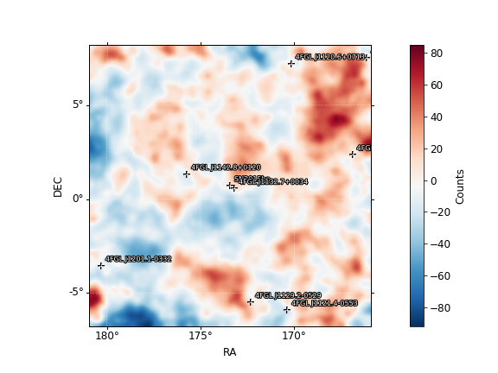
Fit results Bin 1
Deivid’s results
Pazit’s results
SN2015bn (2.68)
Prefactor 0.00887 +/- 0.00479
Index 4.65 +/- 0.199
4FGL J1132.7+0034 (46.44)
Prefactor 1.35 +/- 0.215
Index 2.33 +/- 0.149
galdiff
Prefactor 0.621 +/- 0.0155
Index 0.315 +/- 0.0155
isodiff
Norm 1.28 +/- 0.0264
SN2015bn (1.96)
Prefactor 0.00274 +/- 0.0038
Index 5 +/- 0.0027
4FGL J1132.7+0034 (48.83)
Prefactor 1.36 +/- 0.324
Index 2.34 +/- 0.363
galdiff
Prefactor 0.635 +/- 0.108
Index 0.309 +/- 0.0512
isodiff
Norm 1.26 +/- 0.148

Slide 4
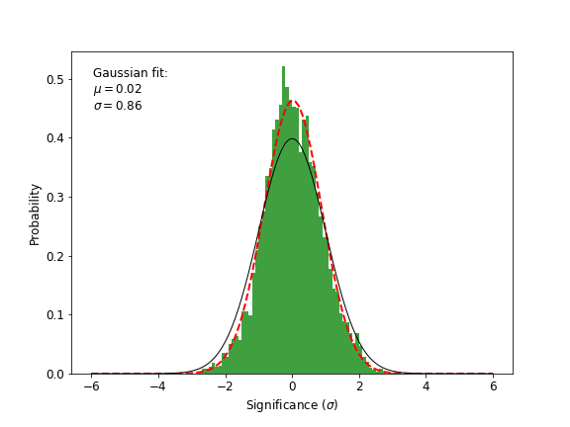
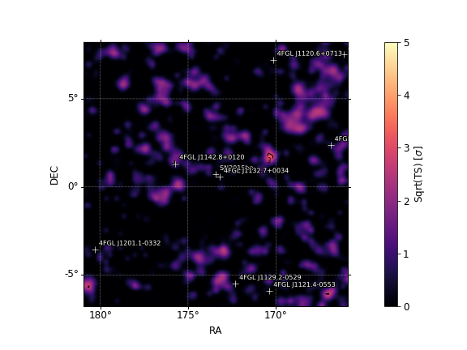
Bin 1
Pazit’s results
Deivid’s results

Slide 5
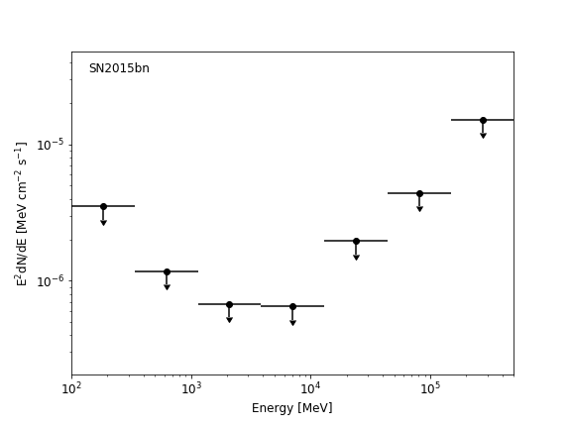
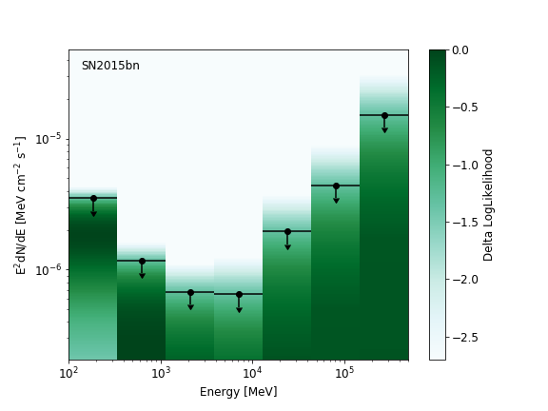
Bin 1
Pazit’s results
Deivid’s results

Slide 6
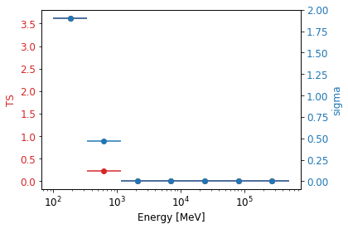
TS per energy – Bin 1
Deivid’s results
Pazit’s results

Slide 7
Bin 1
sourcename offset norm eflux index ts npred free
--------------------------------------------------------------------------------
SN2015bn 0.000 0.009 1.49e-06 4.65 2.68 123.0 *
4FGL J1132.7+0034 0.273 1.346 9.86e-06 2.33 46.44 199.5 *
4FGL J1142.8+0120 2.373 1.900 4.95e-06 2.77 28.63 76.8 *
4FGL J1129.2-0529 6.312 2.131 6.11e-06 2.64 15.96 137.4
4FGL J1107.6+0222 6.718 2.502 5.77e-06 2.17 21.91 69.9
4FGL J1120.6+0713 7.270 1.105 6.43e-06 3.54 37.95 119.6 *
4FGL J1121.4-0553 7.296 1.098 1.5e-05 3.02 107.39 305.0 *
4FGL J1201.1-0332 8.083 8.062 4.16e-06 2.07 9.37 35.9
4FGL J1058.4+0133 8.837 3.137 9.31e-05 2.33 42.63 321.8
4FGL J1147.8-0724 8.872 1.072 1.83e-05 2.73 11.03 111.6
4FGL J1130.8+1016 9.572 4.487 2.42e-05 2.81 9.17 147.8
4FGL J1104.4+0730 9.953 0.633 4.25e-06 2.34 11.37 41.3
4FGL J1114.5-0819 10.227 4.499 2.77e-05 2.82 15.59 176.9
4FGL J1152.3-0839 10.476 6.579 3.26e-05 2.38 4.63 99.5
4FGL J1204.2-0709 10.977 6.150 3.97e-05 1.93 5.17 50.1
4FGL J1229.0+0202 13.903 1.524 0.000311 3.05 27.85 313.9
isodiff --- 1.281 0.066 2.24 142.80 6920.4 *
galdiff --- 0.621 0.173 0.31 73.90 5869.7 *
Fixing parameters for 4FGL J1229.0+0202 : ['norm', 'alpha', 'beta']
Fixing parameters for 4FGL J1058.4+0133 : ['norm', 'alpha', 'beta']
sourcename offset norm eflux index ts npred free
-------------------------------------------------------------------------------
SN2015bn 0.000 0.003 9.19e-07 5.00 1.96 104.5 *
4FGL J1132.7+0034 0.273 1.364 9.99e-06 2.34 48.83 205.0 *
4FGL J1142.8+0120 2.373 0.501 9.3e-06 2.05 33.34 102.1 *
4FGL J1129.2-0529 6.312 2.131 6.11e-06 2.64 15.96 137.4
4FGL J1107.6+0222 6.718 2.502 5.77e-06 2.17 21.91 69.9
4FGL J1120.6+0713 7.270 1.099 6.39e-06 3.56 37.75 119.0 *
4FGL J1121.4-0553 7.296 1.094 1.51e-05 3.01 107.81 307.9 *
4FGL J1201.1-0332 8.083 8.062 4.16e-06 2.07 9.37 35.9
4FGL J1058.4+0133 8.837 3.137 9.31e-05 2.33 42.63 321.8
4FGL J1147.8-0724 8.872 1.072 1.83e-05 2.73 11.03 111.6
4FGL J1130.8+1016 9.572 4.487 2.42e-05 2.81 9.17 147.8
4FGL J1104.4+0730 9.953 0.633 4.25e-06 2.34 11.37 41.3
4FGL J1114.5-0819 10.227 4.499 2.77e-05 2.82 15.59 176.9
4FGL J1152.3-0839 10.476 6.579 3.26e-05 2.38 4.63 99.5
4FGL J1204.2-0709 10.977 6.150 3.97e-05 1.93 5.17 50.1
4FGL J1229.0+0202 13.903 1.524 0.000311 3.05 27.85 313.9
isodiff --- 1.261 0.0649 2.24 135.12 6810.1 *
galdiff --- 0.635 0.177 0.31 74.53 5964.7 *
Deivid’s results
Pazit’s results

Slide 8
Bin 2

Slide 9
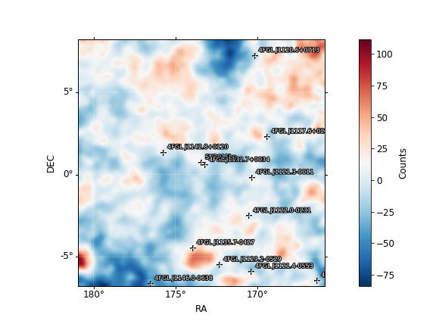
Fit results - Bin 2
Deivid’s results
Pazit’s results
SN2015bn (15.79)
Prefactor = 0.0112 +/- 0.00816
Index = 4.84 +/- 0.251
4FGL J1132.7+0034 (109.59)
Prefactor = 1.55 +/- 0.28
Index = 1.95 +/- 0.137
galdiff
Prefactor = 0.587 0.0443
Index = 0.214 0.0405
isodiff
Normalization = 1.34 0.0631
SN2015bn (10.09)
Prefactor 0.00557 +/- 0.00361
Index 5 +/- 0.167
4FGL J1132.7+0034 (108.62)
Prefactor 1.52 +/- 0.289
Index 1.94 +/- 0.142
galdiff
Prefactor 0.557 +/- 0.101
Index 0.292 +/- 0.546
isodiff
Norm 1.4 +/- 0.14

Slide 10

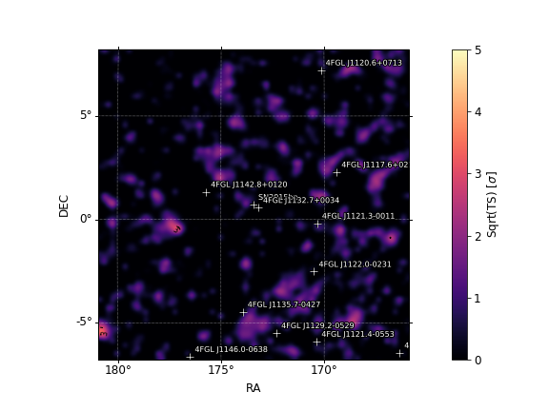
Bin 2
Deivid’s results
Pazit’s results

Slide 11
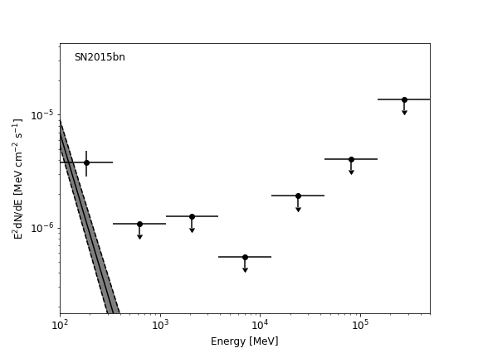
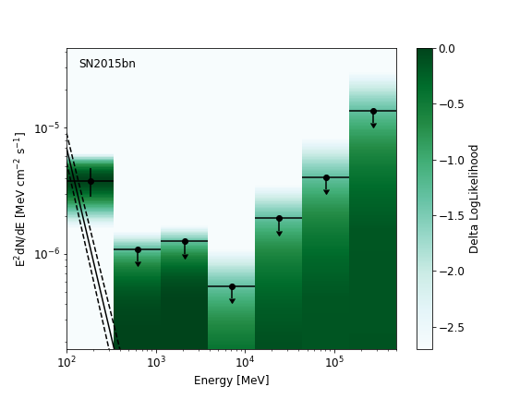
Bin 2
Pazit’s results
Deivid’s results

Slide 12
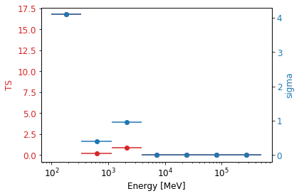
TS per energy – Bin 2
Deivid’s results
Pazit’s results

Slide 13
Bin 2 - Sources in the fit
sourcename offset norm eflux index ts npred free
--------------------------------------------------------------------------------
SN2015bn 0.000 0.011 2.73e-06 4.84 15.79 286.8 *
4FGL J1132.7+0034 0.273 1.552 1.7e-05 1.95 109.59 163.5 *
4FGL J1142.8+0120 2.373 1.254 3.61e-06 3.03 22.53 76.1 *
4FGL J1121.3-0011 3.205 0.265 7.05e-06 0.91 6.92 1.6 *
4FGL J1117.6+0217 4.309 4.934 4.06e-06 2.80 9.13 131.6 *
4FGL J1122.0-0231 4.363 3.076 3.96e-06 2.11 12.37 55.7 *
4FGL J1135.7-0427 5.215 0.883 4.29e-06 2.61 10.82 116.8
4FGL J1129.2-0529 6.312 1.678 4.81e-06 2.64 9.92 120.5
4FGL J1120.6+0713 7.270 0.759 8.48e-06 2.51 37.51 177.3 *
4FGL J1121.4-0553 7.296 0.682 1.36e-05 2.59 82.94 330.6 *
4FGL J1146.0-0638 7.979 1.096 3.7e-06 1.75 9.17 11.0
4FGL J1058.4+0133 8.837 1.104 0.000814 1.86 39.59 351.7 *
4FGL J1130.8+1016 9.572 4.726 2.55e-05 2.81 10.75 168.1
4FGL J1105.3-0626 10.068 2.813 5.94e-06 1.56 9.81 8.0
4FGL J1114.5-0819 10.227 2.799 1.72e-05 2.82 7.37 123.8
4FGL J1152.3-0839 10.476 6.565 3.25e-05 2.38 5.74 111.4
4FGL J1204.2-0709 10.977 8.456 5.46e-05 1.93 10.71 76.9
4FGL J1050.1+0432 11.513 2.955 4.5e-05 2.58 4.56 116.0
4FGL J1216.2-0600 12.575 21.389 5.66e-05 2.53 5.59 111.3
4FGL J1229.0+0202 13.903 0.141 0.000241 2.25 21.61 328.5 *
isodiff --- 1.341 0.0691 2.24 124.77 7999.1 *
galdiff --- 0.587 0.158 0.21 42.43 5369.9 *
sourcename offset norm eflux index ts npred free
--------------------------------------------------------------------------------
SN2015bn 0.000 0.006 1.85e-06 5.00 10.09 227.5 *
4FGL J1132.7+0034 0.273 1.519 1.71e-05 1.94 108.62 158.2 *
4FGL J1142.8+0120 2.373 1.202 3.22e-06 2.87 20.76 60.2 *
4FGL J1121.3-0011 3.205 0.237 7.22e-06 0.87 6.89 1.5 *
4FGL J1117.6+0217 4.309 4.500 3.11e-06 2.61 6.76 88.3 *
4FGL J1122.0-0231 4.363 3.734 4.58e-06 2.46 14.59 114.9 *
4FGL J1135.7-0427 5.215 0.883 4.29e-06 2.61 10.82 116.8
4FGL J1129.2-0529 6.312 1.678 4.81e-06 2.64 9.92 120.5
4FGL J1120.6+0713 7.270 0.916 5.91e-06 2.68 32.53 106.2 *
4FGL J1146.0-0638 7.979 1.096 3.7e-06 1.75 9.17 11.0
4FGL J1058.4+0133 8.837 0.852 0.000773 1.87 30.61 310.0 *
4FGL J1130.8+1016 9.572 4.726 2.55e-05 2.81 10.75 168.1
4FGL J1105.3-0626 10.068 2.813 5.94e-06 1.56 9.81 8.0
4FGL J1114.5-0819 10.227 2.799 1.72e-05 2.82 7.37 123.8
4FGL J1152.3-0839 10.476 6.565 3.25e-05 2.38 5.74 111.4
4FGL J1204.2-0709 10.977 8.456 5.46e-05 1.93 10.71 76.9
4FGL J1050.1+0432 11.513 2.955 4.5e-05 2.58 4.56 116.0
4FGL J1216.2-0600 12.575 21.389 5.66e-05 2.53 5.59 111.3
4FGL J1229.0+0202 13.903 0.001 1.8e-05 2.41 6.08 179.7 *
isodiff --- 1.404 0.0723 2.24 172.99 8372.7 *
galdiff --- 0.557 0.154 0.29 51.78 5644.1 *
Deivid’s results
Pazit’s results

Slide 14
Bin 3

Slide 15
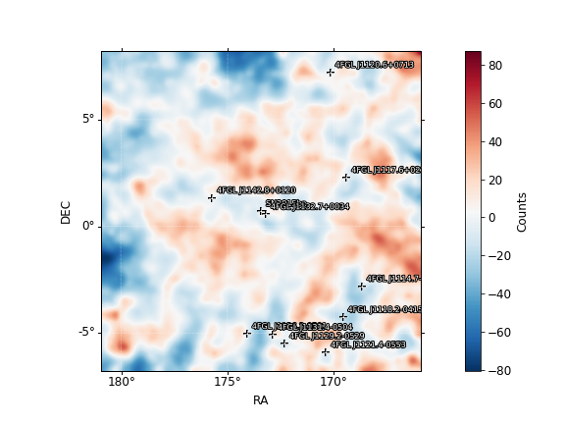
Fit Results Bin 3
Pazit’s results
Deivid’s results
SN2015bn (4.42)
Prefactor 0.447 +/- 0.57
Index 2.1 +/- 0.679
4FGL J1132.7+0034 (61.95)
Prefactor 1.94 +/- 0.527
Index 2.14 +/- 0.188
galdiff
Prefactor 0.536 +/- 0.122
Index 0.42 +/- 0.0679
isodiff
Normalization 1.39 +/- 0.163
SN2015bn (1.20)
Prefactor 0.443 +/- 0.596
Index 2.1 +/- 0.714
4FGL J1132.7+0034 (23.27)
Prefactor 1.95 +/- 0.54
Index 2.14 +/- 0.19
galdiff
Prefactor 0.535 +/- 0.107
Index 0.421 +/- 0.057
isodiff
Norm 1.39 +/- 0.151

Slide 16
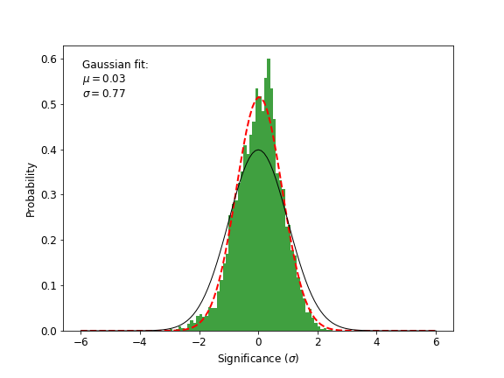
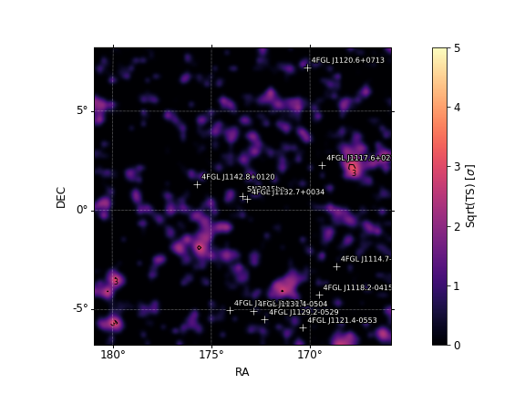
Bin 3
Deivid’s results
Pazit’s results

Slide 17
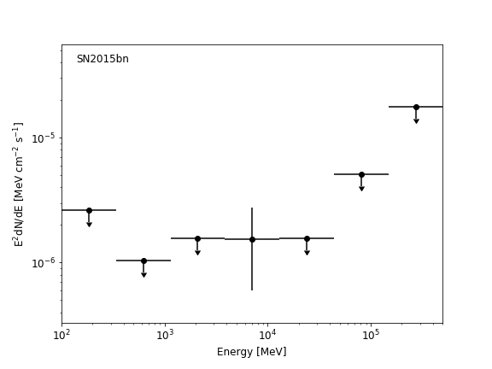
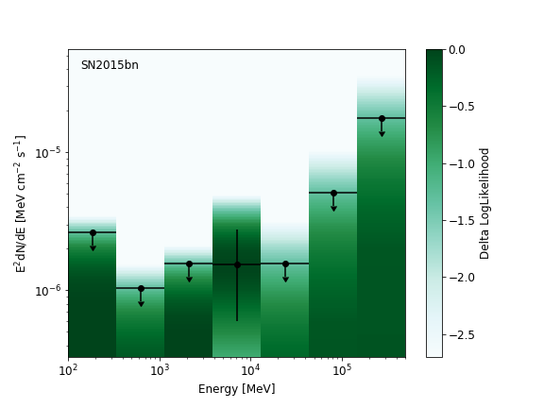
Bin 3
Deivid’s results
Pazit’s results

Slide 18
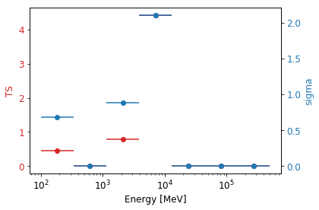
TS per energy – Bin 3
Deivid’s results
Pazit’s results

Slide 19
Bin 3
Deivid’s results
Pazit’s results
sourcename offset norm eflux index ts npred free
--------------------------------------------------------------------------------
SN2015bn 0.000 0.575 4.9e-06 2.00 4.42 41.5 *
4FGL J1132.7+0034 0.273 1.771 1.3e-05 2.33 61.95 222.1 *
4FGL J1142.8+0120 2.373 0.503 1.35e-06 2.38 4.65 12.5 *
4FGL J1117.6+0217 4.309 6.239 4.13e-06 2.54 10.68 86.0 *
4FGL J1136.3-0501 5.792 3.743 3.95e-06 2.51 7.59 71.2
4FGL J1131.4-0504 5.825 1.181 2.67e-06 4.50 8.66 45.8
4FGL J1114.7-0248 5.899 3.710 3.21e-06 2.87 4.59 77.9
4FGL J1118.2-0415 6.292 1.365 3.32e-06 2.64 5.33 68.7
4FGL J1129.2-0529 6.312 3.339 1.17e-05 2.92 50.09 261.6 *
4FGL J1120.6+0713 7.270 0.401 1.83e-06 2.52 4.18 17.9
4FGL J1121.4-0553 7.296 0.378 4.9e-06 2.73 9.51 73.7
4FGL J1058.4+0133 8.837 0.122 0.000141 2.23 31.15 259.9 *
4FGL J1147.8-0724 8.872 0.712 1.21e-05 2.73 4.33 63.1
4FGL J1130.8+1016 9.572 4.217 2.27e-05 2.81 6.80 117.4
4FGL J1050.1+0432 11.513 3.732 5.68e-05 2.58 5.58 115.9
4FGL J1229.0+0202 13.903 1.106 0.000226 3.05 12.11 192.1
isodiff --- 2.240 0.115 2.24 23586.96 10275.3 *
galdiff --- 0.100 0.0268 0.00 -2.16 547.5 *
No changes beyond distance (fix >5deg) and TS (fix <25).
sourcename offset norm eflux index ts npred free
--------------------------------------------------------------------------------
SN2015bn 0.000 0.443 3.2e-06 2.10 1.20 35.2 *
4FGL J1132.7+0034 0.273 1.945 1.58e-05 2.14 2 3.27 191.7 *
4FGL J1142.8+0120 2.373 0.793 2.08e-06 2.46 8.53 20.9 *
4FGL J1117.6+0217 4.309 4.409 3.04e-06 2.16 8.03 37.2 *
4FGL J1136.3-0501 5.792 3.743 3.95e-06 2.51 7.59 71.2
4FGL J1131.4-0504 5.825 1.181 2.67e-06 4.50 8.66 45.8
4FGL J1114.7-0248 5.899 3.710 3.21e-06 2.87 4.59 77.9
4FGL J1118.2-0415 6.292 1.365 3.32e-06 2.64 5.33 68.7
4FGL J1129.2-0529 6.312 3.583 1.03e-05 2.64 38.18 195.9 *
4FGL J1120.6+0713 7.270 0.401 1.83e-06 2.52 4.18 17.9
4FGL J1121.4-0553 7.296 0.378 4.9e-06 2.73 9.51 73.7
4FGL J1058.4+0133 8.837 2.422 0.00697 1.53 30.24 270.0 *
4FGL J1147.8-0724 8.872 0.712 1.21e-05 2.73 4.33 63.1 4
FGL J1130.8+1016 9.572 4.217 2.27e-05 2.81 6.80 117.4
4FGL J1050.1+0432 11.513 3.732 5.68e-05 2.58 5.58 115.9
4FGL J1229.0+0202 13.903 1.106 0.000226 3.05 12.11 192.1
Isodiff --- 1.393 0.0718 2.24 233.96 6390.6 *
galdiff --- 0.535 0.158 0.42 94.52 4969.8 *

Slide 20
Bin 4

Slide 21
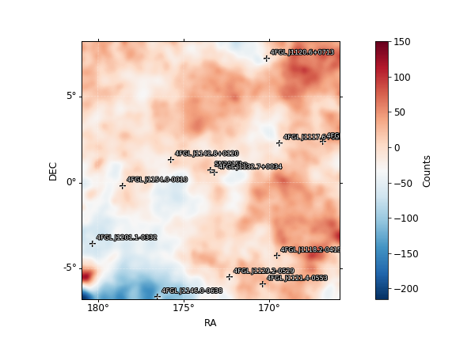
Fit Results Bin 4
Pazit’s results
Deivid’s results
SN2015bn (2.25)
Prefactor 0.377 +/- 0.423
Index 2.79 +/- 0.649
4FGL J1132.7+0034 (42.61)
Prefactor 1.39 +/- 0.367
Index 2.02 +/- 0.164
galdiff
Prefactor 0.55 +/- 0.0312
Index 0.336 +/- 0.031
isodiff
Norm 1.4 +/- 0.0485
SN2015bn (2.25)
Prefactor 0.377 +/- 0.423
Index 2.79 +/- 0.649
4FGL J1132.7+0034 (42.61)
Prefactor 1.39 +/- 0.367
Index 2.02 +/- 0.164
galdiff
Prefactor 0.55 +/- 0.0312
Index 0.336 +/- 0.031
Isodiff
Normalization 1.4 +/- 0.0485

Slide 22
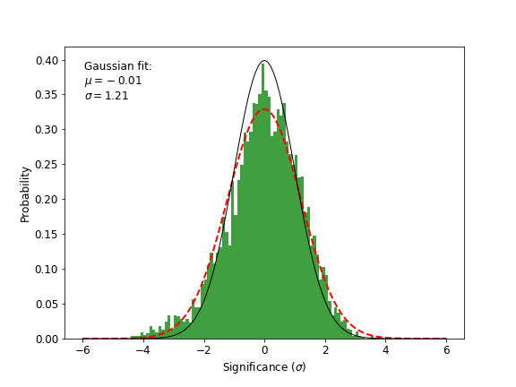
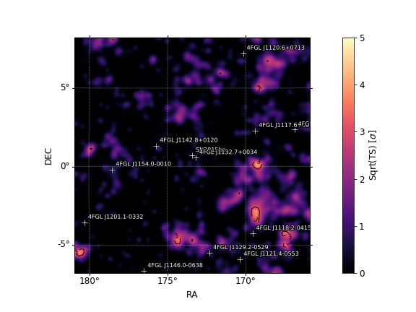
Bin 4
Pazit’s results
Deivid’s results

Slide 23
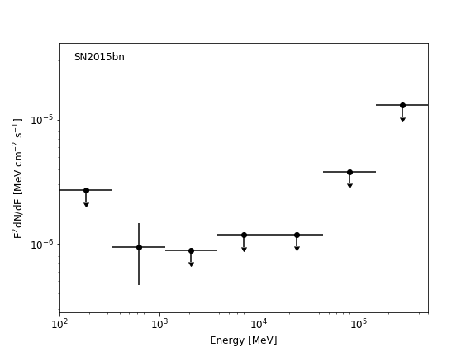
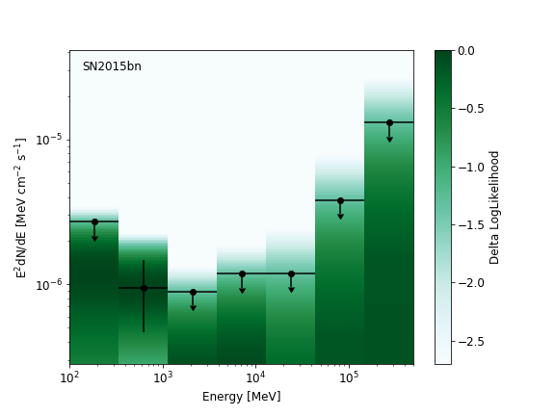
Bin 4
Deivid’s results
Pazit’s results

Slide 24
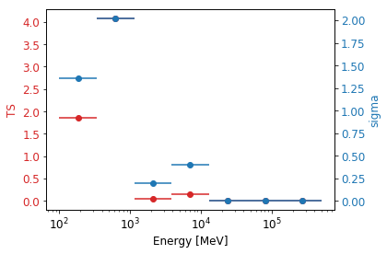
TS per energy – Bin 4
Deivid’s results
Pazit’s results

Slide 25
Bin 4
name SpatialModel SpectrumType offset ts npred
--------------------------------------------------------------------------------
SN2015bn 0.000 0.377 2.95e-06 2.79 2.25 108.1 *
4FGL J1132.7+0034 0.273 1.390 1.33e-05 2.02 42.61 164.0 *
4FGL J1142.8+0120 2.373 0.842 2.26e-06 2.39 11.13 28.7 *
4FGL J1117.6+0217 4.309 3.500 4.7e-06 3.18 11.64 194.9 *
4FGL J1154.0-0010 5.167 1.797 3.91e-06 1.78 4.81 20.2
4FGL J1118.2-0415 6.292 1.384 3.37e-06 2.64 10.32 95.9
4FGL J1129.2-0529 6.312 3.997 1.13e-05 2.61 66.31 291.7 *
4FGL J1107.6+0222 6.718 1.258 2.9e-06 2.17 8.21 40.3
4FGL J1120.6+0713 7.270 0.906 7.54e-06 2.49 45.86 145.8 *
4FGL J1121.4-0553 7.296 0.397 5.15e-06 2.73 22.44 105.7
4FGL J1146.0-0638 7.979 0.917 3.1e-06 1.75 5.88 9.6
4FGL J1201.1-0332 8.083 5.551 2.87e-06 2.07 5.56 28.6
4FGL J1058.4+0133 8.837 1.541 4.57e-05 2.33 12.38 181.6
4FGL J1147.8-0724 8.872 0.693 1.18e-05 2.73 5.26 83.6
4FGL J1130.8+1016 9.572 5.367 2.89e-05 2.81 14.20 202.7
4FGL J1207.2-0524 10.390 47.252 5.21e-05 2.01 9.78 109.6
4FGL J1152.3-0839 10.476 13.281 6.58e-05 2.38 21.89 233.8
4FGL J1204.2-0709 10.977 12.015 7.76e-05 1.93 16.57 113.1
4FGL J1216.2-0600 12.575 25.859 6.84e-05 2.53 7.40 139.4
4FGL J1229.0+0202 13.903 0.264 6.37e-05 2.87 6.58 195.7 *
isodiff --- 1.404 0.0723 2.24 205.77 8772.3 *
galdiff --- 0.550 0.155 0.34 64.27 6202.4 *
Pazit’s results
Deivid’s results
sourcename offset norm eflux index ts npred free
--------------------------------------------------------------------------------
SN2015bn 0.000 0.377 2.95e-06 2.79 2.25 108.1 *
4FGL J1132.7+0034 0.273 1.390 1.33e-05 2.02 42.61 164.0 *
4FGL J1142.8+0120 2.373 0.842 2.26e-06 2.39 11.13 28.7 *
4FGL J1117.6+0217 4.309 3.500 4.7e-06 3.18 11.64 194.9 *
4FGL J1154.0-0010 5.167 1.797 3.91e-06 1.78 4.81 20.2
4FGL J1118.2-0415 6.292 1.384 3.37e-06 2.64 10.32 95.9
4FGL J1129.2-0529 6.312 3.997 1.13e-05 2.61 66.31 291.7 *
4FGL J1107.6+0222 6.718 1.258 2.9e-06 2.17 8.21 40.3
4FGL J1120.6+0713 7.270 0.906 7.54e-06 2.49 45.86 145.8 *
4FGL J1121.4-0553 7.296 0.397 5.15e-06 2.73 22.44 105.7
4FGL J1146.0-0638 7.979 0.917 3.1e-06 1.75 5.88 9.6
4FGL J1201.1-0332 8.083 5.551 2.87e-06 2.07 5.56 28.6
4FGL J1058.4+0133 8.837 1.541 4.57e-05 2.33 12.38 181.6
4FGL J1147.8-0724 8.872 0.693 1.18e-05 2.73 5.26 83.6
4FGL J1130.8+1016 9.572 5.367 2.89e-05 2.81 14.20 202.7
4FGL J1207.2-0524 10.390 47.252 5.21e-05 2.01 9.78 109.6
4FGL J1152.3-0839 10.476 13.281 6.58e-05 2.38 21.89 233.8
4FGL J1204.2-0709 10.977 12.015 7.76e-05 1.93 16.57 113.1
4FGL J1216.2-0600 12.575 25.859 6.84e-05 2.53 7.40 139.4
4FGL J1229.0+0202 13.903 0.264 6.37e-05 2.87 6.58 195.7 *
isodiff --- 1.404 0.0723 2.24 205.77 8772.3 *
galdiff --- 0.550 0.155 0.34 64.27 6202.4 *

Slide 26
Bin 5

Slide 27
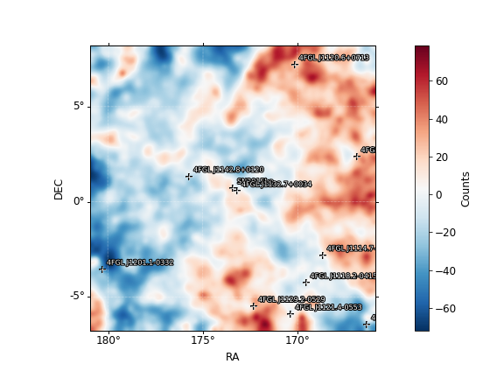
Fit Results Bin 5
Deivid’s results
Pazit’s results
SN2015bn (0.45)
Prefactor 0.00103 +/- 0.00477
Index 4.95 +/- 0.409
4FGL J1132.7+0034 (86.21)
Prefactor 1.43 +/- 0.41
Index 1.86 +/- 0.194
galdiff
Prefactor 0.1 +/- 0.00796
Index 0.911 +/- 0.0608
isodiff
Normalization 1.99 +/- 0.0406
SN2015bn (1.56)
Prefactor 0.00286 +/- 0.0181
Index 4.93 +/- 2.12
4FGL J1132.7+0034 (110.40)
Prefactor 1.52 +/- 0.333
Index 1.8 +/- 0.136
galdiff
Prefactor 0.387 +/- 0.0991
Index 0.484 +/- 0.07
isodiff
Norm 1.58 +/- 0.141

Slide 28
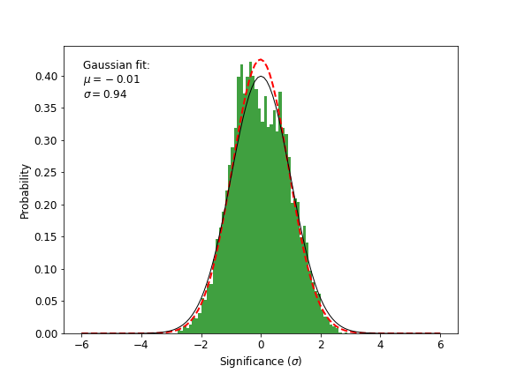
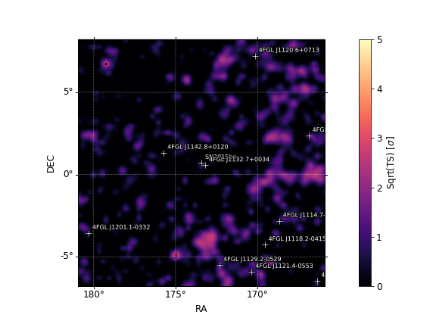
Bin 5
Deivid’s results
Pazit’s results

Slide 29
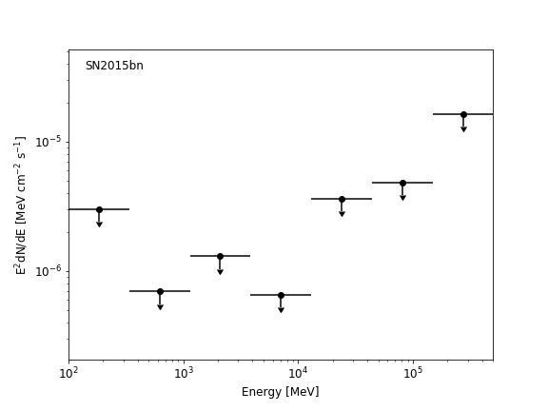
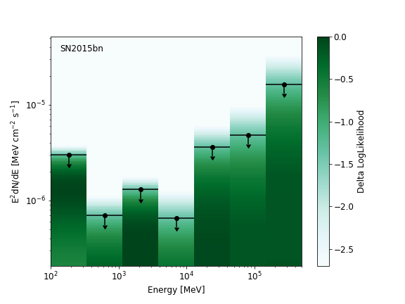
Bin 5
Deivid’s results
Pazit’s results

Slide 30
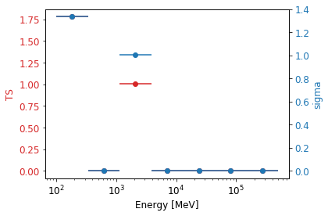
TS per energy Bin 5
Deivid’s results
Pazit’s results

Slide 31
Bin 5
Deivid’s results
Pazit’s results
sourcename offset norm eflux index ts npred free
--------------------------------------------------------------------------------
SN2015bn 0.000 0.001 3.14e-07 4.95 0.45 31.0 *
4FGL J1132.7+0034 0.273 1.433 1.98e-05 1.86 86.21 116.2 *
4FGL J1142.8+0120 2.373 1.450 5.02e-06 1.97 37.90 33.1 *
4FGL J1114.7-0248 5.899 3.653 3.16e-06 2.87 5.04 83.3
4FGL J1118.2-0415 6.292 3.979 9.99e-06 2.71 45.44 233.9 *
4FGL J1129.2-0529 6.312 2.348 6.73e-06 2.64 19.65 137.4
4FGL J1107.6+0222 6.718 1.644 3.79e-06 2.17 16.70 42.8
4FGL J1120.6+0713 7.270 0.685 3.12e-06 2.52 10.39 33.3
4FGL J1121.4-0553 7.296 0.385 6.38e-06 2.46 19.90 101.1
4FGL J1201.1-0332 8.083 4.416 2.28e-06 2.07 5.13 17.6
4FGL J1147.8-0724 8.872 0.844 1.44e-05 2.73 6.31 79.2
4FGL J1130.8+1016 9.572 9.462 5.1e-05 2.81 36.59 289.6
4FGL J1105.3-0626 10.068 2.329 4.91e-06 1.56 6.40 5.5
4FGL J1152.3-0839 10.476 6.561 3.25e-05 2.38 4.31 88.5
4FGL J1229.0+0202 13.903 1.641 0.000335 3.05 27.87 301.1
isodiff --- 1.985 0.102 2.24 2247.44 9841.4 *
galdiff --- 0.100 0.0469 0.91 60.49 2220.3 *
Fixing parameters for 4FGL J1229.0+0202 : ['norm', 'alpha', 'beta']
Fixing parameters for 4FGL J1130.8+1016 : ['Prefactor', 'Index']
sourcename offset norm eflux index ts npred free
--------------------------------------------------------------------------------
SN2015bn 0.000 0.003 8.37e-07 4.93 1.56 83.8 *
4FGL J1132.7+0034 0.273 1.521 2.49e-05 1.80 110.40 122.6 *
4FGL J1142.8+0120 2.373 1.519 4.61e-06 2.15 35.79 37.6 *
4FGL J1117.6+0217 4.309 4.855 3.05e-06 2.38 6.62 59.7 *
4FGL J1114.7-0248 5.899 3.680 3.18e-06 2.87 5.17 86.3
4FGL J1118.2-0415 6.292 4.233 1.04e-05 2.68 51.59 245.0 *
4FGL J1129.2-0529 6.312 2.199 6.3e-06 2.64 17.87 132.3
4FGL J1107.6+0222 6.718 1.542 3.56e-06 2.17 15.90 41.5
4FGL J1120.6+0713 7.270 0.795 3.63e-06 2.52 13.22 40.2
4FGL J1121.4-0553 7.296 0.376 6.85e-06 2.46 20.12 117.9
4FGL J1146.0-0638 7.979 0.917 3.1e-06 1.75 4.05 7.7
4FGL J1201.1-0332 8.083 4.312 2.23e-06 2.07 5.00 17.7
4FGL J1147.8-0724 8.872 0.712 1.21e-05 2.73 4.69 69.0
4FGL J1130.8+1016 9.572 9.434 5.08e-05 2.81 38.07 301.0
4FGL J1105.3-0626 10.068 2.252 4.75e-06 1.56 6.26 5.5
4FGL J1229.0+0202 13.903 1.493 0.000305 3.05 24.09 284.6
isodiff --- 1.578 0.0813 2.24 452.94 8092.4 *
galdiff --- 0.387 0.119 0.48 82.01 4411.3 *

Slide 32
Bin 6

Slide 33
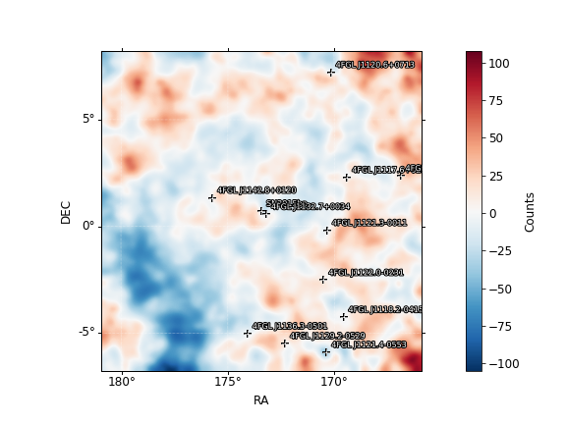
Fit Results Bin 6
Pazit’s results
Deivid’s results
SN2015bn (4.18)
Prefactor 0.553 +/- 0.412
Index 2.62 +/- 0.558
4FGL J1132.7+0034 (42.91)
Prefactor 1.16 +/- 0.394
Index 1.93 +/- 0.212
galdiff
Prefactor 0.502 +/- 0.096
Index 0.315 +/- 0.0467
Isodiff
Normalization 1.42 +/- 0.134
SN2015bn (5.66)
Prefactor 0.611 +/- 0.395
Index 2.71 +/- 0.415
4FGL J1132.7+0034 (43.79)
Prefactor 1.17 +/- 0.407
Index 1.95 +/- 0.22
galdiff
Prefactor 0.562 +/- 0.0941
Index 0.118 +/- 0.0383
isodiff
Norm 1.35 +/- 0.133

Slide 34
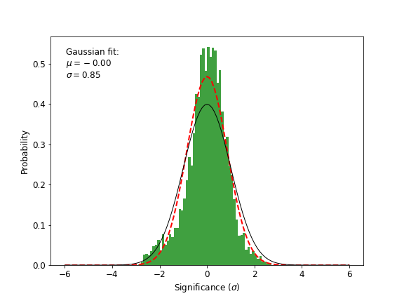
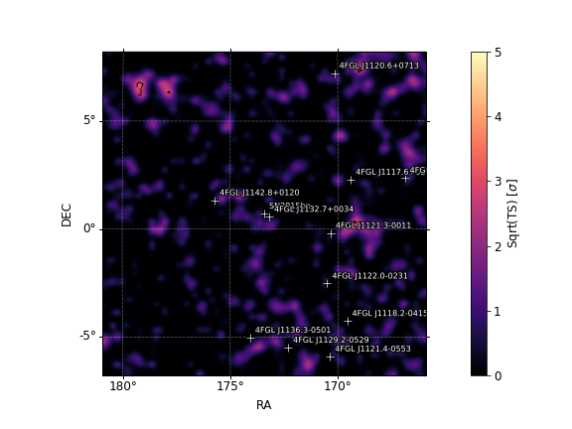
Bin 6
Pazit’s results
Deivid’s results

Slide 35
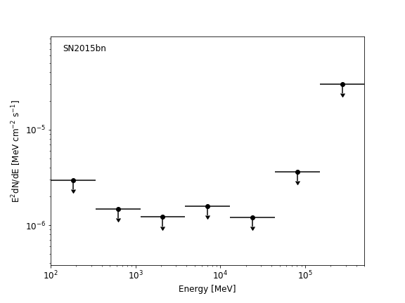
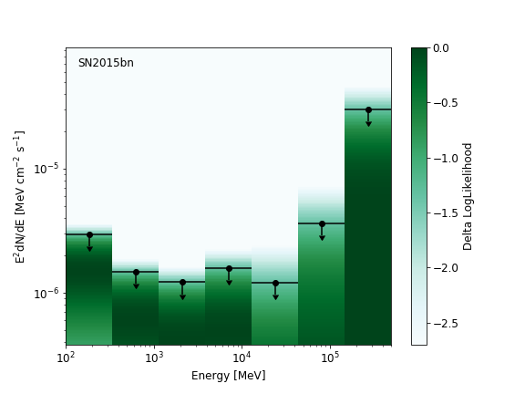
Bin 6
Deivid’s results
Pazit’s results

Slide 36
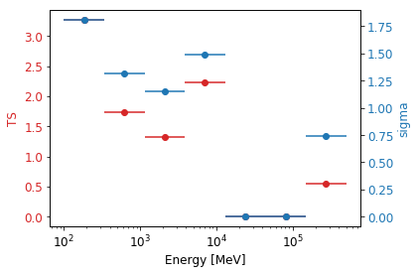
TS per energy – Bin 6
Deivid’s results
Pazit’s results

Slide 37
Bin 6
Pazit’s results
Deivid’s results
sourcename offset norm eflux index ts npred free
--------------------------------------------------------------------------------
SN2015bn 0.000 0.553 3.71e-06 2.62 4.18 127.3 *
4FGL J1132.7+0034 0.273 1.162 1.34e-05 1.93 42.91 132.8 *
4FGL J1142.8+0120 2.373 0.304 3.91e-06 2.13 17.48 69.3 *
4FGL J1121.3-0011 3.205 3.050 3.48e-06 2.18 11.61 64.9 *
4FGL J1117.6+0217 4.309 3.773 3.39e-06 2.88 6.87 129.5 *
4FGL J1122.0-0231 4.363 2.728 3.3e-06 2.44 9.62 93.0
4FGL J1136.3-0501 5.792 2.478 2.61e-06 2.51 4.91 72.7
4FGL J1118.2-0415 6.292 1.220 2.97e-06 2.64 4.97 94.1
4FGL J1129.2-0529 6.312 1.976 5.66e-06 2.64 19.74 166.5
4FGL J1107.6+0222 6.718 1.997 4.61e-06 2.17 16.37 67.4
4FGL J1120.6+0713 7.270 1.077 5.56e-06 2.65 41.90 91.2 *
4FGL J1121.4-0553 7.296 1.502 1.81e-05 3.32 215.71 472.6 *
4FGL J1058.4+0133 8.837 2.015 5.98e-05 2.33 23.73 251.3
4FGL J1147.8-0724 8.872 0.715 1.22e-05 2.73 6.36 95.9
4FGL J1130.8+1016 9.572 5.474 2.95e-05 2.81 14.82 199.6
4FGL J1114.5-0819 10.227 2.494 1.54e-05 2.82 6.63 130.7
4FGL J1152.3-0839 10.476 7.675 3.8e-05 2.38 9.15 152.2
4FGL J1216.2-0600 12.575 22.402 5.93e-05 2.53 7.12 134.3
4FGL J1229.0+0202 13.903 1.826 0.000373 3.05 48.50 451.6
isodiff --- 1.416 0.0729 2.24 222.36 9356.9 *
galdiff --- 0.502 0.14 0.32 61.14 5829.5 *
Fixing parameters for 4FGL J1229.0+0202 and 4FGL J1122.0-0231
sourcename offset norm eflux Index ts npred free
--------------------------------------------------------------------------------
SN2015bn 0.000 0.611 4.41e-06 2.71 5.66 162.5 *
4FGL J1132.7+0034 0.273 1.172 1.3e-05 1.95 43.79 135.8 *
4FGL J1142.8+0120 2.373 0.339 3.53e-06 2.07 17.21 55.5 *
4FGL J1121.3-0011. 3.205 1.899 4.76e-06 2.71 15.17 171.2 *
4FGL J1117.6+0217 4.309 3.938 5.07e-06 3.15 14.84 221.2 *
4FGL J1122.0-0231 4.363 2.728 3.3e-06 2.44 9.62 93.0
4FGL J1136.3-0501 5.792 2.478 2.61e-06 2.51 4.91 72.7
4FGL J1118.2-0415 6.292 1.220 2.97e-06 2.64 4.97 94.1
4FGL J1129.2-0529 6.312 1.976 5.66e-06 2.64 19.74 166.5
4FGL J1107.6+0222 6.718 1.997 4.61e-06 2.17 16.37 67.4
4FGL J1120.6+0713. 7.270 0.813 9.59e-06 2.46 48.73 208.3 *
4FGL J1121.4-0553 7.296 1.423 2.19e-05 3.05 260.88 626.4. *
4FGL J1058.4+0133 8.837 2.015 5.98e-05 2.33 23.73 251.3
4FGL J1147.8-0724 8.872 0.715 1.22e-05 2.73 6.36 95.9
4FGL J1130.8+1016 9.572 5.474 2.95e-05 2.81 14.82 199.6
4FGL J1114.5-0819 10.227 2.494 1.54e-05 2.82 6.63 130.7
4FGL J1152.3-0839 10.476 7.675 3.8e-05 2.38 9.15 152.2
4FGL J1216.2-0600 12.575 22.402 5.93e-05 2.53 7.12 134.3
4FGL J1229.0+0202 13.903 1.826 0.000373 3.05 48.50 451.6
isodiff --- 1.348 0.0694 2.24 122.64 8906.7 *
Galdiff --- 0.562 0.149 0.12 38.34 5069.0. *

Slide 38
All 3yrs

Slide 39
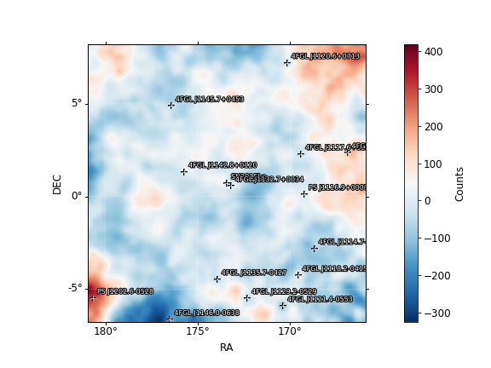
Fit Results 3yrs
Deivid’s results
Pazit’s results
SN2015bn (22.64)
Prefactor 0.302 +/- 0.273
Index 3.12 +/- 0.459
4FGL J1132.7+0034 (335.42)
Prefactor 1.39 +/- 0.223
Index 1.97 +/- 0.0837
galdiff
Prefactor 0.712 +/- 0.0415
Index 0.252 +/- 0.0159
Isodiff
Normalization 1.17 +/- 0.0576
SN2015bn ()
Prefactor 0.3 +/- 0.26
Index 3.07 +/- 0.451
4FGL J1132.7+0034 ()
Prefactor 1.42 +/- 0.216
Index 1.97 +/- 0.081
galdiff
Prefactor 0.766 +/- 0.0408
Index 0.231 +/- 0.015
isodiff
Norm 1.13 +/- 0.0569

Slide 40
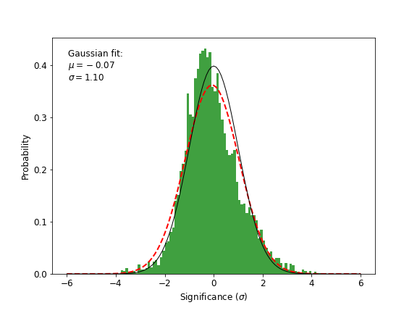
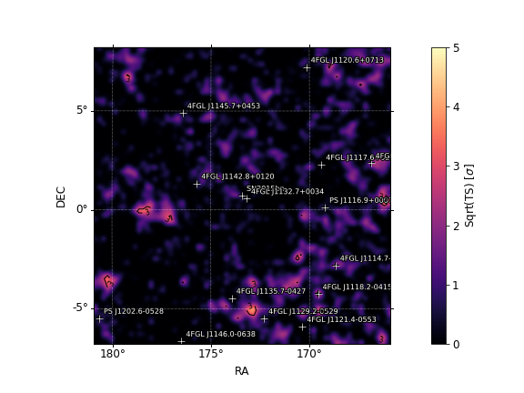
3yrs
Deivid’s results
Pazit’s results

Slide 41
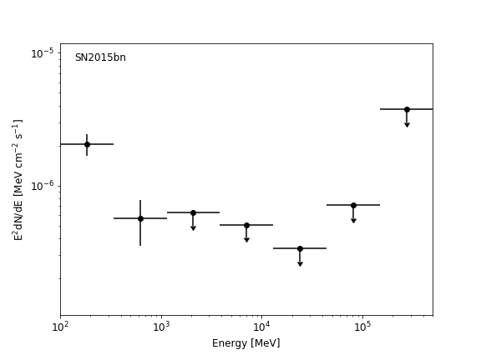
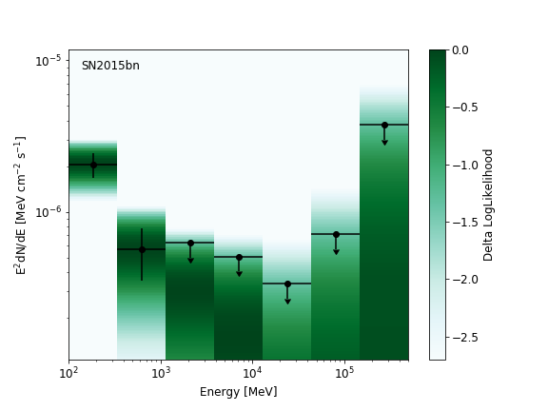
3yrs
Pazit’s results
Deivid’s results

Slide 42
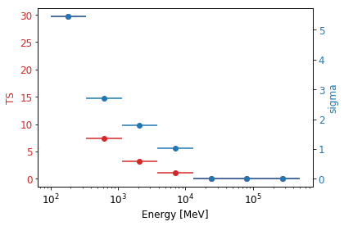
TS per energy – 3yrs
Deivid’s results
Pazit’s results

Slide 43
3yrs
Deivid’s results
Pazit’s results
sourcename offset norm eflux index ts npred free
--------------------------------------------------------------------------------
SN2015bn 0.000 0.300 3.28e-06 3.07 18.59 755.4 *
4FGL J1132.7+0034 0.273 1.418 1.51e-05 1.97 342.51 860.6 *
4FGL J1142.8+0120 2.373 0.495 4.06e-06 2.15 119.26 352.2 *
4FGL J1117.6+0217 4.309 3.525 3e-06 2.83 31.21 569.9 *
4FGL J1145.7+0453 5.140 0.133 1.49e-06 5.00 51.16 869.0
4FGL J1135.7-0427 5.215 0.201 3.37e-06 3.62 48.38 860.1
4FGL J1114.7-0248 5.899 0.242 1.51e-06 5.00 45.20 841.3
4FGL J1118.2-0415 6.292 0.046 2.17e-06 4.99 86.53 1152.5
4FGL J1129.2-0529 6.312 2.592 7.16e-06 2.51 146.09 925.4 *
4FGL J1107.6+0222 6.718 0.888 5.28e-06 1.66 56.63 85.7
4FGL J1120.6+0713 7.270 0.646 6.8e-06 2.51 142.08 793.4 *
4FGL J1121.4-0553 7.296 0.712 9.23e-06 2.73 319.35 1038.1 *
4FGL J1146.0-0638 7.979 0.565 1.91e-06 1.75 20.32 32.3
4FGL J1059.4+0226 8.721 20.218 3.2e-05 2.41 95.48 1131.9
4FGL J1147.8-0724 8.872 0.619 1.05e-05 2.73 23.84 409.1
4FGL J1130.8+1016 9.572 3.783 2.04e-05 2.81 29.02 765.9 *
4FGL J1114.5-0819 10.227 2.608 1.61e-05 2.82 35.38 658.4
4FGL J1152.3-0839 10.476 0.006 1.21e-06 4.99 21.34 519.4
4FGL J1050.1+0432 11.513 2.789 4.25e-05 2.58 23.21 628.9
4FGL J1229.0+0202 13.903 1.485 0.000303 3.05 118.52 1909.9 *
isodiff --- 1.125 0.058 2.24 545.89 38187.8 *
galdiff --- 0.766 0.207 0.23 457.21 40773.9 *
sourcename offset norm eflux index ts npred free
--------------------------------------------------------------------------------
SN2015bn 0.000 0.302 3.55e-06 3.12 22.64 835.2 *
4FGL J1132.7+0034 0.273 1.393 1.47e-05 1.97 335.42 845.5 *
4FGL J1142.8+0120 2.373 0.546 4.01e-06 2.14 123.46 326.0 *
PS J1116.9+0007 4.229 3.135 2.8e-06 1.98 34.98 157.8 *
4FGL J1117.6+0217 4.309 3.536 2.7e-06 2.73 27.63 480.3 *
4FGL J1145.7+0453 5.140 0.135 1.51e-06 5.00 52.20 878.0
4FGL J1135.7-0427 5.215 0.658 3.19e-06 2.61 29.39 494.4
4FGL J1114.7-0248 5.899 0.229 1.43e-06 5.00 40.28 792.9
4FGL J1118.2-0415 6.292 0.045 2.15e-06 5.00 85.09 1150.1
4FGL J1129.2-0529 6.312 2.644 7.73e-06 2.68 165.85 1135.3 *
4FGL J1107.6+0222 6.718 0.909 5.29e-06 1.67 57.28 87.7
4FGL J1120.6+0713 7.270 0.819 5.46e-06 2.64 151.76 553.9 *
4FGL J1121.4-0553 7.296 0.712 9.24e-06 2.73 319.73 1034.1 *
4FGL J1146.0-0638 7.979 0.498 1.68e-06 1.75 17.23 28.3
4FGL J1059.4+0226 8.721 20.573 3.25e-05 2.41 98.20 1146.1
4FGL J1147.8-0724 8.872 0.635 1.08e-05 2.73 24.95 417.9
PS J1202.6-0528 9.533 0.679 5.78e-06 2.00 61.26 209.5 *
4FGL J1130.8+1016 9.572 0.075 2.09e-06 5.00 60.25 1030.0 *
4FGL J1114.5-0819 10.227 2.537 1.56e-05 2.82 33.42 638.4
4FGL J1152.3-0839 10.476 6.540 3.24e-05 2.38 30.08 626.7
4FGL J1050.1+0432 11.513 2.825 4.3e-05 2.58 23.65 633.4
4FGL J1229.0+0202 13.903 1.423 0.00029 3.05 107.12 1819.9 *
isodiff --- 1.172 0.0604 2.24 623.44 39578.3 *
galdiff --- 0.712 0.194 0.25 413.11 38722.3 *

