Slide 1
Week 0 Update: Bayesian Blocks
By Adam Oppenheimer

Slide 2

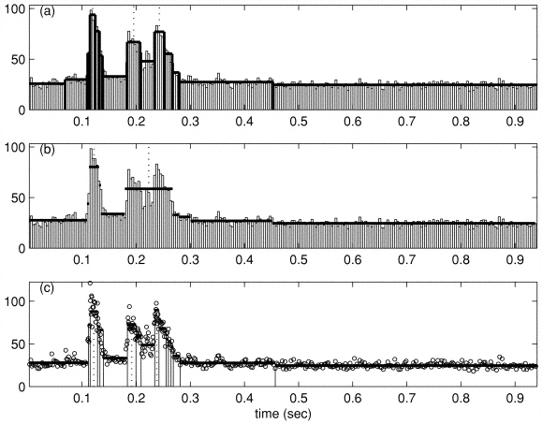
What are Bayesian Blocks?
Bayesian Blocks are used to deconstruct a given time signal into a piecewise function consisting of constant rates
Raw time series data can be inputted into a Bayesian Blocks algorithm to construct these blocks. Each block can be written as a Poisson distribution with a constant rate.
This indicates that each marked time interval will have a constant rate of measured photons
This method works on three very common forms of time series data:
Time-Tagged Event
Binned
Time-to-Spill

Slide 3

How does it work?
This method uses Bayes’s theorem: $P\left(M | D\right)=\frac{P(D|M)∗P(M)}{P(D)}$
By determining a few initial probabilities, the likelihood that the given data is returned assuming that a certain model was used can be determined. This is the global likelihood, called L.
If you were to determine the L values for multiple different models, their ratio can be used to determine which model is more likely to map the data. (This is called the Bayes Factor)
For Bayesian Blocks, the models used are a single rate Poisson distribution or a segmented one which includes multiple different constant rates
After calculating the L values for each possible models, the model with the largest L value will be used
This process can be done to find multiple change-points all at once or in an iterative manner

Slide 4
Why is it important?
Bayesian Blocks allow for a simplification of the data
It can minimize the effects of natural variation and fluctuations in the received signal in order to focus in on flares
They make it easier to analyze since the data is converted into a series of rates as opposed to many series of photon time and amounts
While it was designed with astrophysics in mind, it can be used in many fields that require signal processing, such as acoustics/musical theory and particle physics

Slide 5
Bibliography
Scargle, Jeffrey D. “Studies in Astronomical Time Series Analysis. V. Bayesian Blocks, a New Method to Analyze Structure in Photon Counting Data.” The Astrophysical Journal, vol. 504, no. 1, 1 Sept. 1998, pp. 405–418., doi:10.1086/306064.

