Slide 1
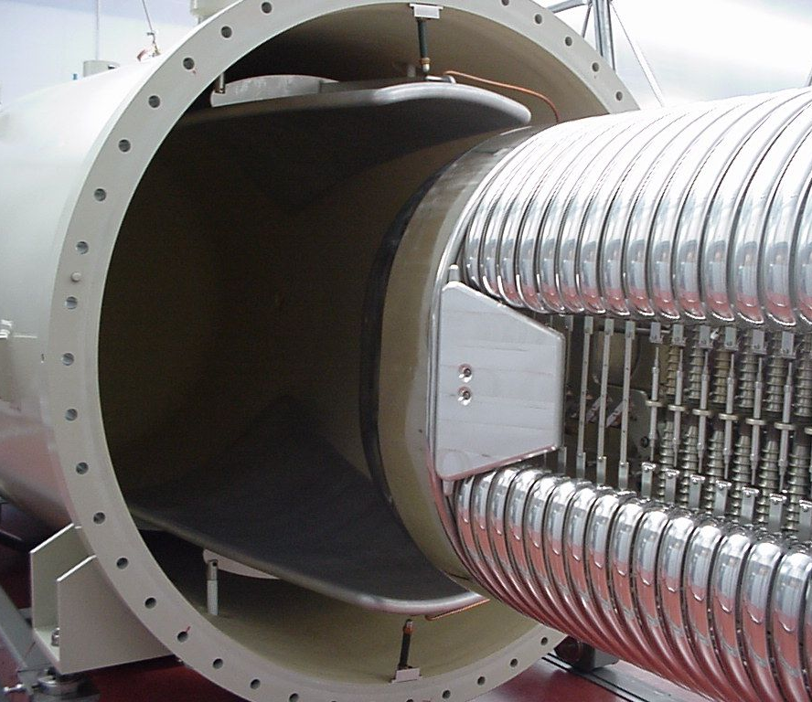
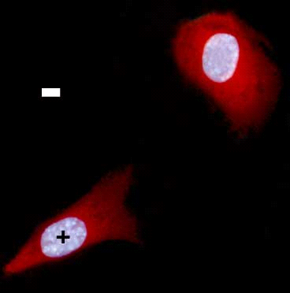
An overview of RARAF: From broad beams to microbeams, single proteins to small animals, where we have been to where we are going.
Andrew Harken
March 28, 2013

Slide 2
An overview of RARAF
History of RARAF
Broad beams
Microbeams
Imaging
Microfluidics
Where we are going

Slide 3
The Radiological Research Accelerator Facility
Columbia University in the City of New York
College of Physicians and Surgeons (P&S)
Columbia University Medical Center (CUMC)
Columbia College
New York Presbyterian Hospital
Department of
Radiation Oncology
Astronomy and Astrophysics
Physics
Center for Radiological Research
(CRR)
RARAF

Slide 4
The Radiological Research Accelerator Facility
Who are we?
We are a Biomedical Technology Resource Center (P41 BTRC) under the National Institute of Biomedical Imaging and Bioengineering (NIBIB) through the National Institute of Health (NIH)
What do we do?
RARAF is a multidisciplinary facility designed for the delivery of known quantities of radiation to target samples with micrometer precision using a single-cell/single-particle microbeam irradiator.

Slide 5
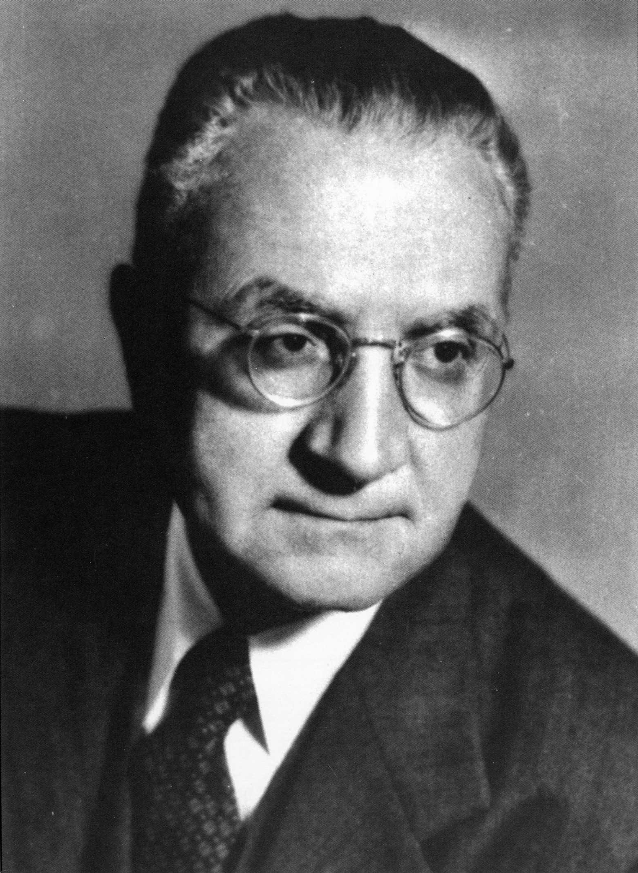
The Center for Radiological Research
Founded 1915 to study applications of radiation in medicine
Early developments:
Dose (≡Energy/mass)
“Controlled” Radiation therapy
Today:
Biological consequences of radiation exposures.
RARAF is the “physics arm” of the CRR
Dr. Gioacchinno Failla (1891 - 1961)

Slide 6
RARAF: History
In the mid-1960’s, Drs. VP Bond (Brookhaven) and HH Rossi (Columbia CRR) want a monoenergtic neutron source to study biological effects, measure dosimetry and develop microdosimetry
RARAF opens at Brookhaven 1967
4 MV Van de Graaff Accelerator
Original injector for the Cosmotron 2 GV collider at Brookhaven

Slide 7
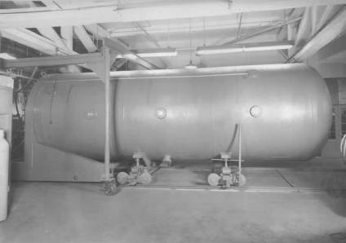
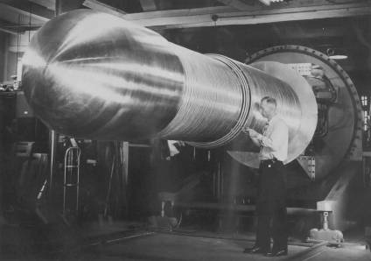
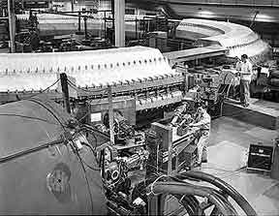
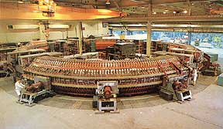
RARAF Accelerator
Van de Graaff at Brookhaven National Laboratory 1949
Cosmotron injector
Cosmotron

Slide 8
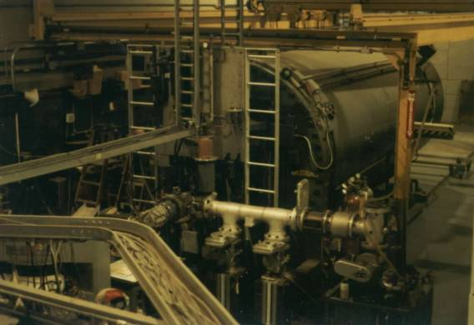
RARAF Accelerator
Van de Graaff at BNL before move to Nevis
RARAF moved out of Brookhaven in 1980 to make space for the ISABELLE p-p collider …..which was never completed.

Slide 9
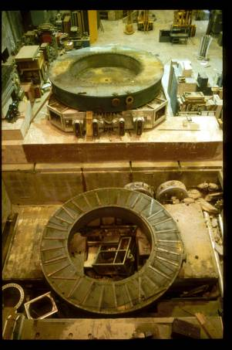
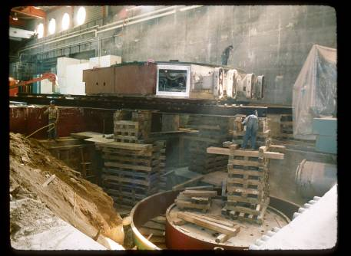
RARAF Accelerator Move from Brookhaven
Nevis 200 MeV cyclotron partially disassembled and being entombed

Slide 10
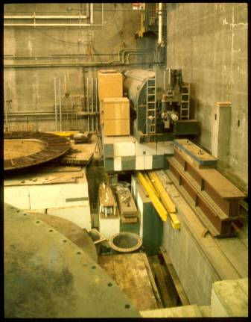
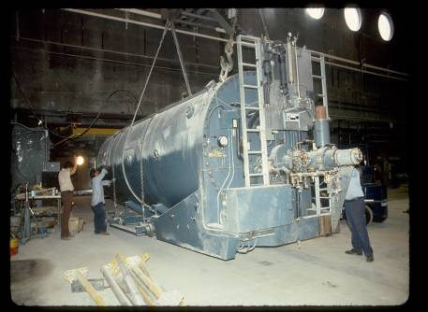
RARAF Accelerator move from Brookhaven
Van de Graaff stored at Nevis and being positioned
RARAF literally built around the accelerator!

Slide 11
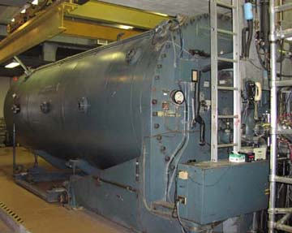
RARAF Accelerator Replacement 2005
Van de Graaff before removal

Slide 12
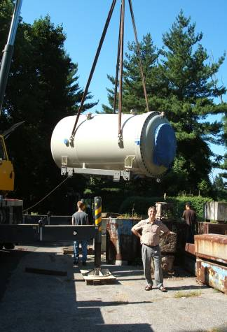
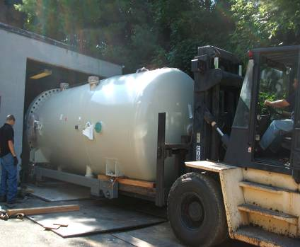
RARAF Accelerator Replacement 2005
New Accelerator going in new back door

Slide 13
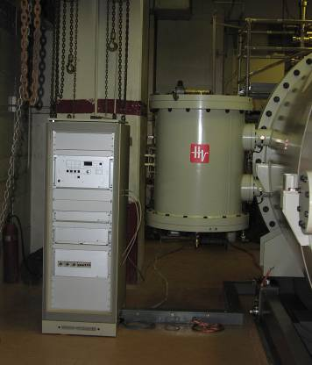
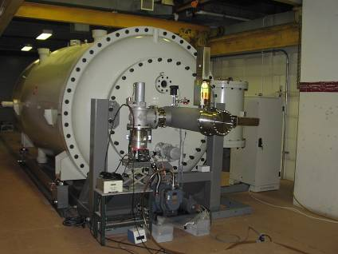
RARAF Accelerator Replacement 2005
HV power supply & resonator coil
Singletron, baseplate & quadrupole

Slide 14
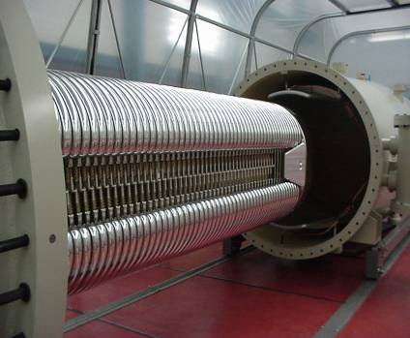
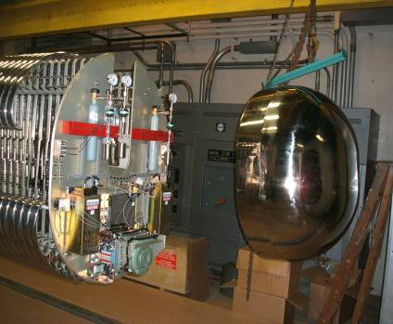
Our 5.5 MV Singletron Accelerator from High Voltage Engineering Europa (HVEE)
Interior of Singletron
Terminal with shell removed

Slide 15
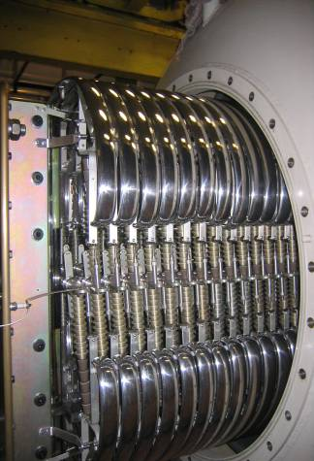
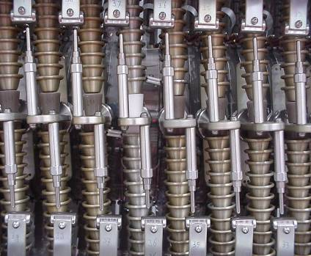
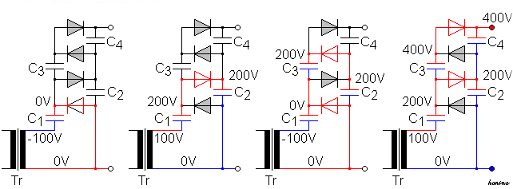
Our 5.5 MV Singletron Accelerator
Electrodes & diode stacks with spark gaps
Cockcroft–Walton charging system ± 100V

Slide 16
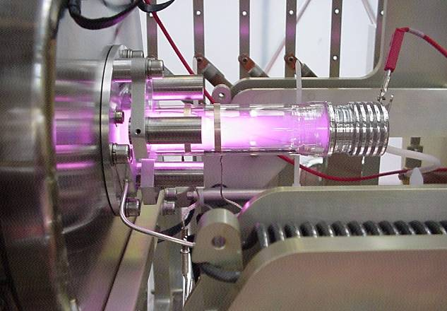
Our 5.5 MV Singletron Accelerator
RF ion source

Slide 17
Our 5.5 MV Singletron Accelerator
Available source gases
Helium (⁴He+, ⁴He++) (⁴He++ = simulated alpha)
Hydrogen ( ¹H+, ¹H₂+, ¹H₃+)
Deuterium ( ¹D+, ¹D₂+, ¹D₃+)
Nitrogen (⁷N+ to ⁷N+5)
Helium-3 (Not currently installed)

Slide 18
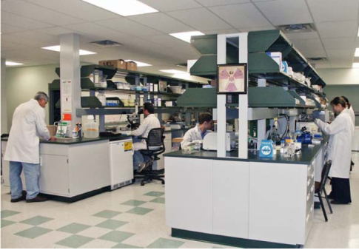
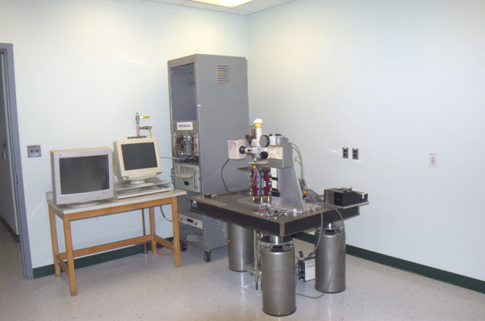
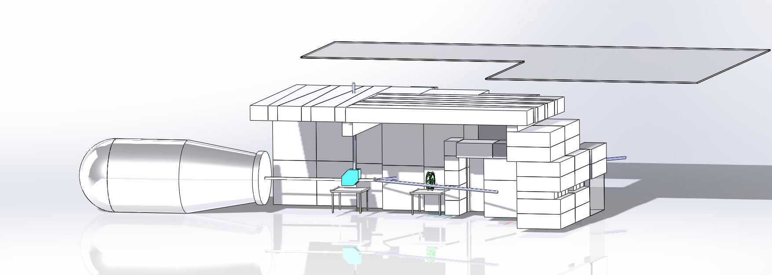
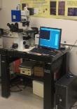
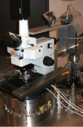
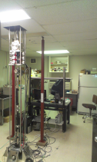
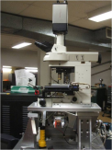
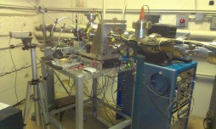
Beam Lines in RARAF
Permanent Magnet Microbeam
3rd floor
1. Microbeam
2. UV Microspot
X-ray microbeam
2nd floor
Track Segment Facility
Accelerator
1st floor
Neutron Facility
Neutron microbeam

Slide 19
RARAF Irradiation Modes
Particles:
Charged particles
Broad beam
Microbeam
Neutrons
Broad beam
Monoenergetic
Spectrum irradiator
Microbeam
Photons:
X-rays Microbeam
UV Microspot
Offline Sources:
Cs-137 irradiator
250 kV x-rays

Slide 20
Broad beams: Where we started
Particles:
Charged particles
Broad beam
Microbeam
Neutrons
Broad beam
Monoenergetic
Spectrum irradiator
Microbeam
Photons:
X-rays Microbeam
UV Microspot
Offline Sources:
Cs-137 irradiator
250 kV x-rays

Slide 21
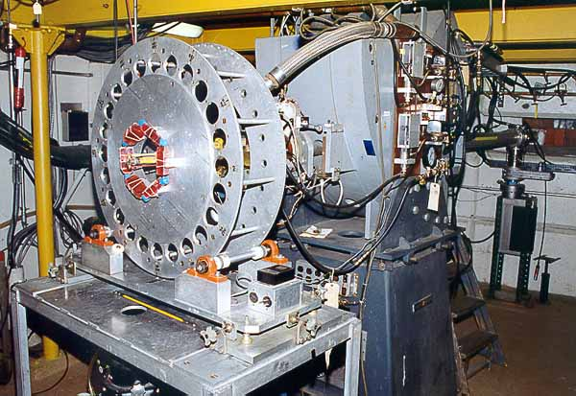
Monoenergtic Neutrons
Proton or deuterium beam on to deuterium and tritium make neutrons
T(d,n)⁴He / T(p,n)³He / D(d,n)³He
Angular location of the sample determines final neutron energy
Target
Neutron system installed at Nevis

Slide 22
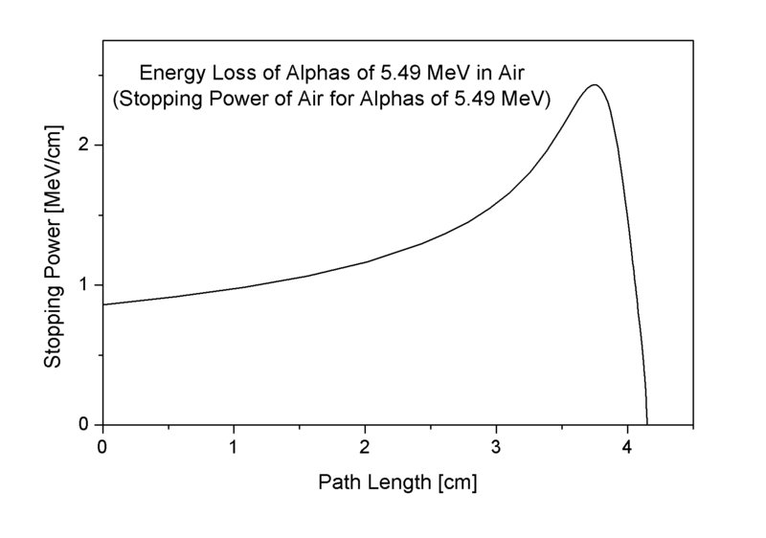
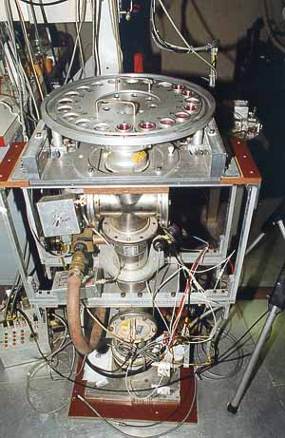
Charged Particle Irradiators: Broad Beam
Track segment
Beam spread out into uniform line
Dishes are passed through the irradiation zone
Time of passage averaged with beam rate = dose
Lots of cells (100’s of thousands+)
Cells get irradiated in both nucleus and cytoplasm (average number of particles in each area)

Slide 23
Low dose radiation risk estimation
Domestic radon exposure
<<1 α/cell
?
Coal miner data
>>1 α/cell
Increased risk
Broad beam experiments
~1 α/cell (poisson)
Microbeam
Experiments!
Dose

Slide 24
Microbeams: Where We Are
Particles:
Charged particles
Broad beam
Microbeam
Neutrons
Broad beam
Monoenergetic
Spectrum irradiator
Microbeam
Photons:
X-rays Microbeam
UV Microspot
Offline Sources:
Cs-137 irradiator
250 kV x-rays

Slide 25

What is a Single-Cell Microbeam?
A single-cell microbeam can deposit ionizing radiation damage in micrometer or sub-micrometer sized regions of cells
Allows investigation of intra- and inter-cellular mechanisms of stress response

Slide 26
A quantitative example of inter-cellular damage communication: Bystander Responses
Damage is expressed in “bystander” cells, which are near to an irradiated cell, but have not themselves received any energy deposition

Slide 27
Low-dose risk estimation and the bystander effect
Where bystander responses have been quantitated, they have shown saturation
In such cases, extrapolating linearly from low to very low doses could underestimate the risk at very low doses.
Based on mutation data from the RARAF microbeam. Zhou et al PNAS 98, 14410-5 (2001)

Slide 28

Microbeams represent the most direct way to study inter-cellular damage response
Produces DNA damage in defined cells, while guaranteeing that adjacent cells are not hit
Can study effects in the adjacent cells
Blue-stained nuclei:
HIT cells
Red-stained cytoplasm:
NON-HIT cells

Slide 29

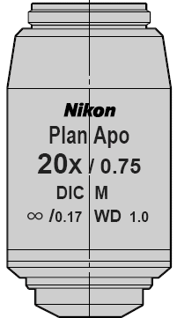
How to make a microbeam?
Imaging system
Particle detector
Moveable stage
Focusing lenses
Beam deflector / shutter
Accelerator

Slide 30
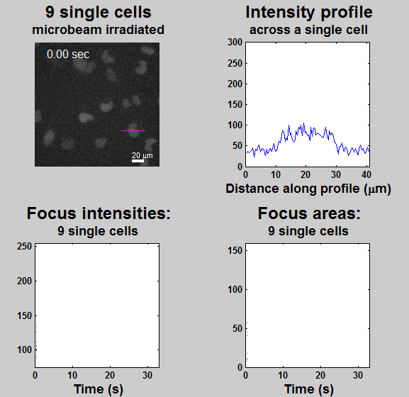
Foci formation at DNA damage site
HT-1080 cells with GFP-tagged XRCC1 SSB repair protein
Cells, courtesy of David J. Chen

Slide 31
Painting “NIH” on a cell nucleus with gfp-tagged XRCC1 repair foci, using our 0.6 mm microbeam
Cells, courtesy of David J. Chen

Slide 32
Example of a microbeam
The Permanent Magnet Microbeam (PMM)
Beam focusing
Double Magnetic Quadrupole Triplet
Beam focusing
Double Magnetic Quadrupole Triplet
Aperture
Beam preparation
Phase space sweeper and apertures

Slide 33
Quadrupole lens
Compression stronger than expansion
Magnetic
Electrostatic
Notes:
Why do we need tuning?
Factory settings were not those required for optimal beam, at the time we ordered the magnet we did not have exact values.

Slide 34
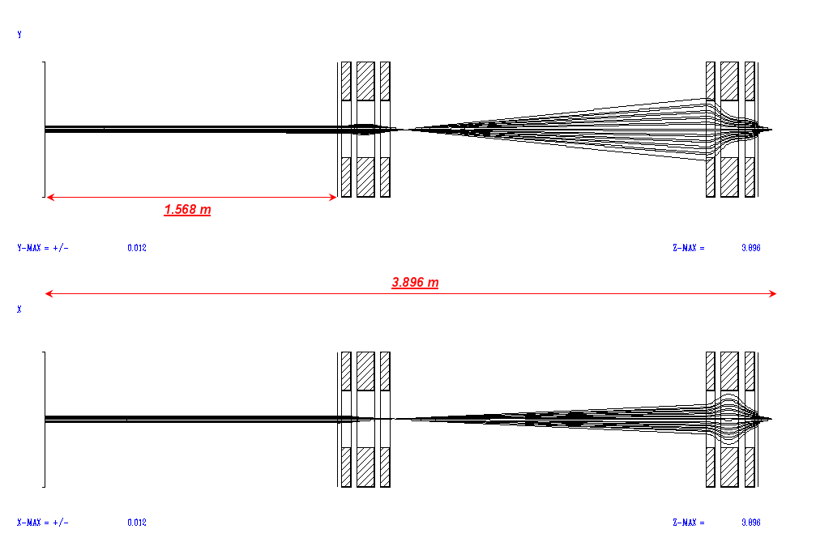
Double triplet lens

Slide 35
How small can we go?
Year | Technique | Diameter (μm)
1996 | Pinhole aperture | 10
2001 | Focused: Single quadrupole quadruplet | 5
2007 | Focused: Single quadrupole triplet | 1.3
Today | Focused: Compound quadrupole triplet | 0.5

Slide 36
Endstation
Imaging
Detector
Piezoelectric stage
Beamline

Slide 37
Other Microbeams

Slide 38
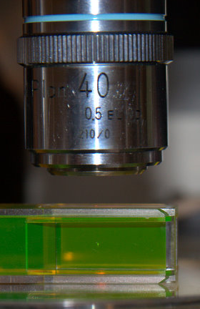
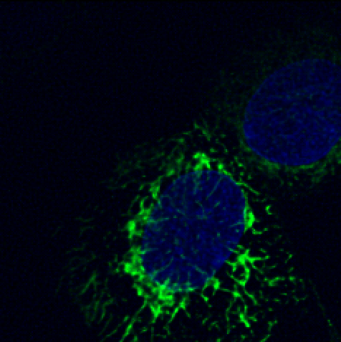

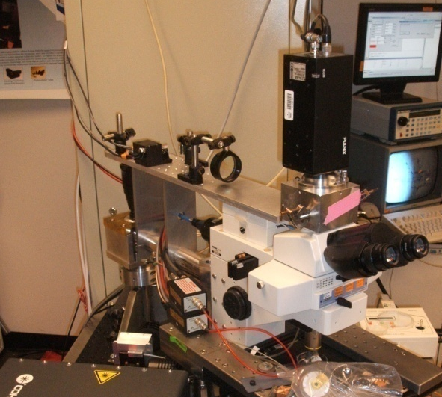
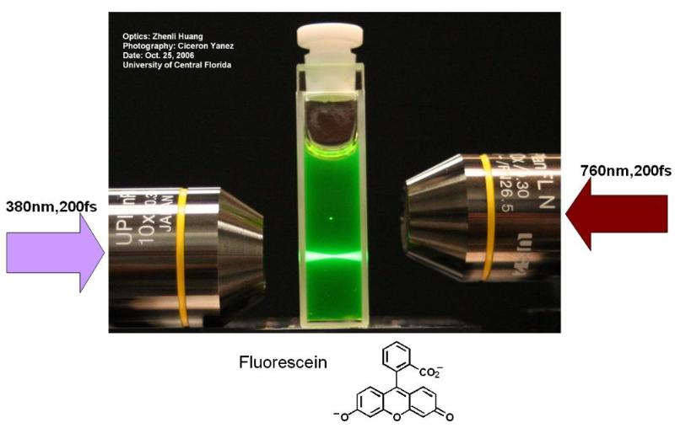
UV Microspot
Use Imaging Tool
as an Irradiator
Multiphoton Microscope
Possible to target a mitochondrion in a live small airway epithelial cell
Form of laser microbeam
Multiphoton processes produces a micro-volume of UV radiation
Can deliver “spot” damage, an advantage over all other microbeam systems
Multiphoton Mode
Wavelengths
Energy Range
Classification
Single-photon
680-1080 nm
1.15-1.82 eV
Visible / IR
Two-photon
340-540 nm
2.30-3.65 eV
UVA / Visible
Three-photon
227-360 nm
3.45-5.47 eV
UVA / UVB / UVC
Notes:
38

Slide 39
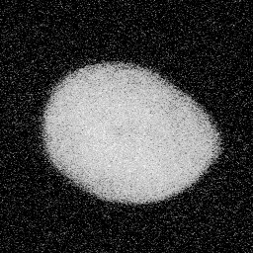
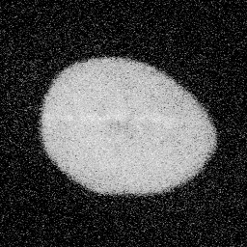
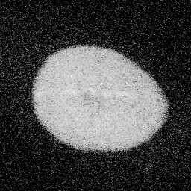
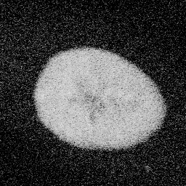
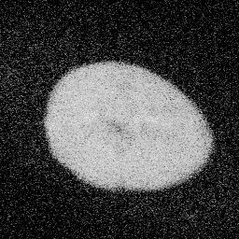
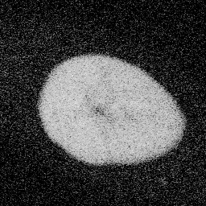
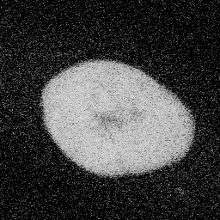
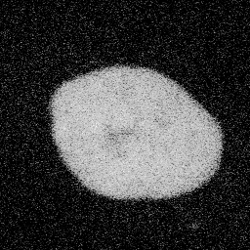
OGG1 – View 6
Irradiation: 5 horizontal line scans (~50 mJ delivered to cell nucleus)
Before
After 1 min.
After 2 min.
After 3 min.
After 4 min.
After 5 min.
After 17 min.
After 28 min.
Observation: faint response, signal remains in nucleus.
Cells, courtesy of David J. Chen

Slide 40
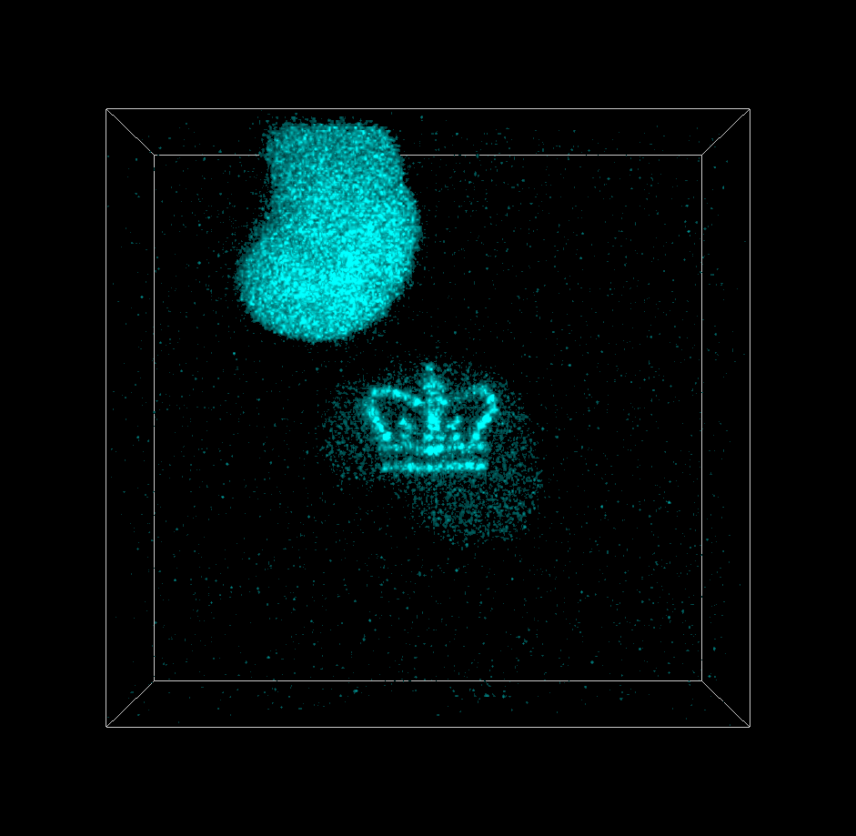
Cells, courtesy of David J. Chen

Slide 41


Soft X-ray microbeam

Slide 42




Zone Plate
120 μm diameter
50 nm outer ring spacing
1st order transmission efficiency at 4.5 keV 12.5% or better
10 mGy/sec delivered to sample with a 5 μm spot
20 μm
10 μm
2 μm
1 μm

Slide 43

PIXE Soft X-ray Microbeam:
Proton spot size
120 μm x 50 μm
X-ray Spot size:
5 μm x 5 μm
Present dose rate
10 mGy/sec
(10 photons
absorbed)

Slide 44


Irradiation Results
0 Gy
0.1 Gy
5 μm
5 μm
AG1522 cell stained for γ-H2AX
Fixed 30 minutes post irradiation

Slide 45

Nanopositioning
Stage
Lens
Chamber
Zone
Plate
Holder
protons→
Target

Slide 46

A neutron microbeam?
30 keV Neutrons cannot be focused
Use a kinematic trick!
⁷Li(p,n)⁷Be has threshold at E_{p}=1.880 MeV
At E_{p}=1.880 + δ
Momentum at CM very low
Momentum in Lab strongly forward peaked
Requires tight control of beam energy

Slide 47
Neutron Microbeam
0 20 40 60 80 μm
Focused 1.886 MeV proton microbeam
Sept 2012: 90 μm
Feb 2013: 70 μm
Design goal: 20 μm
Neutron microbeam visualized with ⁶Li coated CR-39 track etch detector

Slide 48
Imaging

Slide 49




To target cells or sub-cellular components they must be imaged
Most common approach is with fluorescent labeling
Fluorescent labeling is often OK, but not always

Slide 50
We use 50-100 nM

Slide 51

Cell survival with various UV intensities
We use < 0.5 mW/cm²

Slide 52


Rapid EMCCD image acquisition at the microbeam
Standard Intensified CCD
500 msec exposure
EMCCD
0.001 msec exposure
Image quality maintained with EMCCD, but with a major decrease in UV exposure
A_{L} human/hamster hybrid cells, 100 nm Hoechst 33342 stained at 40x magnification with less than 0.2 mW/cm² UV illumination.

Slide 53


SIMI: Simultaneous Immersion Mirau Interferometry
HT1080 fibrosarcoma cells imaged with SIMI in PBS

Slide 54
Microbeam-Integrated Multiphoton Imaging System
To provide 3D imaging capability for RARAF microbeam users, which is integrated with the microbeam irradiation system
To record post-irradiation dynamics in cells, tissue samples, and small organisms

Slide 55
Principle of multiphoton imaging

Slide 56


Light-tight detector housing
(2 PMT channels)
Switch Mirror
Scan Lens
Attenuator
Chameleon Ultra II
Ti:S Laser
(680-1080nm)
Scan Head
Beam Expander
Instrument Designer
Gary Johnson

Slide 57


Examples of 3-D tissue imaging at the RARAF microbeam
In vitro
Human Umbilical Vein Endothelial Cell tissue
YOYO-1 stain (green)
Auto-fluorescence (blue)
In vivo
Wild type C. elegans pharynx
Auto-fluorescence (blue)
Second Harmonic Generation (red)
Z-stack rotations
Sequence of optical sections

Slide 58

Animal models for the microbeam
A lot of interesting biology happens in 3D systems
Requirements for small animal irradiation:
Thin sample - Proton penetration 200-300 μm
Optically clear – to enable targeting
Well established system – need good endpoints

Slide 59


In vivo microbeam irradiation of worms
Worms have green fluorescent protein expressed in response to stress

Slide 60


Zebrafish embryos
40x
GFP atrium
RFP ventriculum
Microbeam irradiation of either atrium or ventriculum
To investigate repopulation of non-irradiated cells in lethally exposed areas
Studies just initiated (Dr. K. Targoff)

Slide 61

Mouse irradiations
We have designed and built a holder to position the flattened mouse ear over the microbeam port
Clamp for ear
Mouse cradle
Suction

Slide 62


Mouse irradiations
Notes:
Virus transfection
A thin liquid film (50 µl) containing 100 particles is spread over a small portion of the ear
It is covered with a Tegaderm patch
Incubated for 1 h
Irradiation 24 h later

Slide 63
Microfluidics on the Microbeam

Slide 64
Why microfluidics
Microfluidics is the science and technology of systems that manipulate minute amounts of fluids, using sub-millimeter microchannels.
Microfluidics provides:
High throughput/automation of single cell handling
A host of single cell analysis devices

Slide 65

FAST (Flow-And-Shoot Technology)
Currently Cells attached to microbeam dishes, and either:
Dish moved to bring cellular target over the microbeam
Beam moved to shoot cellular targets (point & shoot)
Proposed
Cells flowing through a microfluidic channel
Cells targeted by Point & Shoot as they flow by
Cells dispensed to user device
Cells
Microbeam
Irradiated cells
Flow
`
`
`
`
`
`

Slide 66


FAST (Flow-And-Shoot Technology)
Mounted on Permanent Magnet Microbeam
5µm diameter beam
Point & Shoot
5.3 MeV He⁺⁺/protons
1000/sec

Slide 67
Real time tracking
Images the flowing cells
Center of cell located in real time frame to frame
Future position predicted using:
velocity
New position
Old position
Actual time

Slide 68

With Cells
CRL4025 - Human endothelial cell line (trypsinized)
GFP expressed throughout the cell.

Slide 69
Optical manipulation of cells
Why do we want this?
Parallel Manipulation of cells
Controlling distance between cells before, during and after irradiation
Handling groups of cells in parallel
Manipulating cells in suspension

Slide 70
Optical manipulation of cells How does it work?
Optical tweezers system:
Transparent conductive top electrode
Photoconductive bottom electrode
Dynamic light source
Conductive Glass
10-100μm
Photo conductor
Light pattern generator

Slide 71
Optical manipulation of cells How does it work
Light pattern generated on photoconductive electrode
AC is applied
Electric fields are formed
Fields repel cells
No physical barriers!
AC

Slide 72
Optical manipulation of cells How does it work
Light pattern generated on photoconductive electrode
AC is applied
Electric fields are formed
Fields repel cells
No physical barriers!
Illumination pattern can be changed dynamically.
Cells can be boxed in
Cells will track pattern
AC

Slide 73


How does this work?
Cells
OET

Slide 74


Optical manipulation of cells preliminary data with beads

Slide 75


Microfluidic irradiation of worms
We have:
Built worm clamps with thin (~10 μm) bottoms, to allow microbeam penetration
4 channels/clamp
Worm irradiations now routinely performed in clamps
Notes:
75

Slide 76
Where are we going?

Slide 77
Aiming at still smaller targets
At present our imaging capabilities and our microbeam targeting capabilities roughly match (as they should)
Both are around 300 - 400 nm
Imaging limits are because of the Abbe diffraction limit
Microbeam diameter limits are because of inherent spherical and chromatic aberrations from our electrostatic focusing lenses

Slide 78
We want to target specific areas on a single chromosome

Slide 79
We want to target transcription sites
Solovjeva L et al. Mol. Biol. Cell 2005
Notes:
Expression of GFP-tagged human Fen1 in transfected Chinese hamster V79 cells. (A) Two patterns of GFP-Fen1 distribution in the nuclei of transiently transfected live cells: diffuse (left) and focal (right). Bar, 10 μm. (B) Western blots of total protein from stably transfected V79 cells probed with antibodies against human recombinant Fen1 (right) or GFP (left). Endogenous Fen1 protein is marked as e-Fen1.

Slide 80
We want to target mitochondria
5 μm

Slide 81


Current imaging on the Microbeam
5 μm
5 μm
Resolution ~250 nm
Resolution ~400 nm

Slide 82



The Abbe diffraction limit d_{min}~200 nm

Slide 83
The Particle Beam Focusing Limit
Microbeam Diameter (microns)
Where we are now
Aberration limit
Limiting aperture diameter (microns)

Slide 84

Breaking through both the aberration limit and the diffraction limit on the microbeam

Slide 85
Getting to the limit
Stray magnetic fields can deflect the beam
Opening/closing the door
Moved beam by several microns!

Slide 86

The Super Microbeam
We currently use quadrupole electrostatic lenses to provide the strong fields necessary for focusing
These electrostatic lenses provide a lower limit on how small a diameter we can make the microbeam, due to their intrinsic spherical and chromatic aberrations
In principle solenoid lenses can provide lower spherical and chromatic aberrations, and consequently superior spatial resolution

Slide 87


A solenoid has many coils of wire carrying DC current
The field is strong and uniform in the center and weak and divergent on the outside
Ions entering a solenoid spiral around the field lines and are periodically refocused onto the axis
Head-on view

Slide 88
When the field strength and the length of the solenoid are selected appropriately, the ions make one partial turn and then focus beyond the far end of the solenoid

Slide 89
Double superconducting magnet solenoid lens design
Predicted beam spot: 75 nm

Slide 90
Super Resolution Microscopy
Super Resolution microscopy is need for targeting at the 70 nm resolution for the super microbeam
We have chosen to use STimulated Emission Depletion (STED)

Slide 91

How does STED work?
Excitation
STED Donut
Effective
Fluorescence limited to the sub-diffraction spot by a depletion ‘donut’ surrounding the excitation focus
Depletion happens by de-exciting the fluorophores stimulating them to emit at a longer wavelength – STimulated Emission Depletion
Requires STED intensity >> Fluorophore saturation intensity
STED Photon in
2hν₂
1
λ
Stimulated Emission
Excitation
STED
Resolution
d
=
Fluorescence
·
hν₁
1
+
I
/
2
NA
I
STED
Fsat

Slide 92

Super Resolution STED at RARAF
Excitation laser – existing multiphoton system
Provides laser path, introduction, and detection capabilities
Broad range of excitation wavelengths for multi-color STED
STED laser
Coupled on optical bench just before laser scan head
Current microbeam endstation
STED
Laser
Existing
Multiphoton
Laser

Slide 93
Live cells require media immersion ultimate resolution ~70 nm – right on par with Super Microbeam
STED - Off
STED - On
GFP-tagged mitochondria imaged at Mechanical Engineering STED Laboratory

Slide 94
Continuing Microfluidics: Single-cell microfluidics-based qRT-PCR
Microfluidic handling to enable near-simultaneous qRT-PCR analysis by parallel processing

Slide 95

Check us out!

Slide 96
RARAF – The People
Director: David Brenner
Assoc. Director, Chief Physicist: Gerhard Randers-Pehrson
Facility Manager: Steve Marino
Physics:
Alan Bigelow
Guy Garty
Yanping Xu
Andrew Harken
Sasha Lyulko
Biology:
Brian Ponnaiya, Chief Biologist
Manuela Buonanno
Charles Geard-Emeritus Chief biologist
External Advisory Committee

Slide 97
Thank you

