Slide 1


COLUTA to LpGBT mapping
FEB2 block diagrams
J. Bán, G. Brooijmans, J. Parsons, W. Sippach
Nevis Laboratories

Slide 2
PA/SH1
ADC1
lpGBT1
VTRx+1
F1
PA/SH2
ADC2
lpGBT2
F2
PA/SH3
ADC3
PA/SH4
ADC4
lpGBT3
F3
PA/SH5
ADC5
lpGBT4
F4
PA/SH6
ADC6
PA/SH7
ADC7
lpGBT5
VTRx+2
F5
PA/SH8
ADC8
lpGBT6
F6
PA/SH9
ADC9
PA/SH10
ADC10
lpGBT7
F7
PA/SH11
ADC11
lpGBT8
F8
PA/SH12
ADC12
PA/SH13
ADC13
lpGBT9
VTRx+3
F9
PA/SH14
ADC14
lpGBT10
F10
PA/SH15
ADC15
PA/SH16
ADC16
lpGBT11
F11
Data/signal flow
lpGBT12
VTRx+4
F12
lpGBT13
VTRx+5
F13
PA/SH17
ADC17
lpGBT14
VTRx+6
F14
PA/SH18
ADC18
lpGBT15
F15
PA/SH19
ADC19
lpGBT16
F16
PA/SH20
ADC20
PA/SH21
ADC21
lpGBT17
VTRx+7
F17
PA/SH22
ADC22
lpGBT18
F18
PA/SH23
ADC23
PA/SH24
ADC24
lpGBT19
F19
PA/SH25
ADC25
lpGBT20
F20
PA/SH26
ADC26
PA/SH27
ADC27
lpGBT21
VTRx+8
F21
10.24/5.12 GHz
PA/SH28
ADC28
lpGBT22
F22
10.24GHz
PA/SH29
ADC29
640MHz
PA/SH30
ADC30
lpGBT23
F23
PA/SH31
ADC31
lpGBT24
F24
Analog
PA/SH32
ADC32

Slide 3
PA/SH1
ADC1
To send clocks to ADC and PA/SH chips,
phase programmable clock outputs are used.
Each lpGBT has 4 such outputs (48.8p steps).
When CP40 for ALFE is off, pull down/up is active.
PA/SH2
ADC2
lpGBT1
PA/SH3
ADC3
lpGBT2
PA/SH4
ADC4
lpGBT3
PA/SH5
ADC5
lpGBT4
Clock distribution Cp40 CP640
LpGBT1 |  | LpGBT1
PSCLK0 PA1 |  | ECLK0 ADC1
PSCLK1 ADC1 |  | ECLK2 ADC2
PSCLK2
PSCLK#
LpGBT2 |  | LpGBT2
PSCLK0 PA2 |  | ECLK0 ADC3
PSCLK1 ADC2 |  | ECLK2
PSCLK2 PA3 |  | ECLK4
PSCLK3 ADC3 |  | ECLK6
PA/SH6
ADC6
PA/SH7
ADC7
lpGBT5
PA/SH8
ADC8
lpGBT6
PA/SH9
ADC9
To send clocks to lpGBT,
ECLK outputs are used.
Each lpGBT has 29 such outputs.
PA/SH10
ADC10
lpGBT7
PA/SH11
ADC11
lpGBT8
PA/SH12
ADC12
PA/SH13
ADC13
lpGBT9
PA/SH14
ADC14
lpGBT10
PA/SH15
ADC15
PA/SH16
ADC16
lpGBT11
lpGBT12
VTRx+4
PIO
PIO
ECLKOUT
Mode[1]
LockMode
RefClk
Clock distribution
LockMode
Mode[1]
RefClk
ECLKOUT
PIO
PIO
PA/SH17
ADC17
lpGBT14
lpGBT13
VTRx+5
PA/SH18
ADC18
lpGBT15
PA/SH19
ADC19
lpGBT16
PA/SH20
ADC20
PA/SH21
ADC21
lpGBT17
PA/SH22
ADC22
lpGBT18
PA/SH23
ADC23
Redundant controls**
LpGBT12 |  | LpGBT13
ECLK0 |  | RefCLK
GPIO12 |  | LockMode
GPIO8 |  | Mode[1]
RefClk |  | ECLK0
LockMode |  | GPIO12
Mode[1] |  | GPIO8
PA/SH24
ADC24
lpGBT19
Cp40MHz
PA/SH25
ADC25
lpGBT20
PA/SH26
ADC26
Cp640MHz
PA/SH27
ADC27
lpGBT21
2.56GHz
PA/SH28
ADC28
lpGBT22
5.12GHz FEC12
PA/SH29
ADC29
PA/SH30
ADC30
lpGBT23
PA/SH31
ADC31
lpGBT24
**board external 40MHz clock resistors are removed
PA/SH32
ADC32

Slide 4
ADC1
ADC has 2 diff inputs for BCR
(with programmable termination inside the ADC).
ADC2
ADC3
ADC4
ADC5
ADC6
ADC7
ADC8
ADC9
ADC10
To send BCR to ADC,
16 EDOUT outputs are used.
Each lpGBT has 16 such outputs.
ADC11
ADC12
ADC13
ADC14
ADC15
ADC16
lpGBT12
VTRx+4
BCR distribution
ADC17
lpGBT13
VTRx+5
ADC18
ADC19
ADC20
ADC21
ADC22
ADC23
ADC24
Secondary BCR
ADC25
ADC26
Primary BCR
ADC27
2.56GHz
ADC28
ADC29
ADC30
ADC31
ADC32

Slide 5
PA/SH1
ADC1
lpGBT1
VTRx+1
PA/SH2
ADC2
lpGBT2
PA/SH3
ADC3
PA/SH4
ADC4
lpGBT3
M0
PA/SH5
ADC5
lpGBT4
PA/SH6
ADC6
PA/SH7
ADC7
lpGBT5
VTRx+2
PA/SH8
ADC8
lpGBT6
PA/SH9
ADC9
PA/SH10
ADC10
lpGBT7
M0
PA/SH11
ADC11
lpGBT8
PA/SH12
ADC12
PA/SH13
ADC13
lpGBT9
VTRx+3
Redundant controls
LpGBT12 |  | LpGBT13
GPIO14 |  | SC_I2C
SC_I2C |  | GPIO14
RSTB |  | GPIO10
GPIO10 |  | RSTB
LpGBT12 |  | LpGBT11
EC |  | EC
GPIO15 |  | SC_I2C
LpGBT14 |  | LpGBT13
EC |  | EC
SC_I2C |  | GPIO15
PA/SH14
ADC14
lpGBT10
PA/SH15
ADC15
M0
PA/SH16
ADC16
lpGBT11
SC
M0
M1
EC
M2
lpGBT12
Si2C
VTRx+4
USB-I2C
Slow control (I2C)
PIO
M1
SC_I2C
PIO
Si2C
M0
lpGBT13
M2
VTRx+5
ADC17
SC_I2C
EC
SC
PA/SH17
ADC18
lpGBT14
M0
VTRx+6
PA/SH18
ADC19
lpGBT15
PA/SH19
ADC20
lpGBT16
PA/SH20
ADC21
PA/SH21
ADC22
lpGBT17
VTRx+7
PA/SH22
ADC23
lpGBT18
PA/SH23
ADC24
PA/SH24
lpGBT19
PA/SH25
ADC25
lpGBT20
PA/SH26
ADC26
PA/SH27
ADC27
lpGBT21
VTRx+8
PA/SH28
ADC28
lpGBT22
PA/SH29
ADC29
PA/SH30
ADC30
lpGBT23
PA/SH31
ADC31
lpGBT24
PA/SH32
ADC32

Slide 6
LpGBT1 | I2C | on bus | clocks | target | GPIO | function | ADC | monitor
 | M0 | ADC1 | Psclk0 | cp40_PA1 | 0 | PA1-3_RSTB | 0 | PA1-1.2V
 | M1 | PA1 | Psclk1 | cp40_ADC1 |  |  |  | PA2-1.2V
 | M2 | ADC2 | Psclk2
 | Slave | M0LPGBT!2 | Psclk3
 |  |  | Eclk1 | cp640_ADC1
 |  |  | Eclk2 | cp640_ADC2
LpGBT2 |  | I2C |  | clocks | GPIO | function | ADC | monitor
 | M0 | PA2 | Psclk0 | cp40_PA2 | 0 | ADC1-3_RSTB | 0 | PA3-1.2V
 | M1 | ADC3 | Psclk1 | cp40_ADC2
 | M2 | PA3 | Psclk2 | cp40_PA3
 | Slave | M0LPGBT!2 | Psclk3 | cp40_ADC3
 |  |  | Eclk1 | cp640_ADC3

Slide 7
I2C address assignment

Slide 8
4A dual or 8A single
1.2V LDO
ADC1
1.2V LDO
L
ADC2
ADC power
@1.2VA < 610mA
@1.2VD < 70mA
24V
LTM4619 DC-DC
_1
1.2V LDO
L
ADC3
1.2V LDO
L
ADC4
1.2V LDO
L
ADC5
1.2V LDO
L
ADC6
1.2V LDO
L
ADC7
en_ADC_a
2.2V ADC raw_a
1.2V LDO
L
ADC8
1.2V LDO
L
ADC9
1.2V LDO
L
ADC10
24V
LTM4619 DC-DC
_2
1.2V LDO
L
ADC11
1.2V LDO
L
ADC12
1.2V LDO
L
ADC13
1.2V LDO
L
ADC14
1.2V LDO
L
ADC15
en_ADC_a
1.2V LDO
L
ADC16
L
ADC power regulators
1.2V LDO
L
ADC17
24V
LTM4619 DC-DC
_1
1.2V LDO
L
ADC18
1.2V LDO
L
ADC19
1.2V LDO
L
ADC20
1.2V LDO
L
ADC21
1.2V LDO
L
ADC22
2.2V ADC raw_b
1.2V LDO
L
ADC23
en_ADC_b
1.2V LDO
L
ADC24
1.2V LDO
L
ADC25
24V
LTM4619 DC-DC
_2
1.2V LDO
L
ADC26
1.2V LDO
L
ADC27
1.2V LDO
L
ADC28
1.2V LDO
L
ADC29
32 LDO’s
4 DC-DC
1.2V LDO
L
ADC30
1.2V LDO
L
ADC31
en_ADC_b
1.2V LDO
L
ADC32

Slide 9
Slow control & monitoring overview
LpGBT9 |  | PA9-16_+2.5V | PA9-16_+1.2V
LpGBT10 |  | ADC13_VDD | ADC14_VDD | ADC15_VDD | VTRX3_1P2
LpGBT11 |  | ADC16_VDD | REF_VDD | VTRX3_TEMP | VTRX3_RSSI | VTRX4_1P2
LpGBT12 |  | VTRX4_TEMP | V2P5_MON_A | VTRX4_RSSI | TEMP_T1 | TEMP_T2 | TEMP_T3 | TEMP_B1 | TEMP_B2
LpGBT13 |  | VTRX5_TEMP | V2P5_MON_B | VTRX5_RSSI | TEMP_T4 | TEMP_T5 | TEMP_T6 | TEMP_B3 | TEMP_B4
LpGBT14 |  | ADC17_VDD | VTRX5_1P2 | VTRX6_1P2
LpGBT15 |  | PA17-24_+2.5V | PA17-24_+1.2V | VTRX6_TEMP | VTRX6_RSSI
LpGBT16 |  | ADC18_VDD | ADC19_VDD | ADC20_VDD | MAIN_PS

Slide 10
To generate resets and enable DC-DC converters,
PIO pins are used.
Each lpGBT has 16 such outputs.
PA_RSTB_a
lpGBT12
ADC_RSTB_a
VTRx_RSTB_a
LpGBT13_RSTN
Power control
signal | LpGBT# | GPIO pin #
DCDC_EN_PA_A | 12 | 2
DCDC_EN_LPGBT_B | 12 | 4
DCDC_EN_ADC_A | 12 | 11
DCDC_EN_PA_B | 13 | 2
DCDC_EN_ADC_B | 13 | 3
DCDC_EN_LPGBT_A | 13 | 4
en_PA_a
en_ADC_a
en_lpGBT_a
Slow control
PA_RSTB_b
RESET control
signal | LpGBT# | GPIO pin #
PA_RSTB_A | 12 | 0
ADC_RSTB_A | 12 | 1
VTRX_RSTB_A | 12 | 3
LPGBT13_RSTN | 12 | 10
PA_RSTB_B | 13 | 0
ADC_RSTB_B | 13 | 1
VTRX_RSTB_B | 13 | 5
LPGBT12_RSTN | 13 | 10
lpGBT13
ADC_RSTB_b
VTRx_RSTB_b
LpGBT12_RSTN
en_PA_b
en_ADC_b
en_lpGBT_b

Slide 11
Tx PT1000 probe on PCB top side
Bx PT1000 probe on PCB bottom side
Temperature monitoring
Temperature monitoring
Temperature | LpGBT# | ADC input #
T1 | 12 | 5
T2 | 12 | 2
T3 | 12 | 1
T4 | 13 | 5
T5 | 13 | 6
T6 | 13 | 1
B1 | 12 | 6
B2 | 12 | 7
B3 | 13 | 2
B4 | 13 | 7
VTRx+3 | 11 | 2
VTRx+4 | 12 | 0
VTRx+5 | 13 | 1
VTRx+6 | 15 | 2
T1
B2
B1
lpGBT12
T2
T2
T3
T4
T6
B3
lpGBT13
T5
B4

Slide 12
Power monitoring and control
LDO/Power monitoring
Voltage | LpGBT# | ADC input #
PA9-16_+2.5V | 9 | 0
PA9-16_+1.2V | 9 | 1
ADC13_VDD | 10 | 0
ADC14_VDD | 10 | 1
ADC15_VDD | 10 | 2
VTRX3_1P2 | 10 | 6
ADC16_VDD | 11 | 0
REF_VDD | 11 | 1
VTRX4_1P2 | 11 | 7
VTRX3_RSSI | 11 | 6
V2P5_MON_A | 12 | 3
VTRX4_RSSI | 12 | 4
V2P5_MON_B | 13 | 3
VTRX5_RSSI | 13 | 4
ADC17_VDD | 14 | 0
VTRX6_1P2 | 14 | 6
VTRX5_1P2 | 14 | 7
PA17-24_+2.5V | 15 | 0
PA17-24_+1.2V | 15 | 1
VTRX6_RSSI | 15 | 3
ADC18_VDD | 16 | 0
ADC19_VDD | 16 | 1
ADC20_VDD | 16 | 2
MAIN_PS | 16 | 6
Digital signal status bits
signal | LpGBT# | GPIO pin #
PA14_I2C_ERROR | 9 | 0
PA13_I2C_ERROR | 9 | 15
PA15_I2C_ERROR | 10 | 15
PA16_I2C_ERROR | 11 | 15
PA17_I2C_ERROR | 14 | 15
PA19_I2C_ERROR | 15 | 0
PA18_I2C_ERROR | 15 | 15
PA20_I2C_ERROR | 16 | 15
LpGBT12/13 cross control
signal | LpGBT# | GPIO pin #
LPGBT13_MOD1 | 12 | 8
LPGBT13_LOCKMODE | 12 | 12
LPGBT13_SC_I2C | 12 | 14
LPGBT12_MOD1 | 13 | 8
LPGBT12_LOCKMODE | 13 | 12
LPGBT12_SC_I2C | 13 | 14

Slide 13
Timing monitoring and timing control (1)
Proposed FEB2 architecture is a complex system from timing point of view
It is needed to distribute/set-up signals carrying timing information and have a tools to monitor, that the set-up is stable over time
The signals carrying the timing info:
LHC synchronous CP40 40MHz clock is a main sampling clock of FEB2 ADC
This clock is recovered from LpGBT12&13 downstream optical data
As this is ADC sampling clock, FEB2 needs to be guaranteed that this is low jitter clock
compatible with the ADC precision. The clock is jitter cleaned in the FELIX board
FEB2 board has to have a possibility for adjustment of this clock as much as 25ns for different ADC channels. As the ADC samples all channel at the same time, we propose to limit adjustment possibility of sampling clock to be common for all channels within the ADC
CP640 640MHz signal running main state machine of ADC digital modules. It is also used to synchronize the data transmission between ADC and LpGBT
The clock is supplied to the ADC from corresponding LpGBT. We need set and monitor certain
relationship between this clock and 40MHz clock as both clocks are used to generate
all other ADC internal clocks and also to drive all ADC state machines

Slide 14
Timing monitoring and timing control (2)
Bunch crossing reset signal is used to generate the time stamp on data transmitted to LpGBT and beyond
This signal resets Bunch crossing counter inside the ADC. The lower bits of this counter
are transmitted together with the physics data. BCR signal will be strobed by the ADC
40MHz clock, so relationship between BCR and CP40 must obey set-up time
requirements (for BCR to be correctly strobed).
The issue here is that BCR and CP40 are generated by different LpGBT chips
and processed by third chip - ADC
ADC Internal 80/160MHz clock is used to drive the digital data processing unit of the ADC
this clock signal is generated inside the ADC, but its timing is dependent on CP640 to CP40 relationship
We need to monitor CP640/CP40 relationship, but also to check the 80MHz clock . This is needed for a FEB2 as on this board there is no possibility to check that the ADC is working in optimal ENOB region by independent signal source.

Slide 15
Timing monitoring and timing control - summary
On the FEB2 level we need to set-up, generate and monitor timing sensitive signals with very high precision.
The issues come from the fact that proposed FEB2 architecture will require
ADC chips to be supplied by timing information from different LpGBT chips. There is also a situation
when data from one ADC is sent to two different lpGBTs. (One should expect that in a big system these
“dependencies” will be built from the chips coming from different technology corners.)
The timing setup and monitoring process should be fully under high level software control.
To achieve this goals we propose the solutions on board and on ADC chip levels (see next 2 slides)

Slide 16
Timing monitoring and timing control-
Proposed scheme on the FEB2 level
(A)
All timing sensitive signals on FEB2 are controlled by the software.
Physical signals are sent from LpGBT to ADC with the time precision of few ps
(exception is BCR to be sent by the downlink channel and the resolution is only 12.5ns).
(B)
Time sensitive signals are received at COLUTA, processed and sent back to the LpGBT to be analyzed/monitored by FEB2 user.
LPGBT EDIN input can strobe the data with 640MHz with adjusted strobe edge to few ps.
EDOUT
LpGBT
CP40
BCR
CP40
LpGBT12 or 13
COLUTA ADC
CP640
COLUTA ADC channel MUX
PSCLK
PSCLK
LpGBT
CP40
EDIN

Slide 17
Timing monitoring and timing control-
Proposed scheme on the ADC level
THIS hardware should be added to the ADC channel.
ADC_channel output
ADC_cannel neighboring output
ADC BCR
ADC CP40
ADC CP80
COLUTA ADC channel MUX
MUX control bits

Slide 18
FEB2 ID concept (1)
We are required to send the board ID information each optical fiber inform which would allow to identify the source of the data.
We have > 1560 boards with 22 data fibers on each board. To identity the each FEB2 we need at least 11 bits of ID.
We propose to burn this information into e-fuses of one of control lpgbt (12 or 13)
During initial power up of the board when we burn also other parts of e-fuse space
to make sure that the board will be able to communicate with the control system via optics.
During the COLUTA Configuration we propose to move this information to each
COLUATA chips on the board (we reserve slow control bits 302:292) for this purpose
We also need a special data output mode on the COLUTA chip to send this ID on each fiber
Combining FEB2 ID with other information available in to the same LpGBT frame we can send also COLUTA chip I2C address and ADC channel numbers inside COLUTA chip
This concept would allow identification each of the LpGBT(VTRx) optics data fibers (~34300 of them) down to the channel number in the COLUTA ADC chip .

Slide 19
FEB2 ID concept ddpu output modes-(2)
In order to implement proposed concept we need implement the changes in the DDPU of the CV4.
WE propose the following changes in the CV4 output data modes:
//**************************************************************
// DDPU Control bits definition (main control)
//
// ddpu_mode[0] 0 => DDPU flavor is MDAC
// 1 => DDPU flavor is AUX/test (FEB_ID transmitted)
//
// ddpu_mode[1] 0 => 16 bit normal mode
// 1 => 32 bit raw data mode
//
// ddpu_mode[2] 1 => MDAC/SAR bits are corrected
// 0 => non corrected MDAC/SAR bits are used
//
// ddpu_mode[3] 1 => serializer test mode
// 0 => serializer normal mode
//**************************************************************

Slide 20
FEB2 ID concept-ddpu output modes (2)
// If DDPU flavor is "MDAC"
// serializer 16 bit mode output: {overflow, final_MDAC[14:0]}
// If DDPU flavor is "AUX/test"
// serializer 16 bit mode output: {flag, valid, FEB_ID[11:0]}
//
// 32 bit mode, MDAC flavor
// Upper 16 bits for 32 bit raw mode
// tranmitted by serializer A:
// { before_edge_tst[1:0],
// after_edge_tst[1:0],
// mdac_r2[11:4], sar_r2[20:17]};

Slide 21
FEB2 ID concept-ddpu output modes (3)
// 32 bit mode, AUX/test flavor
// Upper 16 bits for 32 bit raw mode
// tranmitted by serializer A:
// { Test_inputs[15:0]};
// Lower 16 bits for both 32 bit raw modes are
// transmitted by serializer B:
// {sar_r2[16:1]}
// if DDPU IN serializer test more:
// channel A output in 16 bit mode is : {4'b1010, ser_ID, 5'b01001}
// in 32 bit mode
// channel A output is : {4'b1010, ser_ID, 5'b01001}
// channel B output is : {4'b1010, ser_ID, 5'b01010}
//
// where ser_ID <= {I2C_ID, CH_N};
// frame output has always a for : {1'b1, 1'b0, FIRST, BCNUMBER[4:0],
8'b00000000}

Slide 22
LpGBT package

Slide 23
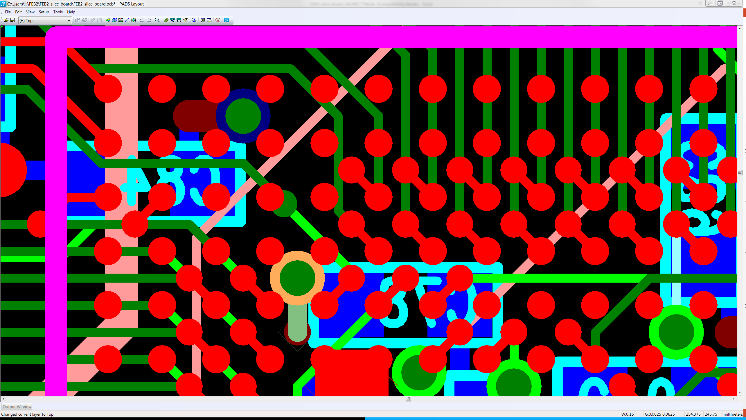

Slide 24
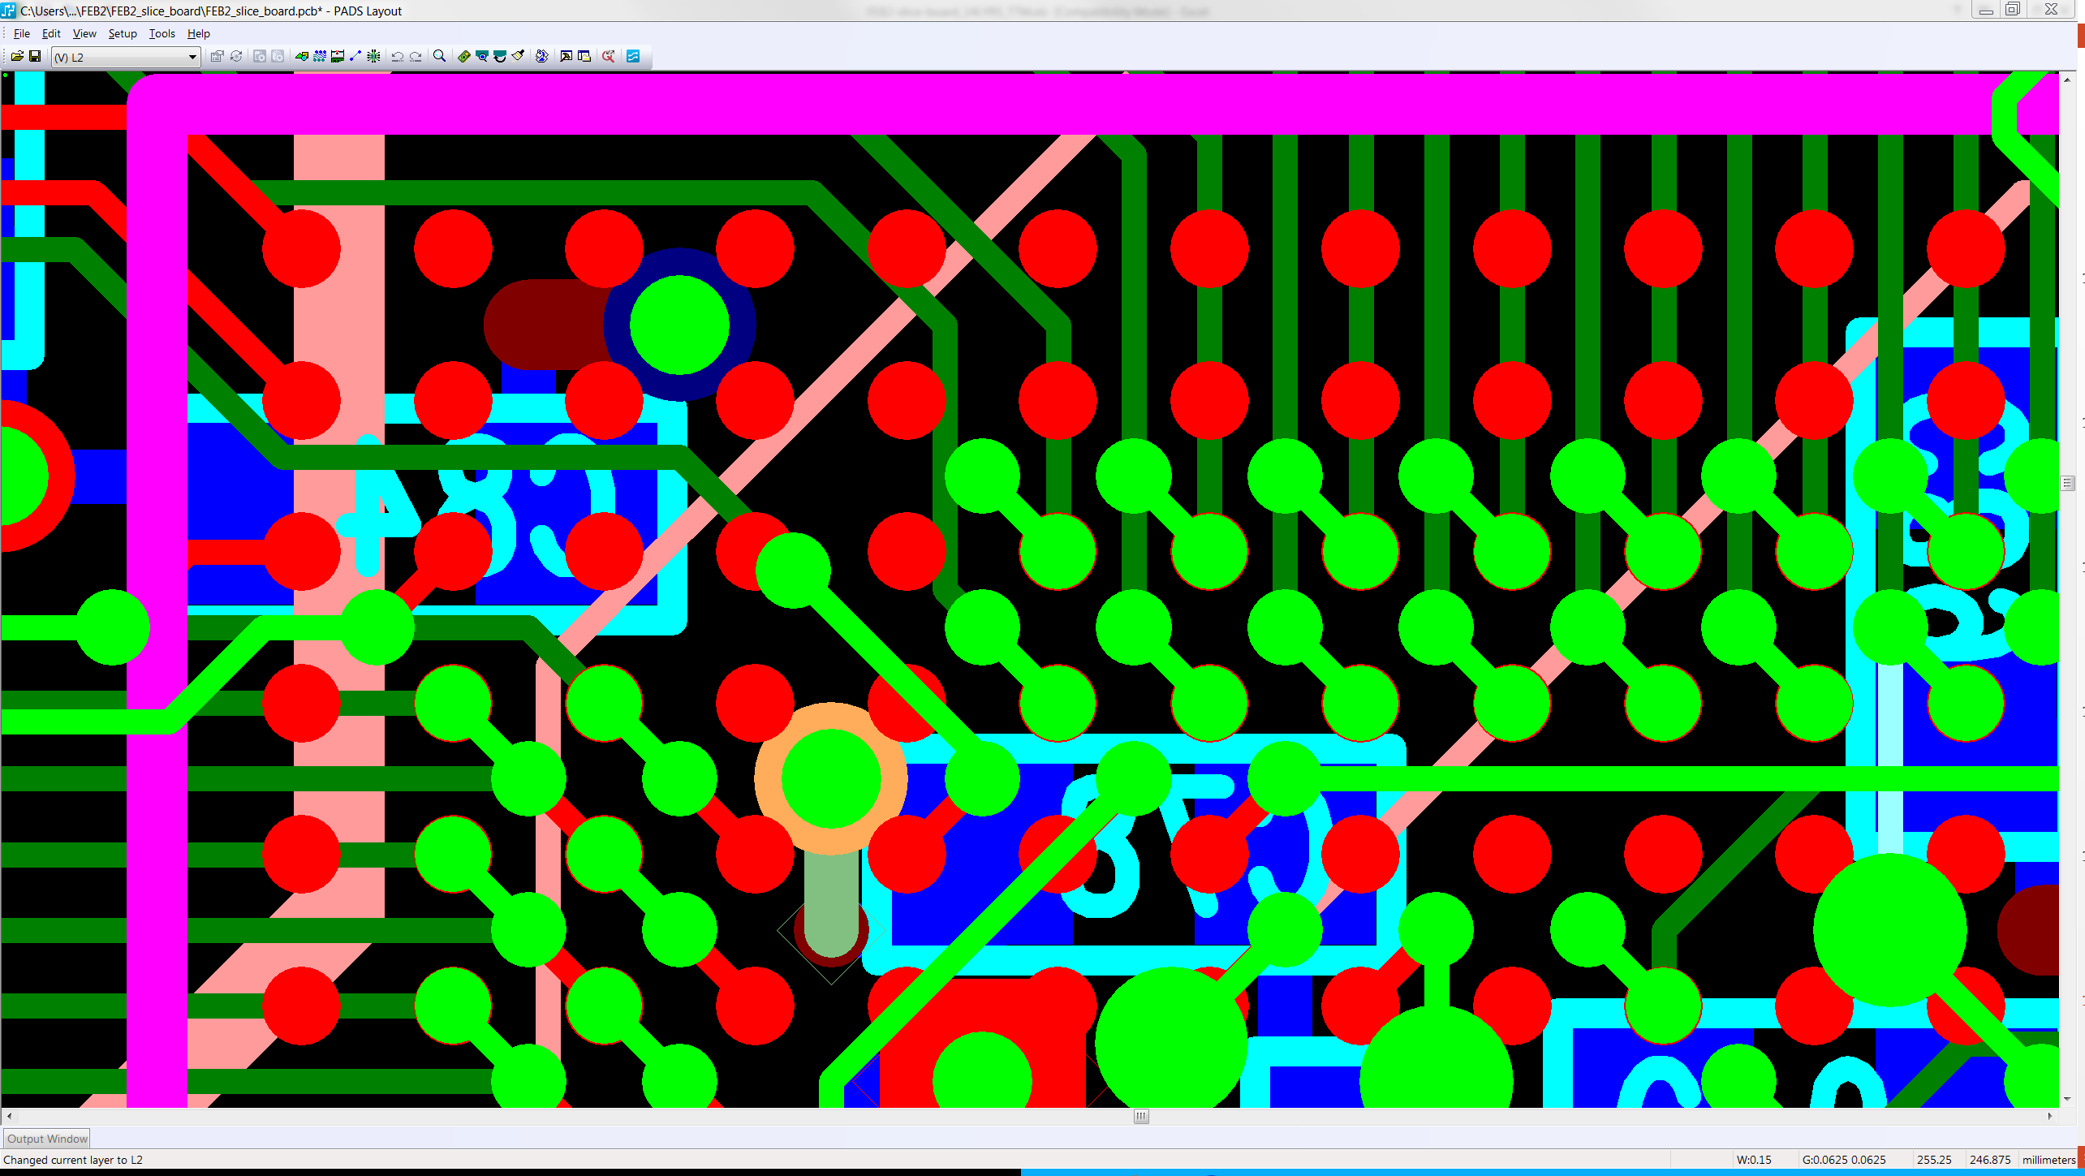

Slide 25
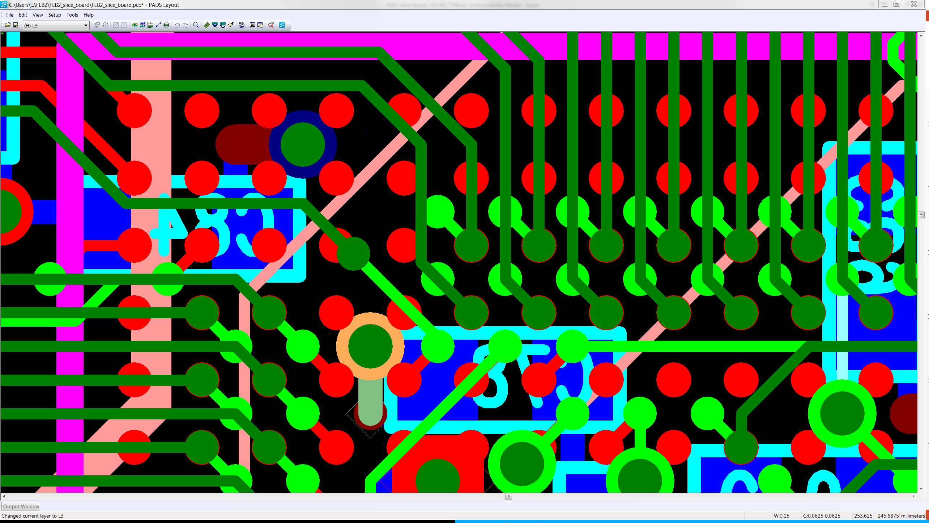

Slide 26
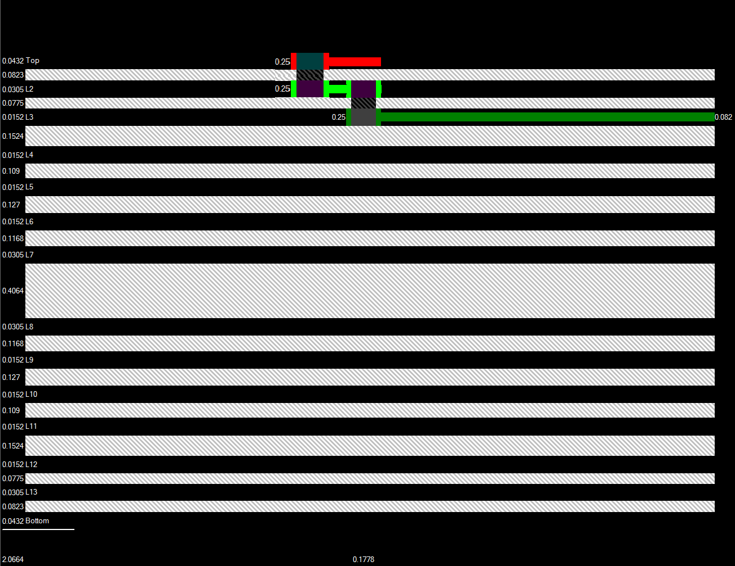

Slide 27
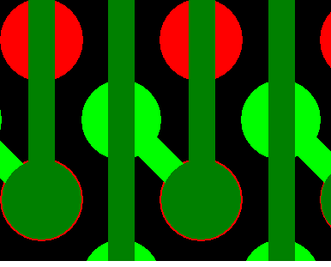
0.25mm
9.84mil
0.084 0.083 0.084
3.3 3.2 3.3

Slide 28


Slide 30
Proposed Laser vias
MICRO vias Pad Laser drill Dielectric
MICRO_TOP 10 5 3.24
MICRO_2_3 10 5 3.05
MICRO_2_3 10 5 3.05
MICRO_BOTTOM 10 5 3.24

Slide 31
Mechanical vias
Via type Drill Pad PCB Thickness Aspect Ratio
STANDARDVIA 10 20 0.082” 8.2
BURRIED_2_13 10 20 0.071” 7.1

Slide 32
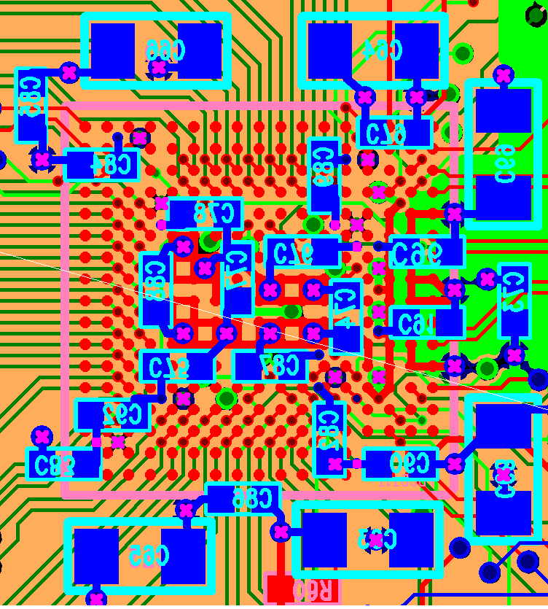

Slide 33
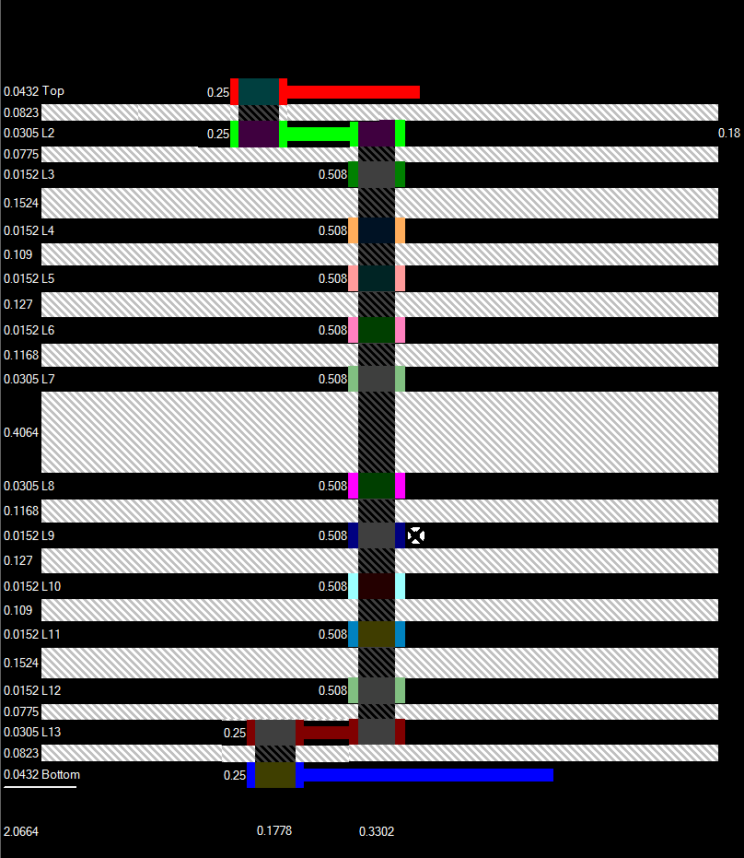
Power
Connections
&
Filters

Slide 34
Top Layer 100Ohm diff routing
L2 reference
L3 chip VDDs (1.2v) distribution
L4 ground plane
L5 input signal routing, BCR&
L6 ground plane VDD distribution
L7 lpGBT –> chips clock routing
L8
L9 ground plane
L10 input signal routing, routing around lpGBT
L11 ground plane
L12 power distribution
L13
Bottom layer slow signal routing

Slide 35
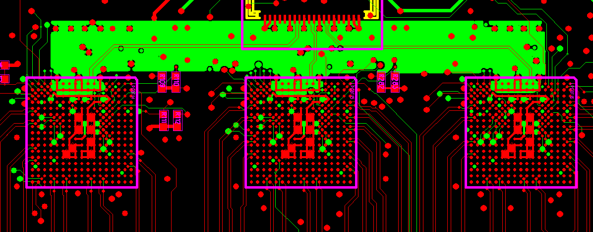
10Gbps lines
VTRX+
LpGBT
Printed on Top layer
Target diff line impedance 100 Ohm
Line width 4mils
Line space 5mils
Dielectric_type signal loss [per inch@10G]
TU872SLK 1.65dB
TU883 1.35dB
Megtron6 1.35dB

Slide 37
Drill Table
Start Layer | End Layer | Drill Type | Plate Type | Via Fill |  |  | Drill Size (min) | Drill Depth | Pad Size(min) | Stacked Vias
1 | 14 | Mech | PTH | -- |  |  |  | 79.41
2 | 13 | Mech | Via | Non-Conductive Via Fill (Flat) |  |  |  | 69.65
13 | 12 | Laser | Micro Via | CuVF_Button Pattern |  |  |  | 4.09
14 | 13 | Laser | Micro Via | CuVF_Button Pattern |  |  |  | 4.28
1 | 2 | Laser | Micro Via | CuVF_Button Pattern |  |  |  | 4.28
2 | 3 | Laser | Micro Via | CuVF_Button Pattern |  |  |  | 4.09
Impedance Table
Layer | Structure Type |  |  | Coated Microstrip | Target Impedance (ohms) | Impedance Tolerance (ohms) | Target Linewidth (mils) | Edge Coupled Pitch * (mils) | Reference Layers | Modelled Linewidth (mils) | Modelled Impedance (ohms) | CoPlaner Space (mils)
1 | Edge Coupled Differential |  |  | Yes | 100.00 | +/-10 | 4.00 | 9.00 | (2) | 4.25 | 99.47
3 | Edge Coupled Differential |  |  | --- | 100.00 | +/-10 | 3.20 | 6.80 | (2, 4) | 3.50 | 99.63
5 | Edge Coupled Differential |  |  | --- | 100.00 | +/-10 | 3.20 | 6.20 | (4, 6) | 3.25 | 98.99
10 | Edge Coupled Differential |  |  | --- | 100.00 | +/-10 | 3.20 | 6.20 | (11, 9) | 3.25 | 98.99
12 | Edge Coupled Differential |  |  | --- | 100.00 | +/-10 | 3.20 | 6.80 | (13, 11) | 3.50 | 99.63
14 | Edge Coupled Differential |  |  | Yes | 100.00 | +/-10 | 4.00 | 9.00 | (13) | 4.25 | 100.50
* | Edge Coupled Pitch is measured from the center line of one differential trace to the center line of the other.
* | This stack-up was created using estimated copper area percentages. (25% signal, 50% mix, 75% plane) Once data is received minor adjustments of traces and pre-preg thickness may occur.
Process Plating Info Final Assembly - 1/14 = Pattern Plate Sub Assembly - 2/13 = Pattern Plate

Slide 38




BCR
LpGBT routing layers:
ADCs
Clocks
LpGBTs
1-11
Layer3
BCR_A
BCR
Layer5
BCR_A
Data
CLOCK
Layer1
LpGBT12
Layer10
ADCs
LpGBTs
14-24
LpGBT13
Data
CLOCK

Slide 39
FEB2 initial power up procedure (hardware)
The issues:
-LPGBT chips do not work “out of the box”
They need to be configured and FEB-ID e-fuses need to be burned in
-FEB2 hardware configuration needs to be flexible
in case of an extra debug actions (we do not want to change the
LpGBT conf resitors or jumpers during initial power-up procedure, also
DC-DC power on/off should be automatized)

