Slide 1


COLUTA to LpGBT mapping
FEB2 BCR distribution
J. Bán,
Nevis Laboratories

Slide 2
PA/SH1
ADC1
lpGBT1
VTRx+1
F1
PA/SH2
ADC2
lpGBT2
F2
PA/SH3
ADC3
PA/SH4
ADC4
lpGBT3
F3
PA/SH5
ADC5
lpGBT4
F4
PA/SH6
ADC6
PA/SH7
ADC7
lpGBT5
VTRx+2
F5
PA/SH8
ADC8
lpGBT6
F6
PA/SH9
ADC9
PA/SH10
ADC10
lpGBT7
F7
PA/SH11
ADC11
lpGBT8
F8
PA/SH12
ADC12
PA/SH13
ADC13
lpGBT9
VTRx+3
F9
PA/SH14
ADC14
lpGBT10
F10
PA/SH15
ADC15
PA/SH16
ADC16
lpGBT11
F11
Data/signal flow
lpGBT12
VTRx+4
F12
lpGBT13
VTRx+5
F13
PA/SH17
ADC17
lpGBT14
VTRx+6
F14
PA/SH18
ADC18
lpGBT15
F15
PA/SH19
ADC19
lpGBT16
F16
PA/SH20
ADC20
PA/SH21
ADC21
lpGBT17
VTRx+7
F17
PA/SH22
ADC22
lpGBT18
F18
PA/SH23
ADC23
PA/SH24
ADC24
lpGBT19
F19
PA/SH25
ADC25
lpGBT20
F20
PA/SH26
ADC26
PA/SH27
ADC27
lpGBT21
VTRx+8
F21
10.24/5.12 GHz
PA/SH28
ADC28
lpGBT22
F22
10.24GHz
PA/SH29
ADC29
640MHz
PA/SH30
ADC30
lpGBT23
F23
PA/SH31
ADC31
lpGBT24
F24
Analog
PA/SH32
ADC32

Slide 3
PA/SH1
ADC1
To send clocks to ADC,
phase programmable clock outputs are used.
Each lpGBT has 4 such outputs (48.8p steps).
PA/SH2
ADC2
lpGBT1
PA/SH3
ADC3
lpGBT2
PA/SH4
ADC4
lpGBT3
PA/SH5
ADC5
lpGBT4
PA/SH6
ADC6
PA/SH7
ADC7
lpGBT5
PA/SH8
ADC8
lpGBT6
PA/SH9
ADC9
To send clocks to lpGBT,
ECLK outputs are used.
Each lpGBT has 29 such outputs.
PA/SH10
ADC10
lpGBT7
PA/SH11
ADC11
lpGBT8
PA/SH12
ADC12
PA/SH13
ADC13
lpGBT9
PA/SH14
ADC14
lpGBT10
PA/SH15
ADC15
PA/SH16
ADC16
lpGBT11
lpGBT12
VTRx+4
PIO
PIO
ECLKOUT
Mode[1]
LockMode
RefClk
Clock distribution
LockMode
Mode[1]
RefClk
ECLKOUT
PIO
PIO
PA/SH17
ADC17
lpGBT14
lpGBT13
VTRx+5
PA/SH18
ADC18
lpGBT15
PA/SH19
ADC19
lpGBT16
PA/SH20
ADC20
PA/SH21
ADC21
lpGBT17
PA/SH22
ADC22
lpGBT18
PA/SH23
ADC23
Redundant controls**
LpGBT12 |  | LpGBT13
ECLK0 |  | RefCLK
GPIO12 |  | LockMode
GPIO8 |  | Mode[1]
RefClk |  | ECLK0
LockMode |  | GPIO12
Mode[1] |  | GPIO8
PA/SH24
ADC24
lpGBT19
Cp40MHz
PA/SH25
ADC25
lpGBT20
PA/SH26
ADC26
Cp640MHz
PA/SH27
ADC27
lpGBT21
2.56GHz
PA/SH28
ADC28
lpGBT22
5.12GHz FEC12
PA/SH29
ADC29
PA/SH30
ADC30
lpGBT23
PA/SH31
ADC31
lpGBT24
**board external 40MHz clock resistors are removed
PA/SH32
ADC32

Slide 4
Bunch crossing counter (1)
Data Time stamp is required to transmit with the detector data
Time stamp is a bunch crossing number (BC) in which interaction happened
BC is counted with respect to the beginning of the LHC machine revolution
At that time BCR, the bunch crossing reset signal is issued and distributed to the subdetectors
Subdetectors are required to count locally BC using BCR
Coluta computes BC internally and transmit it with the data in the frame signals in a form
{1'b1, 1'b0, FIRST, BCNUMBER[4:0], 8'b00000000};
Note: local BC is 5 bit counter reset by BCR signal

Slide 5
ADC1
ADC2
ADC3
ADC4
ADC5
ADC6
ADC7
ADC8
ADC9
ADC10
To send BCR to ADC,
16 EDOUT outputs are used.
Each lpGBT has 16 such outputs.
ADC11
ADC12
ADC13
ADC14
ADC15
ADC16
lpGBT12
VTRx+4
BCR distribution
ADC17
lpGBT13
VTRx+5
ADC18
ADC19
ADC20
ADC21
ADC22
ADC23
ADC24
Secondary BCR
ADC25
ADC26
Primary BCR
ADC27
2.56GHz
ADC28
ADC29
ADC30
ADC31
ADC32

Slide 6
Bunch crossing counter (2)
FEB2 is required to be able to work if one optical link (on LpGBT12 or lpGBT13) fails. This is so called
redundant mode of operation.
For BC circuitry it means that it has to be functional
In case that one of control lpGBT must be replaced
by another one. This has a consequences how the BCR is distributed on the board.

Slide 7
ADC1
ADC2
Routing box
BCR distribution zoomed for two neighboring
ADCs
lpGBT12
lpGBT13
Routing box, has to be able to deliver
BCR to ADC1 and ADC2 from lpGBT12
Or fromLpGBT13.
Task: What is in the routing box?

Slide 8
ADC1
Chip2 BCR
mux
Line termination for both BCR lines. Located on the PCB.
ADC2
Chip1 BCR
mux
BCR distribution zoomed for two neighboring
ADC (proposed solution)
lpGBT12
lpGBT13
Routing box is only two terminated diff lines printed
On the FEB2 PCB. But:
-Two BCR inputs are needed for each ADC
- And Mux inside ADC selecting which BCR is used

Slide 9
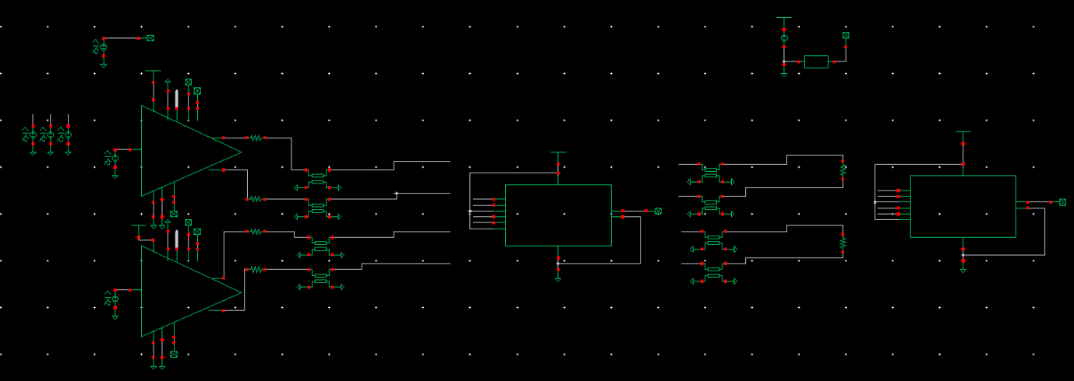
Simulation setup(1)

Slide 10
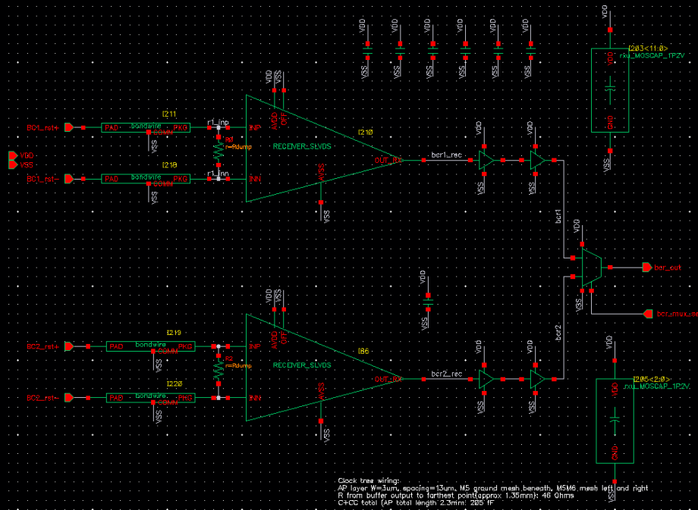
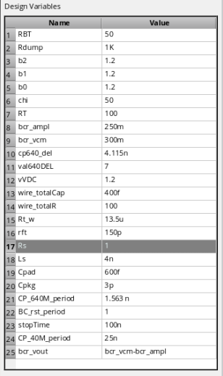
Simulation setup(2)
Simulation parameters

Slide 11
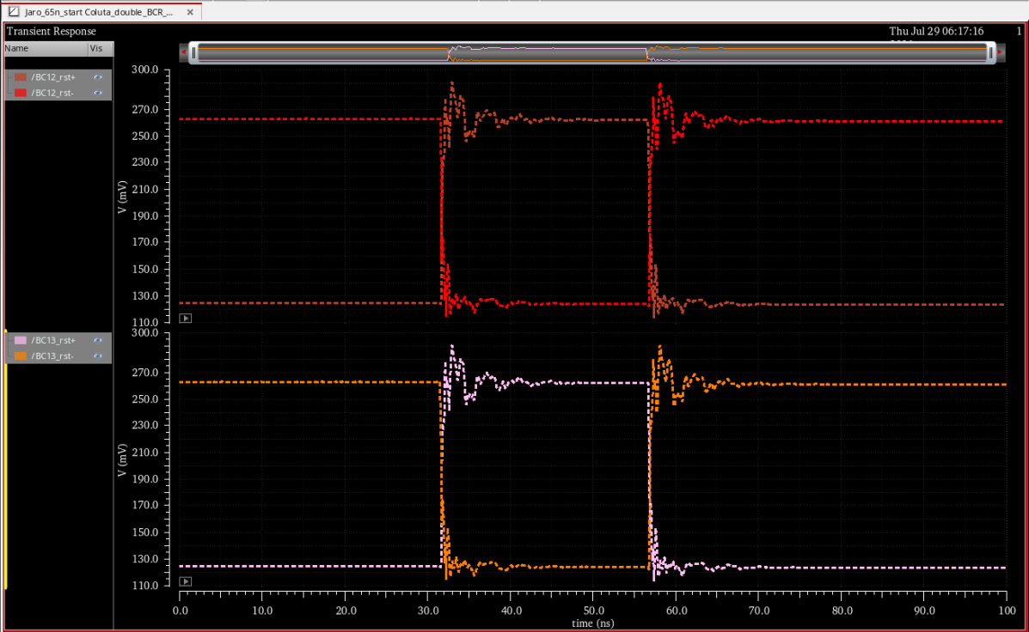
Simulation results(1)
Bus PCB signals (at chip#1 input and chip#2 input)

Slide 12
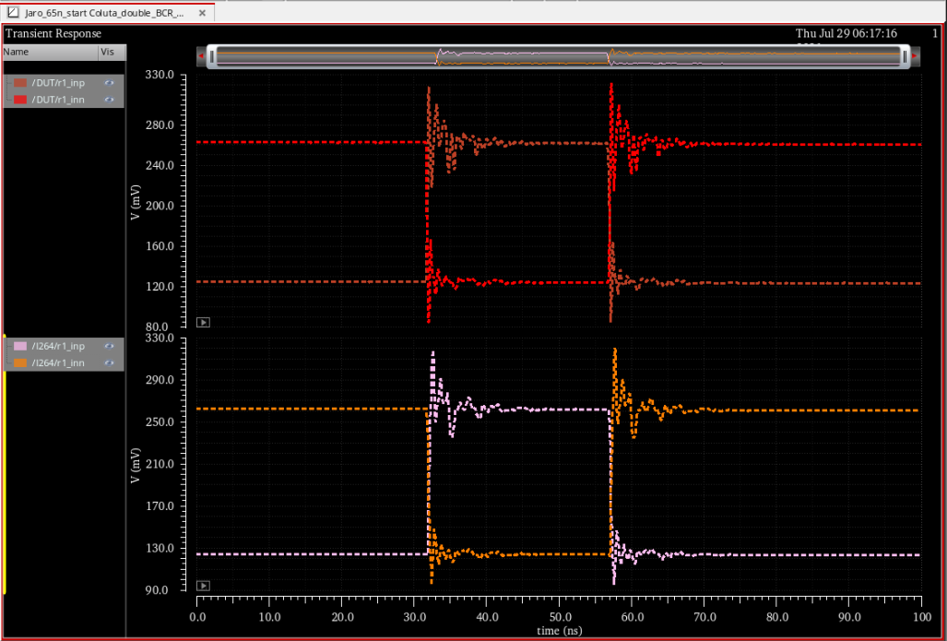
Simulation results(2)
Internal rec1 & rec2 inputs

Slide 13
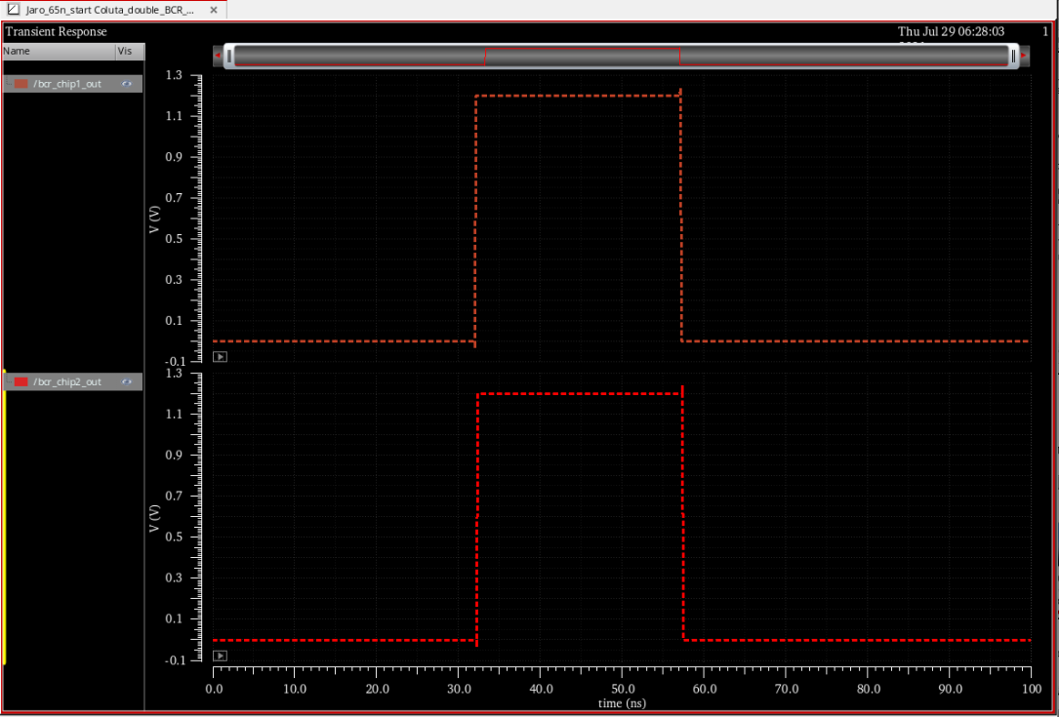
Simulation results(3)
Recovered BCR after mux

Slide 14
Conclusion
BCR signal distribution for FEB2 working in redundant mode is proposed.
The t-line and bond wires parameters were varied and the proposed solution allows to recover a high quality BCR signal in both ADC chips
Such a distributed BCR signal is recovered inside the ADC and valid for whole 25 ns period in which strobing clock is programmed with fine steps by LpGBT
ADC has a monitoring system allowing to set and measure cp40/BCR relationship over time inside the ADC chip

